Slide 1
Thank you for viewing this presentation.
We would like to remind you that this material is the property of the author. It is provided to you by the ERS for your personal use only, as submitted by the author.
2021 by the author

Slide 2
ERS statement on Philips devices: clinicians’ and patients’ perspectives, and questions to be answered
ERS Webinar 1 st July 2021

Slide 3
ERS statement on Philips devices: clinicians’ and patients’ perspectives, and questions to be answered
ERS Webinar 1 st July 2021
Programme: 1- Introduction from the Chairs – 2 minutes 2- What do we know and what can we recommend regarding the Philips recall notice? W. Randerath- 10 minutes 3- The Foam issue in HMV patients. M. Duiverman and João Carlos Winck – 10 minutes 4- Recommendations for providers of children prescribed recalled Philips Respironics devices. R. Ersu- 6 minutes 5- The point of view of patients. L. Roberti - 5 minutes 5- Panel discussion. 12 minutes 6- Q&A – 15 minutes

Slide 4
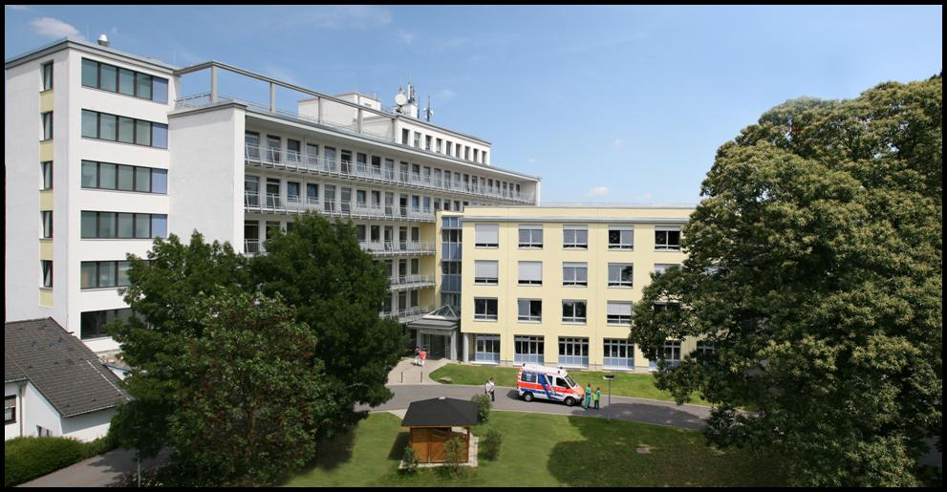
What do we know and what can we recommend regarding the Philips recall notice?
Winfried Randerath
University of Cologne
Clinic for Pneumology/ Allergology
Sleep Medicine and Respiratory Care
Bethanien Hospital, Solingen, Germany
Notes:
Dear Chairmen, dear colleagues,
Thank you very much for the kind invitation to participate in this very interesting meeting. It is a great pleasure and honour for me to present the theoretical background and our first experiences with a new automatic bilevel algorithm.

Slide 5
What do we know and what can we recommend regarding the Philips recall notice?
Sound abatement foam used inside the devices.
Foam is polyester polyurethane, which appears to degrade through a process of hydrolysis.
50% of the machines affected were using ozone therapy to clean the devices
Grainy materials being released, which have been found in the mask and tubing.
Volatile toxins contain organic chemicals with carcinogenic risk in animal trials.
Degradation reported in 0.008% of devices.
Many events found when device was serviced.
Newer machines using a silicon-based foam.

Slide 6
What do we know and what can we recommend regarding the Philips recall notice?
Statement of the European Respiratory Society, endorsed by the European Sleep Research Society
No evidence of acute life-threatening incidents.
Precise quantitation of risk of each treatment option is impossible.
Patients should not stop or change their treatment, even if they receive notification from the manufacturer.
Acute and chronic risk of potential exposure to toxins
Acute and chronic risk of cessation of treatment

Slide 7
What do we know and what can we recommend regarding the Philips recall notice?
Statement of the European Respiratory Society, endorsed by the European Sleep Research Society
Physician should decide on an individual basis.
Patients have the right to up-to-date information so that they can fully participate in decision-making.
Medical recommendation should take into consideration:
Impairment due to daytime sleepiness, accident risk, and comorbidities.
Disease severity based on AHI, hypoxic load, objective impairment in daytime performance and hypercapnia.
Examples for possible decisions may vary between the following extremes:
Continuation of therapy until a comparable alternative is available
Severe breathing difficulties or ventilatory failure.
Excessive daytime sleepiness or accident risk.
Significant pulmonary, cardiovascular or neurological comorbidities.
Swap to alternative therapy such as mandibular advancement splint or position modifier device
Mild to moderate symptoms and respiratory and cardiovascular burden of the OSA.
Interruption of the treatment until the device can be replaced
Mild symptoms and disease burden.
Regular clinical review.

Slide 8
What do we know and what can we recommend regarding the Philips recall notice?
Statement of the European Respiratory Society, endorsed by the European Sleep Research Society
Due to high number, it will be impossible to exchange devices under in-lab supervision immediately.
Swapping of non-invasive ventilation must not be performed without supervision.
Exchanges of sleep apnoea devices may be reasonable without supervision in individual cases.
The evaluation should be performed at the earliest possible date.
As long as patients are advised to continue with their current device, the use of in-line bacterial filters is recommended.
Hydrophobic (electrostatic) filters.
Resistance 0.7 cm H2O/l/sec at 0.5 l/ sec.
No humidifiers.
Exchange of the filter weekly?

Slide 9
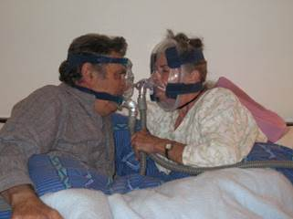
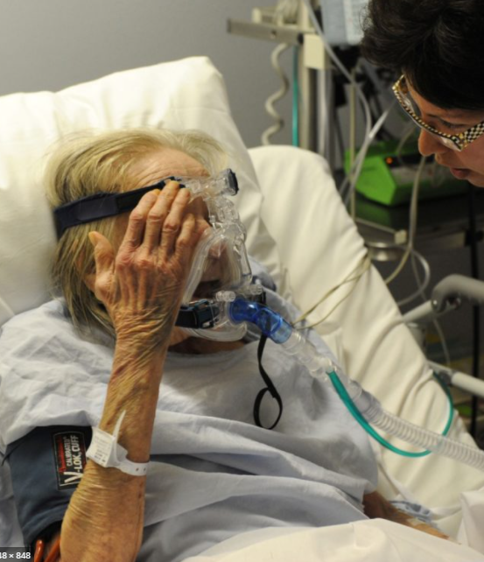
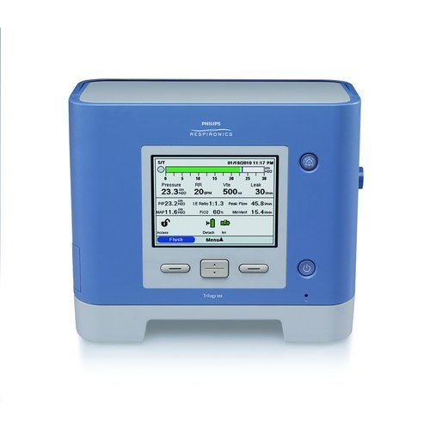
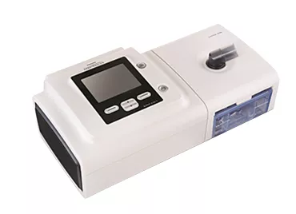
The Foam issue in HMV patients
Marieke Duiverman and Joao Winck
Assembly 2 group 2.2

Slide 10
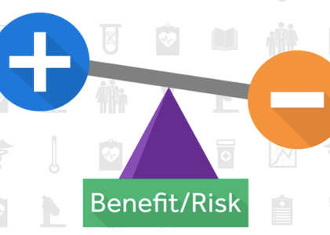
Risk versus benefit in HMV patients
Patients on HMV are usually suffering from respiratory failure and therefore stopping therapy is causing serious harm
Risk assessment difficult because of lack of information, no clinical clues that use of these machines cause harm.
DO NOT STOP!

Slide 11
Discussion points
To set priorities if machines need to be replaced/repaired?
Anti-bacterial filters:
Changes resistance and setting changes might be neccesary (in-hospital/outpatient with TM; lots of effort and time from HMV teams)
Only approved for the use with the Trilogy, difficult with A30/A40 because of in-built humidifier
Change how often?
Might filter particles, but not gases of even small particles
Central (independent) registration of side effects needed?
Possible to have patient data on exposure or clinical harm? Studies neccesary?

Slide 12
Recommendations for providers of children prescribed recalled Philips Respironics devices
Refika Hamutcu Ersu, MD
Chair, ERS Pediatric Physiology and Sleep Group
Pediatric Respirologist
Director, Sleep Laboratory and Home Ventilation Program
Children’s Hospital of Eastern Ontario
Professor, University of Ottawa

Slide 13
Contributors
Rakesh Bhattacharjee, MD
Associate Clinical Professor of Pediatrics | Division of Respiratory Medicine
Director of Sleep Medicine
Rady Children’s Hospital | University of California San Diego
Maida Lynn Chen, MD
Associate Professor of Pediatrics | Division of Pulmonary and Sleep Medicine
Director, Sleep Disorders Program
Seattle Children's Hospital | University of Washington School of Medicine
Bahauddin Al-Shawwa, MD
Associate Professor of Pediatrics | Division of Pulmonology and Sleep Medicine
Director of Sleep Center
Children’s Mercy | University of Missouri-Kansas City School of Medicine
Sherri Katz, MDCM, MSc
Associate Professor | Pediatric Respirology
Division Chief
Children’s Hospital of Eastern Ontario | University of Ottawa
Umakanth Katwa, MD
Instructor of Pediatrics |Pulmonary and Sleep Medicine
Director, Sleep Center
Boston Children’s Hospital |Harvard Medical School
Stephen Hawkins
Assistant Professor | Pediatric Pulmonary and Sleep Medicine
Associate Director | Sleep Medicine Fellowship
Children’s Hospital Colorado | University of Colorado Anschutz Medical Campus
Narong Simakajornboon, MD
Professor | Department of Pediatrics
Director, Sleep Center
Cincinnati Children’s Hospital Medical Center| University of Cincinnati

Slide 14
Background and current state
The impact of the risks on children are not stated by Philips Respironics.
Philips Respironics has suggested, until a replaced or refurbished devices is available, patients should immediately discontinue all recalled devices unless these devices are life- sustaining mechanical ventilator devices.
Device usage recommendations for children may vary based on national health regulatory agencies.

Slide 15
Recommendations: Shared Decision Making
The decision to continue or discontinue these devices are made carefully by the patient and family with close guidance by the child’s sleep/pulmonary provider.
The decision to continue vs. discontinue PAP must balance the risk of discontinuing PAP therapy for the child’s underlying sleep condition against the risk of exposure.
It is important to acknowledge that the decision made jointly should account for the evolving nature of this recall, and that further information by the manufacturer or suppliers of these devices (e.g. durable medical equipment company) may likely have an impact

Slide 16
Patient & Family
Medical Team
Joint Decision Making
Adherence: Clinical and/or Insurance
Severity of daytime dysfunction without treatment
Local availability of alternate devices or treatments
Severity of Underlying Disease
Acute /Chronic symptoms of foam toxicity
AHI
O2
CO2
Sleep quality
Overall
medical complexity
EDS
Drowsy driving
School performance
Behavior
The factors included here for decision making are common ones, but not an extensive list
Decision making in each case should be approached individually
Listed (and unlisted) factors, will have different weights in each patient

Slide 17
Does the child using recalled device have any of these diagnosis/comorbidities?
Neuromuscular disorder with hypoventilation
CSA or Hypoventilation Disorder (e.g. CCHS, ROHHAD, Rett syndrome, Prader-Willi Syndrome, Chiari Malformation)
Chronic Lung Disease with chronic respiratory failure
Cardiovascular disease and/or Pulmonary Hypertension requiring PAP therapy
Severe Upper Airway Obstruction with gas exchange abnormalities
Suggest to continue using PAP device until it is replaced or repaired, or make an appointment to discuss alternative treatment options with child and family
Yes
Register for repair or replacement
Get a replacement device if device is > 5 years old
Assess routine cleaning regimen at home
with recommendation to discontinue any ozone based cleaning or other nonapproved sanitizing methods
For ventilator devices (e.g. Trilogy), consider in line bacterial filter to mitigate risks related to solid foam debris. Of note, filters are not thought to be effective against volatile organic compounds.
No
Yes
Does child have marked improvement in daytime dysfunction related to using recalled device?
No
Suggest to discontinue device
Register for repair or replacement
Get a replacement device if device is > 5 years old
Discuss alternative treatments with child/family if they are uncomfortable with current options
Offer a school note to family/child about PAP therapy suspension
Document patients decision or stated intention in medical chart or EHR

Slide 18
Philips recall
The point of view of patients
Luca Roberti
Italian Sleep Apnoea Patient Organization (Apnoici Italiani)
behalf
Sleep PAG
Network

Slide 19
Introduction
Regarding the philips recall, patients, caregivers and patient associations are not happy with the lack of information from the manufacturer.
We are also not happy with having to provide the data directly to it, as our data is already in the possession of national health systems and homecare provider companies and sleep centers.

Slide 20
Introduction
Moreover, from the information, it is said to refer to one's own clinician or sleep center, which is not adequately prepared and has resources to deal with this problem created by the manufacturer.
We do not know to date for each nation how many patients-devices are involved, the estimated times are too long 12 to 24 months, compared to the seriousness and risk for the health of pediatric or adult patients.

Slide 21
Questions to Panelist
The Ers Statement proposes to use an anti-bacterial in-line filter to partially and temporarily solve the problem, can this filter be used with a humidifier or should the use of humidification be discontinued. Also according to the UK Medical & Healthcare products Regulatory Agency (MHRA) alert, issued on 23 June, the use of in-line filters is not validated by Philips for their CPAP/BiPAP machines “and is considered an off-label use”, moreover, do the benefits outweigh the risks?

Slide 22
Questions to Panelist
2. With reference to pediatric patients, do you
think it is a priority in an urgent replacement
plan to give priority to children. Do you think
it is correct that in the absence of an
adequate number of devices for adults, a sort
of prioritization should be organized, for
example for first patients with overlap
comorbidities such as Copd, Asthma,
Sarcoidosis, Diabetes, Hypertension, and
cardiac and neurological problems?

Slide 23
Questions to Panelist
3. Did they become aware of the problem following reports from patients or sleep clinics or had their own internal procedures already identified a possible problem?

Slide 24
Key Message
From our point of view, patients must continue to carry out the therapy with all the necessary precautions relying on their own specialist and sleep center.

Slide 25
Thank You!

Slide 26
What do we know and what can we recommend regarding the Philips recall notice?
Open questions to be discussed
How do panelists estimate the risks?
Which information do we need for our decisions?
Are there patient groups with specific and high risks?
Is there any priorisation for exchange or repair of the devices?
Who should use alternative treatments?
What about the rationale of filter usage?
How should we monitor our patients?
What are open research questions?

Slide 27
We would like to thank the participants of this webinar for their contributions

