Slide 1
Thank you for viewing this presentation.
We would like to remind you that this material is the property of the author. It is provided to you by the ERS for your personal use only, as submitted by the author.
2014 by the author

Slide 3
Involving patients in setting priorities for research: the James Lind Alliance approach
Katherine Cowan
Senior Adviser to the James Lind Alliance

Slide 4
Faculty disclosure

Slide 5
Introduction
Aims
To explain the rationale for involving patients in setting priorities for research and to examine the current picture.
To describe the James Lind Alliance method, detailing the process and providing examples, including the Mesothelioma Priority Setting Partnership.
To explore how patient involvement in research priority setting can make a difference, looking specifically at impacts and outcomes for James Lind Alliance Priority Setting Partnerships.

Slide 6
Introduction
Who am I?
Independent facilitator and coach
Background in social research
Joined the JLA in 2008
Not a healthcare professional or a medical researcher
Interested in public participation and inclusion

Slide 7
Why involve patients in research priority setting?
Economics – it ensures research is relevant and applicable to the end user.
Funding – research funders want to see patient involvement in researchers’ proposals.
Ethics – research is funded with people’s taxes and charity donations, so it’s the right thing to do.

Slide 8
Are patients involved?
Tallon, D. et al. (2000) ‘Relation between agendas of the research community and the research consumer’, The Lancet, Vol. 355. pp. 2037-40

Slide 9
Are patients involved?
Oliver S, Gray J (2006) A bibliography of research reports about patients’, clinicians’ and researchers’ priorities for new research , London: James Lind Alliance
Out of 334 studies only 6 compared patients’ priorities with researchers’ priorities
Only 3 compared clinicians’ and researchers’ priorities

Slide 10
Are patients involved?
Stewart R, Oliver S (2008) A Systematic map of studies of patients’ and clinicians’ research priorities, London: James Lind Alliance
Patients less likely to be consulted as to their research priorities than clinicians (18.2% as opposed to 88.5%)
Clinicians and patients are more likely to work separately on identifying research topics, than collaboratively
The James Lind Alliance Partnerships are highly distinctive
Notes:
Bibliography of 258 studies about patients’ and clinicians’ research priorities studies.

Slide 11
Iain Chalmers and Paul Glasziou

Slide 12
Waste at four stages of research
1 2 3 4
Questions relevant
to clinicians & patients?
Appropriate design and
methods?
Accessible
full publication?
Unbiased and
usable report?
Low priority questions addressed
Important outcomes not assessed
Clinicians and patients not involved in setting research agendas
Over 50% studies designed without reference to
systematic reviews of existing evidence
Over 50% of studies fail to take adequate steps to reduce biases, e.g. unconcealed treatment allocation
Over 50% of studies never published in full
Biased under-reporting of studies with disappointing results
Over 30% of trial interventions not sufficiently described
Over 50% of planned study outcomes not reported
Most new research not interpreted in the context of systematic assessment of other relevant evidence
85% Research waste = over $85 Billion / year
Notes:
12
12

Slide 13
Are patients involved?
Staley K, Hanley B (2008) Scoping research priority setting (and the presence of PPI) with UK clinical research organisations and funders, Oxford: James Lind Alliance
The majority of research funding bodies (31 out of 52) operate in a responsive mode and rely on researchers to submit ideas for research and use a process of peer review to decide which applications to fund

Slide 14
What is the James Lind Alliance (JLA)?
Tackling treatment uncertainties together
Finding out what research is important to:
Patients / service users
Carers / relatives
Clinicians / healthcare professionals

Slide 15
What is the JLA?
Established in 2004
Royal Society of Medicine – Dr John Scadding
The Cochrane Collaboration/James Lind Library - Sir Iain Chalmers
INVOLVE – Sir Nick Partridge
Since April 2013: part of the NIHR Evaluation, Trials and Studies Coordinating Centre (NETSCC)

Slide 16
Who was James Lind?
A Swedish anatomist?
A Danish lawyer and politician?
A Scottish naval surgeon?

Slide 17
What does the JLA do?
Priority Setting Partnerships
Patients, carers and clinicians
Focusing on single conditions or areas
Identifying uncertainties about treatments
Prioritising the ones they think are most important for research to address
A top 10

Slide 18
Completed Partnerships
Asthma
Urinary incontinence
Vitiligo
Prostate cancer
Schizophrenia
Type 1 diabetes
ENT aspects of balance
Life after stroke
Eczema
Tinnitus
Cleft lip and palate
Lyme disease
Pressure ulcers
Sight loss and vision
Dementia
Dialysis
Multiple sclerosis
Hidradenitis Suppurativa
Acne
Anaesthesia & perioperative medicine
Childhood disability
Hip and knee replacement for osteoarthritis
Parkinson’s disease
Pre-term birth
Spinal cord injury

Slide 19
Current Partnerships
Bipolar
Depression
Endometrial cancer
Hair loss
Inflammatory bowel disease
Intensive care
Kidney transplant
Late stillbirth
Mesothelioma
Mild to moderate hearing loss
Neuro-oncology
Palliative and end of life care
Surgery for common shoulder problems

Slide 20
The JLA priority setting process
Set up steering group
Invite partners
Gather uncertainties
Prioritise uncertainties
Promote priorities to researchers and funders

Slide 21
Set up steering group
Patient, carer and clinician representatives
Resources and expertise
Regular meetings
Publicising the project
Overseeing the process
Responsible for dissemination of results
JLA chair – a neutral facilitator
Protocol

Slide 22
Mesothelioma Priority Setting Partnership
Steering group

Slide 23
Invite partners to get involved
Patients, carers, clinicians and their representatives
Consultative body
Promote and participate in the process
Declaration of interests
Exclusions

Slide 24
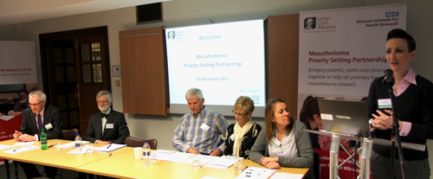
Mesothelioma Priority Setting Partnership
Launched in London, December 2013
Videos - www.psp.nihr.ac.uk/mesothelioma
50 attendees
20 partner organisations

Slide 25
Gather treatment uncertainties
What are treatment uncertainties?
no up-to-date, reliable systematic reviews of research evidence addressing the uncertainty about the effects of treatment exists
up-to-date systematic reviews of research evidence show that uncertainty exists

Slide 26
Gather treatment uncertainties
Survey
Patients and carers
Clinicians
Research recommendations
UK Database of Uncertainties about the Effects of Treatments (UK DUETs)
www.library.nhs.uk/duets

Slide 27
Mesothelioma Priority Setting Partnership
Do you have questions or comments about your experience of the diagnosis of mesothelioma?
Do you have questions or comments about your experience of mesothelioma treatments?
Do you have any other questions or comments about your experience of the care of someone with mesothelioma?
Notes:
Based on your personal experience

Slide 28
Mesothelioma Priority Setting Partnership
Respondent type
Prior involvement in research
Location
Patients/carers
Gender
Age
Age at diagnosis
Type of mesothelioma
Clinicians
Profession

Slide 29
Check the uncertainties
Prepare the dataset
Remove out of scope submissions
Categorise eligible submissions
Format the submissions
PICO questions: Patient/Problem, Intervention, Comparator, Outcome
“Lumping and splitting”
Verify the uncertainties
Identify research recommendations
Prepare the long list

Slide 30
Mesothelioma Priority Setting Partnership
453 respondents, including:
103 patients
82 health or social care professionals
242 carers or bereaved carers
820 questions submitted
52 verified unanswered questions
46 out-of-scope questions
5 questions identified from systematic reviews
1 question which was already answered (Pemetrexed)
Notes:
The one answered question relates to the chemo drug pemetrexed which has been shown to be effective in mesothelioma.

Slide 31
Mesothelioma Priority Setting Partnership
Submissions from patients and carers
“My own personal experience is dealing with the breathing”
“Around September and October 2002 my husband's breathing deteriorated”
“Breathing exercises helped, given by the Hospice”
“It is a nightmare disease to watch and care for as they struggle for breath”
Interventions described
Breathing exercises, physical activity, pilates, yoga, oxygen, chest drain, acupuncture, relaxation, sitting near a fan
Question formulated
What is the best current treatment for breathlessness (e.g. exercise, handheld fans, etc)?

Slide 32
Prioritisation – step 1
Interim prioritisation
From a long list to a short list
Top 10 uncertainties chosen by partners
As individuals
On behalf of members
On behalf of colleagues
Representing an organisation

Slide 33
Mesothelioma Priority Setting Partnership
We would like you to consider each question and rate it according to how much of a priority you think it is for research to answer it, based on what is important for you.
38 patients
98 carers, bereaved carers and family members
50 healthcare professionals
16 organisations

Slide 34
Prioritisation – step 2
Final priority setting
Priority setting workshop
Patients, carers and clinicians
A day of democratic discussion and ranking
Nominal Group Technique
Prioritise the remaining uncertainties
Agree the top 10

Slide 35
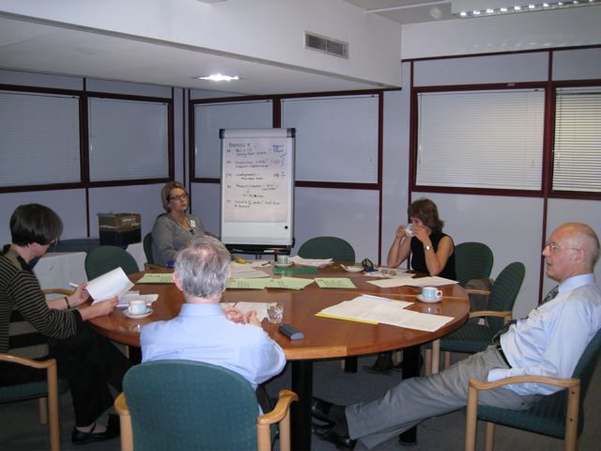
Final priority setting workshop

Slide 36
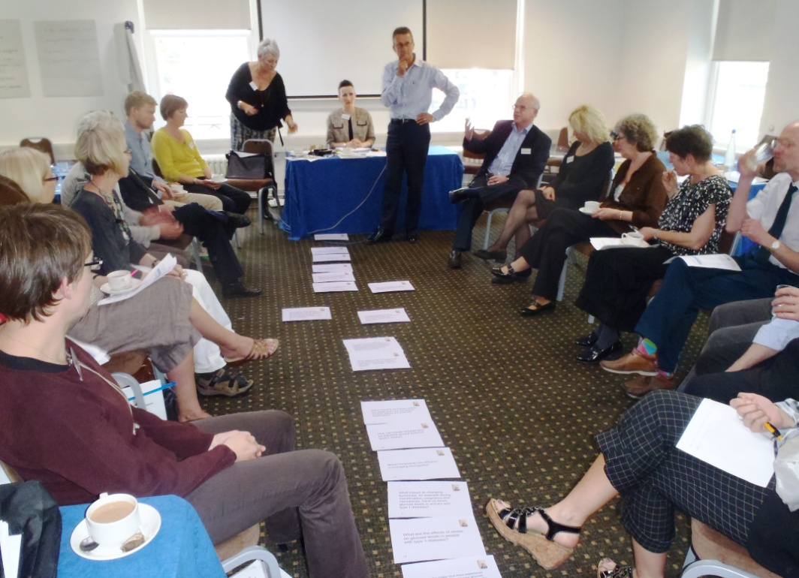
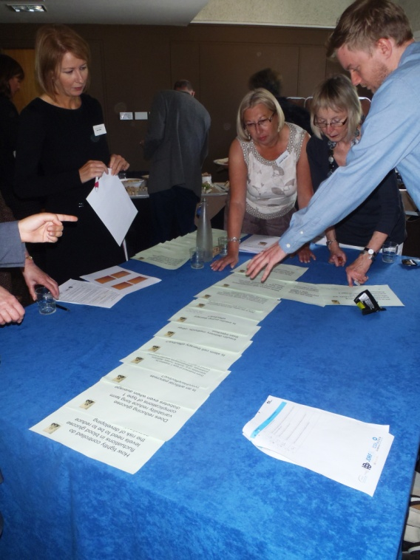
Final priority setting workshop

Slide 37
Final priority setting workshop

Slide 38
What difference does it make?
BREATHE
Breathing REtraining for Asthma Trial of Home Exercises

Slide 39
What difference does it make?
HI Light
Home Intervention of Light therapy

Slide 40
What difference does it make?
Sight Loss and Vision Priority Setting Partnership
12 categories covering 100+ eye conditions
October 2013: parliamentary reception at the House of Lords
Since May 2014: £3,131,257 awarded by Fight for Sight to 46 projects in 10 of the 12 categories
www.sightlosspsp.org.uk

Slide 41
What difference does it make?
Andrew Higgins, patient, Ear, Nose & Throat Aspects Balance Priority Setting Partnership
“The dynamic was good. I felt that clinicians and patients realised they needed each other and I was very struck how much we all respected each other’s opinions. Everyone’s views were listened to very carefully and there was a surprising degree of mutual understanding.”
Irenie Ekkeshis, patient, Sight Loss and Vision Priority Setting Partnership
“I found that being involved in such an important initiative has given me back an element of control over my illness – in terms of empowering me to contribute to the future of corneal research. This is so much more than I imagined I could ever have done when I first became ill. The workshop left me feeling that we patients have an important contribution to make, and, in the right environment, can add enormous value.”

Slide 42
Conclusion
A process which encourages inclusion
Balance of perspectives
Aims to be accessible
Supporting patient participation
Recognises a range of capacities, skills and interests
Transparent and democratic
Agreed protocol and declaration of interests
Neutral facilitation
Data sharing
Reflexive but still evolving
Challenges of capturing and sharing learning
Evaluation needs to improve
Not always reaching seldom-heard groups

Slide 43
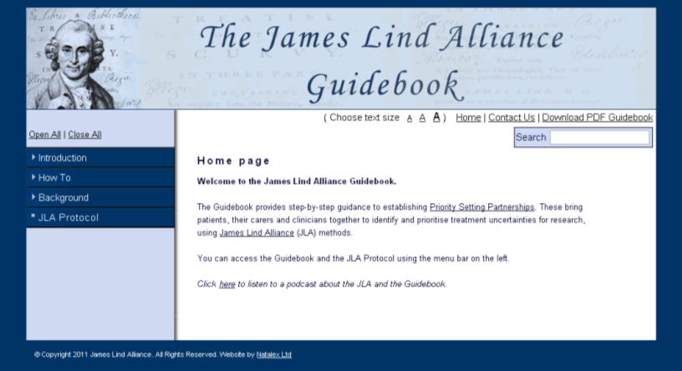
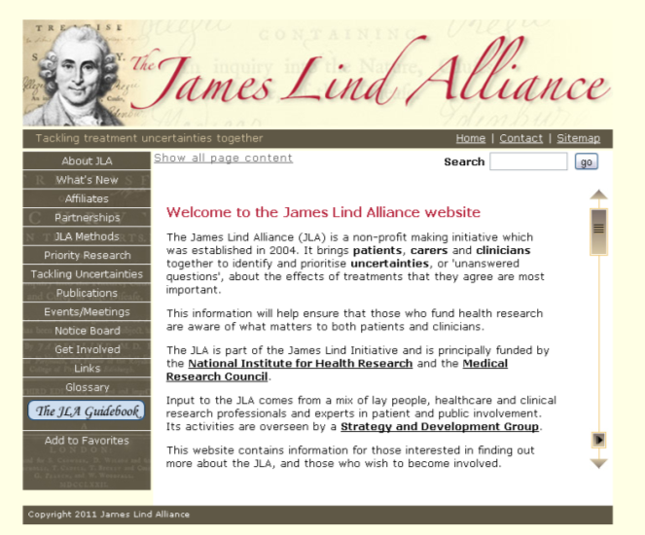
For more information
JLA: www.jla.nihr.ac.uk
JLA Guidebook: www.JLAguidebook.org
Mesothelioma PSP: www.psp.nihr.ac.uk/mesothelioma
Cochrane Agenda and Priority Setting Methods Group: www.capsmg.cochrane.org
@LindAlliance
@Katherine_JLA

Slide 44
Thank you!

