Slide 1
Thank you for viewing this presentation.
We would like to remind you that this material is the property of the author. It is provided to you by the ERS for your personal use only, as submitted by the author.
2012 by the author

Slide 2
PG13 Patient specific modelling and systems biology living labs workshop-
‘The need and potential of patient specific modeling’
Professor Chris Brightling
Institute for Lung Health, Leicester, UK

Slide 3
Conflicts of Interest
AirPROM- EU FP7 6 industry partners, SMEs
www.airprom.european-lung-foundation.org/
COPD MAP- MRC/ABPI 4 Pharma Partners
Research Funding and Consultancy
Roche/ Genentech
AstraZeneca/ MedImmune
Novartis
GlaxoSmithKline
Chiesi

Slide 4
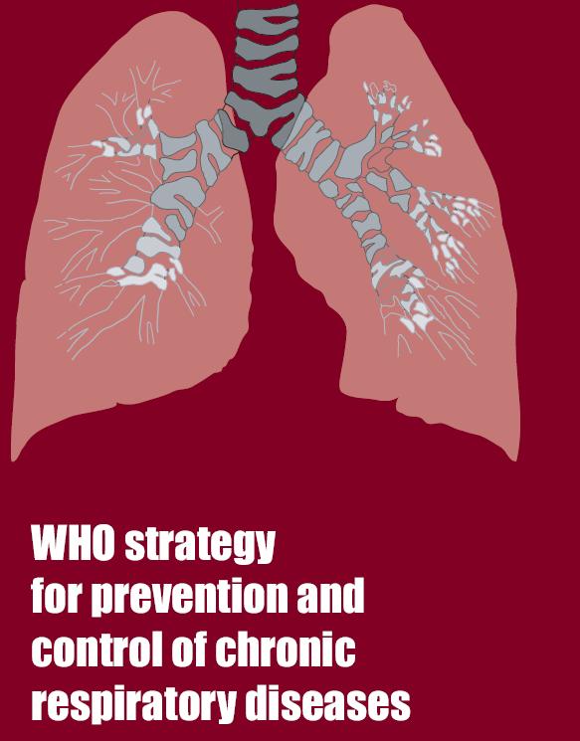
The need and potential of patient specific modeling
400 million people affected with asthma world-wide
COPD third leading cause of death by 2030
Airway disease costs EU >56 billion Euros/annum
Notes:
Abstract.
The airways diseases asthma and chronic obstructive pulmonary disease affect over 400 million people world-wide and cause considerable morbidity and mortality. Airways disease costs the European Union in excess of €56 billion per annum. Current therapies are inadequate and we do not have sufficient tools to predict disease progression or response to current or future therapies. Our consortium, Airway Disease PRedicting Outcomes through Patient Specific Computational Modelling (AirPROM), brings together the exisiting clinical consortia (EvA FP7, U-BIOPRED IMI and BTS Severe Asthma), and expertise in physiology, radiology, image analysis, bioengineering, data harmonization, data security and ethics, computational modeling and systems biology. We shall develop an integrated multi-scale model building upon existing models. This airway model will be comprised of an integrated ‘micro-scale’ and ‘macro-scale’ airway model informed and validated by ‘omic data and ex vivo models at the genome-transcriptome-cell-tissue scale and by CT and functional MRI imaging coupled to detailed physiology at the tissue-organ scale utilising Europe’s largest airway disease cohort. Validation will be undertaken cross-sectionally, following interventions and after longitudinal follow-up to incorporate both spatial and temporal dimensions. AirPROM has a comprehensive data management platform and a well-developed ethico-legal framework. Critically, AirPROM has an extensive exploitation plan, involving at its inception and throughout its evolution those that will ‘develop’ and ‘use’ the technologies emerging from this project. AirPROM therefore will bridge the critical gaps in our clinical management of airways disease, by providing validated models to predict disease progression and response to treatment and the platform to translate these patient-specific tools, so as to pave the way to improved, personalised management of airways disease.

Slide 5
The need and potential of patient specific modeling
Validated models to predict airways disease progression and response to treatment
Platform to translate patient-specific tools
Personalised management of airways disease.
Notes:
Abstract.
The airways diseases asthma and chronic obstructive pulmonary disease affect over 400 million people world-wide and cause considerable morbidity and mortality. Airways disease costs the European Union in excess of €56 billion per annum. Current therapies are inadequate and we do not have sufficient tools to predict disease progression or response to current or future therapies. Our consortium, Airway Disease PRedicting Outcomes through Patient Specific Computational Modelling (AirPROM), brings together the exisiting clinical consortia (EvA FP7, U-BIOPRED IMI and BTS Severe Asthma), and expertise in physiology, radiology, image analysis, bioengineering, data harmonization, data security and ethics, computational modeling and systems biology. We shall develop an integrated multi-scale model building upon existing models. This airway model will be comprised of an integrated ‘micro-scale’ and ‘macro-scale’ airway model informed and validated by ‘omic data and ex vivo models at the genome-transcriptome-cell-tissue scale and by CT and functional MRI imaging coupled to detailed physiology at the tissue-organ scale utilising Europe’s largest airway disease cohort. Validation will be undertaken cross-sectionally, following interventions and after longitudinal follow-up to incorporate both spatial and temporal dimensions. AirPROM has a comprehensive data management platform and a well-developed ethico-legal framework. Critically, AirPROM has an extensive exploitation plan, involving at its inception and throughout its evolution those that will ‘develop’ and ‘use’ the technologies emerging from this project. AirPROM therefore will bridge the critical gaps in our clinical management of airways disease, by providing validated models to predict disease progression and response to treatment and the platform to translate these patient-specific tools, so as to pave the way to improved, personalised management of airways disease.

Slide 6
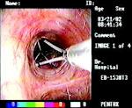
Towards Personalised Medicine
1,200
1,000
800
600
400
200
0
1,133
Exacerbations
No exacerbations
634
Estimated total cost of treatment per person (£)
319
305
310
191
209
152
37
93
% 2.5/17 8/ 32 8/ 18 5/ 7 1.5/ 1
Stage I II III IV V
Asthma UK Asthma Audit 1999

Slide 7
Traditional Asthma Classification
Aetiology
No uniformity
Pathology
Extrinsic / Intrinsic asthma Rackemann 1927
Occupational asthma
Exercise induced asthma
Catamenal asthma
Descriptive
Pavord 1999, Wenzel 1999, Green 2002 - Eosinophilic Vs Non-eosinophilic
Focus on few dimensions of disease
Severity/Control
Patterns of Variable Airflow Obstruction
BTS
ATS Refractory
ERS ‘Difficult’ asthma
GINA
NAEPP III
Turner-Warwick 1977 - Brittle asthma - The morning dipper - Irreversible asthma
Ayres 1998 - Types 1 & 2 brittle asthma

Slide 8
Unravelling Complexity
“If you can not measure it, you can not improve it”.
Lord Kelvin

Slide 9
Unravelling Complexity
High Resolution Complex Phenotyping
Resolution
Symptoms
Signs
Lung function

Slide 10
What is a Phenotype?
A phenotype is any observable characteristic that results from the genetic background as well as the influence of environmental factors and possible interactions between the two.

Slide 11
Airway Disease Domains
CHRONIC INFLAMMATION
SYMPTOMS
EXACERBATIONS
Pathology
AIRWAY DISEASE
Clinical Expression
AIRFLOW OBSTRUCTION
AIRWAY HYPERRESPONSIVENESS
Physiology

Slide 12
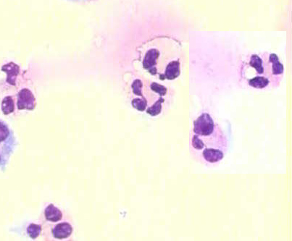
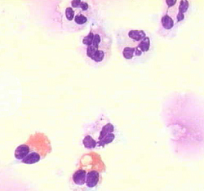
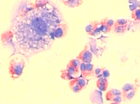
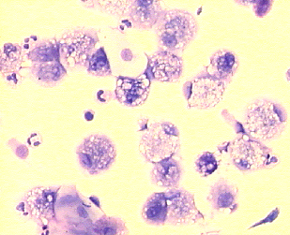
Inflammatory Phenotypes
100
(%)
30
10
eosinophils
3
1
Sputum
0.3
0
Brightling Chest 2006;129(5):1344-8
COPD Asthma
Normal
Brightling et al. Lancet 2000
Green et al Lancet 2002

Slide 13
Phenotyping Heterogeneity
Symptoms
Allergy
- Modified JACS
- Atopic status (SPT)
Variable Airflow Obstruction
Eosinophilic airway inflammation
- PEF Variability
- Induced sputum
Asthma
Demographics
BMI
- Age of onset - Gender
PC20

Slide 14
Summary
Discordant Symptoms
Refractory Asthma
EARLY SYMPTOM PREDOMINANT
Non-eosinophilic Normal BMI High symptom expression
Concordant disease
OBESE FEMALE NON EOSINOPHILIC
High symptom expression
EARLY ONSET ATOPIC
Concordant symptoms, inflammation & airway dysfunction
Symptoms
INFLAMMATION PREDOMINANT
Late onset Greater proportion of males Few daily symptoms
Discordant Inflammation
Haldar et al 2008 AJRCCM
Eos Inflammation

Slide 15
Summary
Refractory Asthma
Discordant Symptoms
120
6 asthma admissions
EARLY SYMPTOM PREDOMINANT
Non-eosinophilic Normal BMI High symptom expression
100
Severe exacerbations (cumulative number)
80
60
OBESE FEMALE NON EOSINOPHILIC
High symptom expression
1 asthma admission
40
Symptoms
20
‡p=0.01
0
0
1
2
3
4
5
6
7
8
9
10
12
11
Time (months)
INFLAMMATION PREDOMINANT
Late onset Greater proportion of males Few daily symptoms
Discordant Inflammation
Haldar et al 2008 AJRCCM
Eos Inflammation

Slide 16
Cluster Specific Outcomes
Phenotype | Outcomes at 12 months | Study Group |  | Sig
Symptom predominant |  | Clinical Protocol N=7 | Sputum management N=4
 | Change in ICS Dose | +1428.57 | -400 | 0.022
 | Severe exacerbation frequency | 5.43 | 2.50 | 0.198
 | Number commenced on OCS | 6 (85.7%) | 0 | -

Slide 17
Cluster Specific Outcomes
Phenotype | Outcomes at 12 months | Study Group |  | Sig
Inflammation predominant |  | Clinical Protocol N=15 | Sputum management N=24
 | Change in ICS Dose | +753.33 | +241.67 | 0.22
 | Severe exacerbation frequency | 3.53 | 0.38 | 0.002
 | Number commenced on OCS | 2 (13.3%) | 9 (37.5%) | 0.167

Slide 18
Refractory Asthma
EARLY SYMPTOM PREDOMINANT
Non-eosinophilic Normal BMI High symptom expression
OBESE FEMALE NON EOSINOPHILIC
High symptom expression
EARLY ONSET ATOPIC
Concordant symptoms, inflammation & airway dysfunction
Symptoms
Specific
Anti-eosinophil Therapy
INFLAMMATION PREDOMINANT
Late onset Greater proportion of males Few daily symptoms
Eos Inflammation

Slide 19
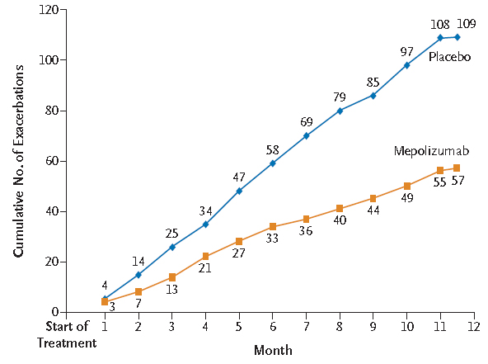
Right Patient, Right Target, Right Outcome
Haldar NEJM 2009

Slide 20
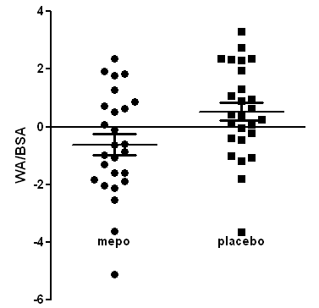
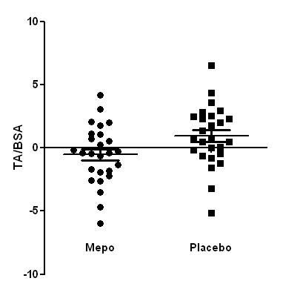
Airway geometry: response to mepolizumab
Mepolizumab
Baseline
Placebo
Siddiqui et al Allergy 2009
Haldar et al NEJM 2009

Slide 21
At Exacerbations: Are there biological clusters?

Slide 22
Study Outline
Bafadhel et al AJRCCM 2011

Slide 23
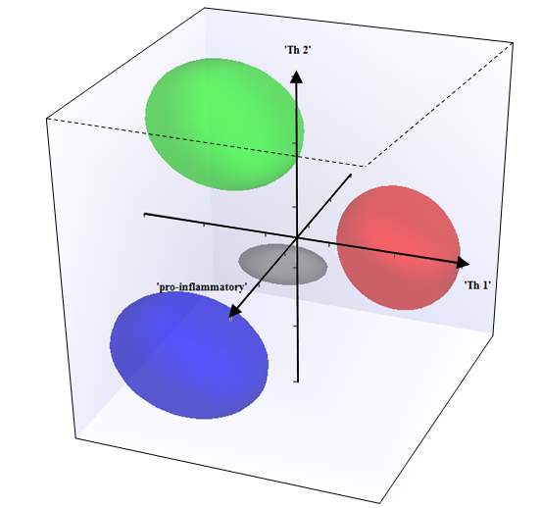
Biological Clustering COPD Exacerbations
 | Factor
 | 1 | 2 | 3
TNF α | 0.80 | -0.36
TNF R1 | 0.88
TNF R2 | 0.93
CCL13 |  | 0.82
CCL17 |  | 0.90
CXCL10 |  |  | 0.92
CXCL11 |  |  | 0.93
IL 1β | 0.89 | -0.36
IL 5 |  | 0.76
IL 6R | 0.89
IL 8 | 0.83
Bafadhel et al AJRCCM 2011

Slide 24
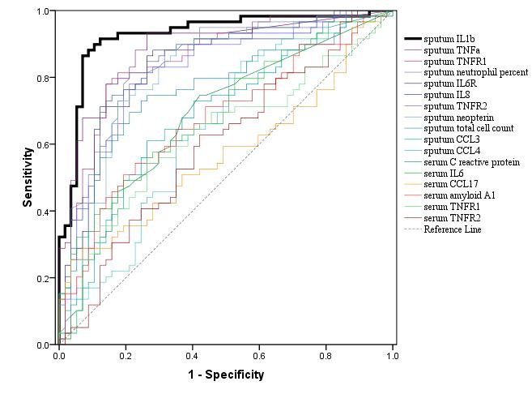
Bacterial Exacerbation
AUC=0.89
IL1β 125pg/ml :
90% sensitive
80% specific
Bacterial exacerbation
if bacteria in stable state
OR 4.9 (2.4 to 9.9)
Notes:
Bacteria – potential pathogenic micro-organism (PsA, HI, SA, SP, MC) or CFU ≥ 10⁷
Sputum markers – dashed
Serum Markers - not dashed
Differentially expressed markers plotted only
Descending order
Sputum TCC – 0.74
Sput Neut % - 0.81
Serum IL6 – 0.67
Sput IL1b – 0.89
Sput TNFa – 0.86
Sput MMP9 – 0.86

Slide 25
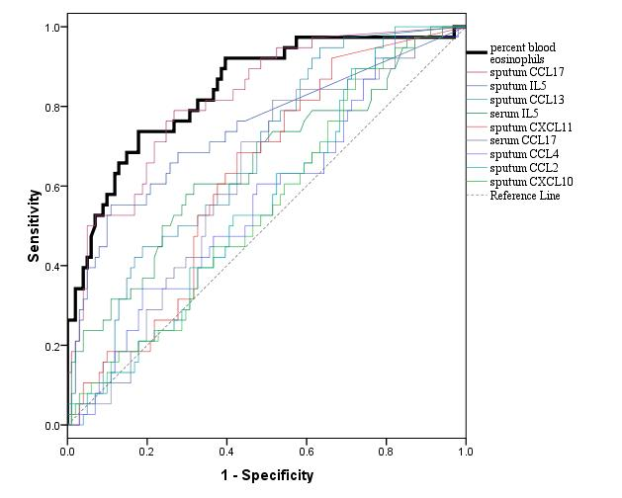
Predictors for Sputum Eosinophilia
AUC = 0.85
2% cut off 90% sensitivity, 60% specificity
Eosinophilic exacerbation
if eosinophilic in stable state
OR 2.7 (1.3 to 5.7)

Slide 26
At Exacerbations: Can biomarkers direct therapy?

Slide 27
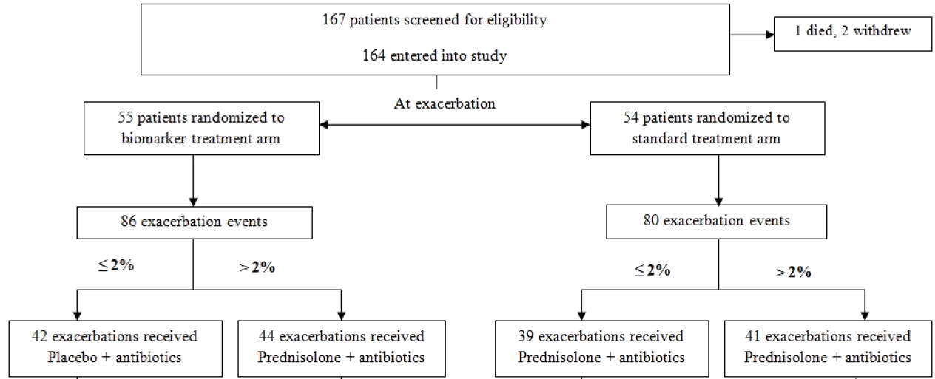
COPD Exacerbations: Targeted Therapy
Bafadhel et al AJRCCM 2012

Slide 28
Targeted Corticosteroid Therapy at Exacerbation
Health Status
Symptom Scores
Lung Function
Bafadhel et al AJRCCM 2012

Slide 29
Targeted Corticosteroid Therapy at Exacerbation
Bafadhel et al AJRCCM 2012

Slide 30
Complex Systems-homeokinesis
triggers
modulators
predictors
Low risk
Day to day variation
prevent
Persistent disequilibrium
High risk
Clinical Exacerbation

Slide 31
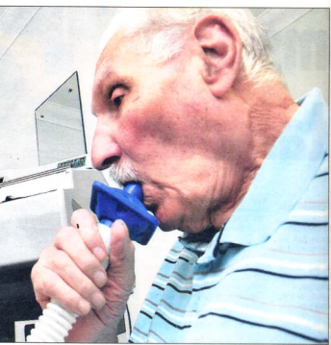
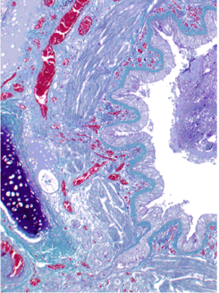
AirPROM- Airway Disease Predicting Outcomes Through Patient Specific Computational Modelling

Slide 32
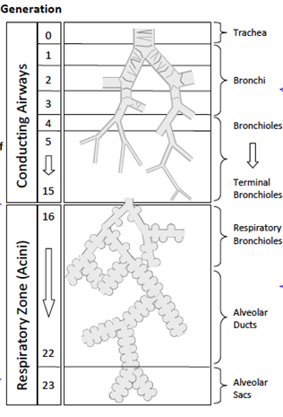
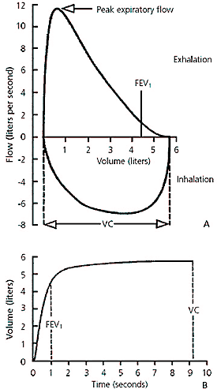
Large Airway: Structure-Function
Notes:
2 metric of diffusion can be measured: short range and long range ADC.
The clinical interpretation of short range ADC is well established in both animal models studies and human studies. In contrast the anatomic correlates of long range ADC are poorly understood, this metric is probably a function of alveolar interconnectivity and may also encorporate information about the alveolar duct.

Slide 33
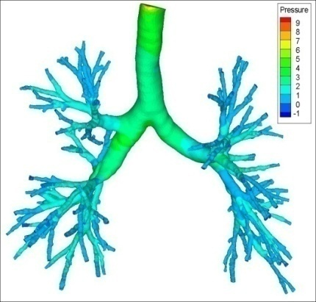
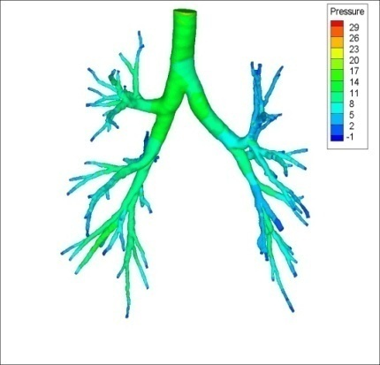
Large Airway: Structure-Function
Healthy
Control
Severe
Asthma

Slide 34
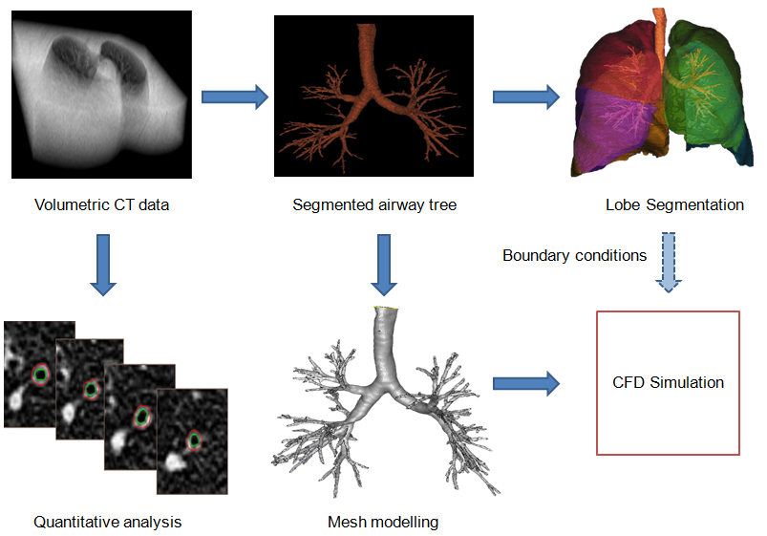
CT Imaging Beyond Geometry
Notes:
Framework:
One of the largest risks for this project is the failure of the models to integrate. In order to mitigate this risk, the first phase of the project will be the establishment of a framework consisting of simplified versions of the existing models that are connected. This framework will be established during the first 6 months of the project concurrently with the development of the knowledge management and project management infrastructure. Mid-way through this period during the organizational meeting a central focus will be the development of the framework to optimise connectivity of the models across the scales.
Iterative cycle #1: The work will then enter into a series of iterative cycles that will work to develop further detail in the models and strengthening their integration. This first cycle will concentrate on strengthening the integration between the molecular and cellular level [WP3] and the tissue to organ level [WP4-6, 8]. During this initial cycle the results of high dimensional analyses and detailed lung function and imaging [WP1,2] will be used to inform the patient-specific models and with the resulting model extensions being used to plan the validation that will occur in the second iterative cycle. This will include deep sequencing of select phenotypes in familial clusters. The extensions for each model will be evaluated for their contribution to the individual model with attention to their potential to further integrate the multiple scales. Towards the conclusion of this cycle, the consortium partners will meet in a two day workshop where the models of the different scales are discussed and plans for how to integrate them decided with focus on integration both up and down the scales. The discussions of the workshop will be carried forward in WP 8 to create the first cycle patient-specific model. In the same iterative cycle the existing ex vivo and in silico models will be extended and the CFD platform optimised towards high-throughput automation.
Interative cycle #2: The second iterative cycle will then see the further integration across all scales molecular to cellular, cellular to tissue, and tissue to organ. Deep sequencing of RNA and DNA analysis will be undertaken to further inform and validate the models. Platform technologies and experimental models will be further developed. Again prior to the development of the 2nd cycle patient-specific model a workshop will be held to discuss model integration and results of validations.
Iterative cycle # 3: Further refinement and validation will be undertaken in the third iterative cycle to provide a validated predictive patient-specific model.

Slide 35
CFD: Therapeutic Response
Notes:
2 metric of diffusion can be measured: short range and long range ADC.
The clinical interpretation of short range ADC is well established in both animal models studies and human studies. In contrast the anatomic correlates of long range ADC are poorly understood, this metric is probably a function of alveolar interconnectivity and may also encorporate information about the alveolar duct.

Slide 36
Small Airway: Structure-Function
Small airway Domains
Small Airway Impedence
Ventilation Heterogeneity
Alveolar structure
Air Trapping
Inflammation

Slide 37
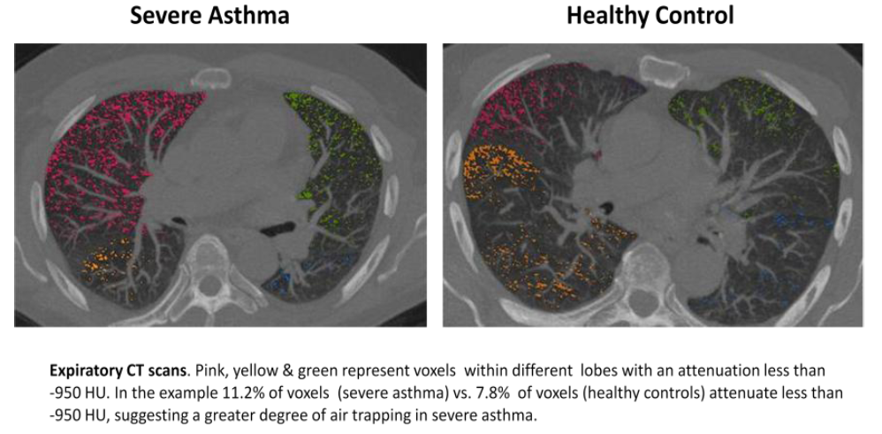
Air Trapping: Expiratory CT

Slide 38
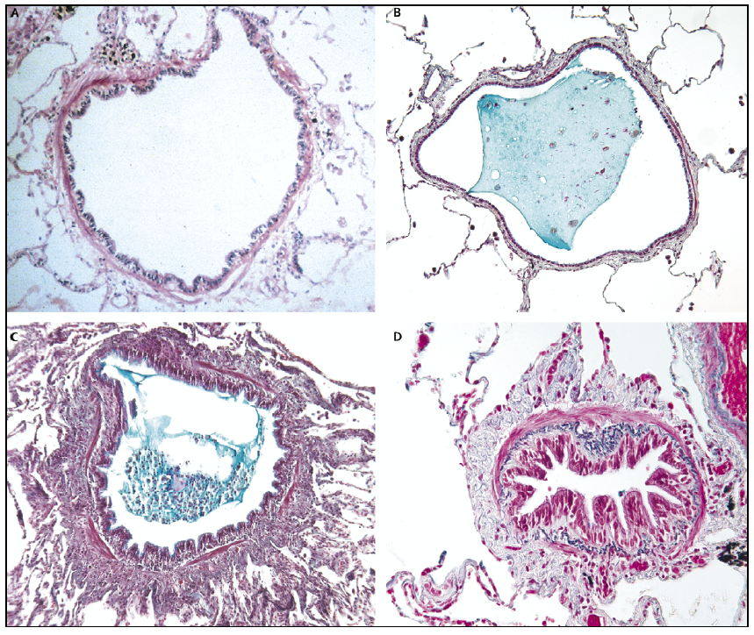
Small airway obstruction in Asthma & COPD
Hogg et al NEJM 2004

Slide 39
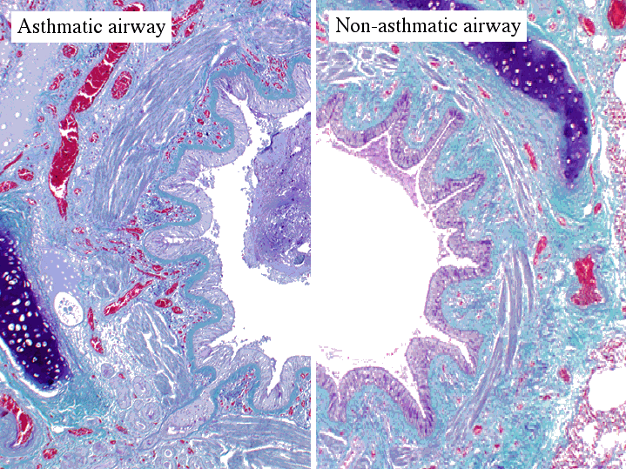
Airway Remodelling

Slide 40
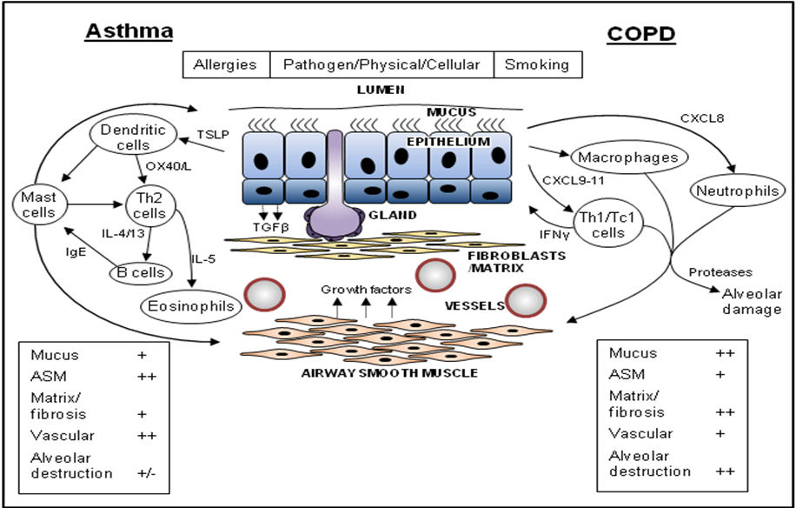
Immunopathology Asthma versus COPD
Notes:
Framework:
One of the largest risks for this project is the failure of the models to integrate. In order to mitigate this risk, the first phase of the project will be the establishment of a framework consisting of simplified versions of the existing models that are connected. This framework will be established during the first 6 months of the project concurrently with the development of the knowledge management and project management infrastructure. Mid-way through this period during the organizational meeting a central focus will be the development of the framework to optimise connectivity of the models across the scales.
Iterative cycle #1: The work will then enter into a series of iterative cycles that will work to develop further detail in the models and strengthening their integration. This first cycle will concentrate on strengthening the integration between the molecular and cellular level [WP3] and the tissue to organ level [WP4-6, 8]. During this initial cycle the results of high dimensional analyses and detailed lung function and imaging [WP1,2] will be used to inform the patient-specific models and with the resulting model extensions being used to plan the validation that will occur in the second iterative cycle. This will include deep sequencing of select phenotypes in familial clusters. The extensions for each model will be evaluated for their contribution to the individual model with attention to their potential to further integrate the multiple scales. Towards the conclusion of this cycle, the consortium partners will meet in a two day workshop where the models of the different scales are discussed and plans for how to integrate them decided with focus on integration both up and down the scales. The discussions of the workshop will be carried forward in WP 8 to create the first cycle patient-specific model. In the same iterative cycle the existing ex vivo and in silico models will be extended and the CFD platform optimised towards high-throughput automation.
Interative cycle #2: The second iterative cycle will then see the further integration across all scales molecular to cellular, cellular to tissue, and tissue to organ. Deep sequencing of RNA and DNA analysis will be undertaken to further inform and validate the models. Platform technologies and experimental models will be further developed. Again prior to the development of the 2nd cycle patient-specific model a workshop will be held to discuss model integration and results of validations.
Iterative cycle # 3: Further refinement and validation will be undertaken in the third iterative cycle to provide a validated predictive patient-specific model.

Slide 41
The need and potential of patient specific modeling
TIME
Gene Protein Cell Tissue Organ Patient
Host Susceptibility
Impaired Innate immunity
PATHOGENS
Bacteria/ Viruses/ Moulds
POLLUTION &
Physical Damage
ALLERGENS

Slide 42
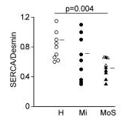
Patient-Specific Multi-Scale Models
ORMDL3
Moffat NEJM 2010, Nature 2007
Cantero-Recaseus Hum Mol Gen 2010
Benayoun 2003 AJRCCM
Mahn 2009 PNAS
Politi J Thero Biol 2010
Notes:
2 metric of diffusion can be measured: short range and long range ADC.
The clinical interpretation of short range ADC is well established in both animal models studies and human studies. In contrast the anatomic correlates of long range ADC are poorly understood, this metric is probably a function of alveolar interconnectivity and may also encorporate information about the alveolar duct.

Slide 43
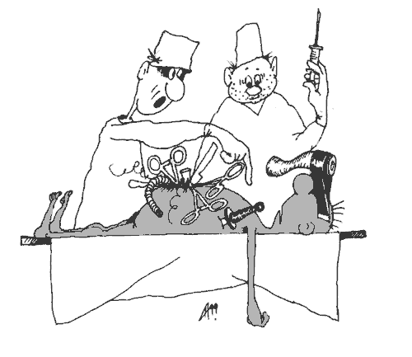
Personalised Healthcare / Target Identification
UP & Down the Scales

Slide 44
Acknowledgements

