Slide 1
Thank you for viewing this presentation.
We would like to remind you that this material is the property of the author. It is provided to you by the ERS for your personal use only, as submitted by the author.
2021 by the author

Slide 2
Are moderate and severe exacerbations different entities?

Slide 3
Agenda
Background
Do the target populatons differ
Do the triggers differ
Summary

Slide 4
Agenda
Background
Do the target populatons differ
Do the triggers differ
Summary

Slide 5
Some Problems Definitions
Mathioudakis et al., Thorax 2020

Slide 6
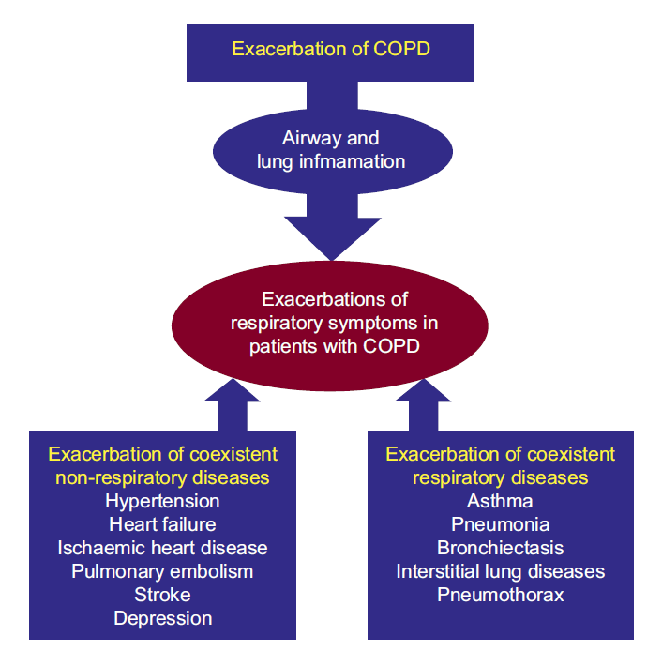
What we see Multiple Causes
Beghe et al., ERJ 2013

Slide 7
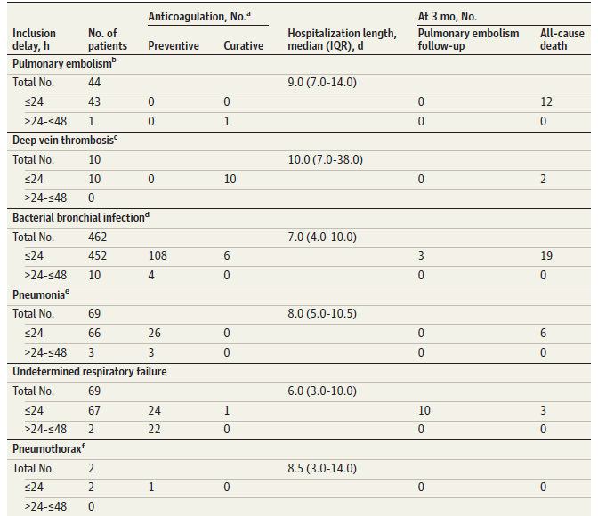
Hospitalized „Exacerbations“ Multiple Causes
Couturaud et al., JAMA 2020

Slide 8
To simplify
Bacteria
Viruses
Type-2 stimulus
Psychological
Cardiac
Stable COPD patient
All Ages
GOLD A-D, I-IV
Variable burden of comorbidities
Remains stable
Mild exacerbation
Moderate
exacerbation
Severe exacerbation

Slide 9
Patient decides
Bacteria
Viruses
Type-2 stimulus
Psychological
Cardiac
Stable COPD patient
Younger
COPD less severe
Little comorbidities
Mild exacerbation
Moderate
exacerbation

Slide 10
Patient decides
Bacteria
Viruses
Type-2 stimulus
Psychological
Cardiac
Stable COPD patient
Older
Severe disease
Many comorbidities
Severe exacerbation

Slide 11
Trigger decides
Viruses
Type-2 stimulus
Psychological
Stable COPD patient
All Ages
GOLD A-D, I-IV
Variable burden of comorbidities
Mild exacerbation
Moderate
exacerbation

Slide 12
Trigger decides
Bacteria
Cardiac
Stable COPD patient
All Ages
GOLD A-D, I-IV
Variable burden of comorbidities
Severe exacerbation

Slide 13
Bacteria
Viruses
Type-2 stimulus
Psychological
Cardiac
?
Stable COPD patient
All Ages
GOLD A-D, I-IV
Variable burden of comorbidities
Remains stable
Mild exacerbation
Moderate
exacerbation
Severe exacerbation

Slide 14
Agenda
Background
Do the target populatons differ
Do the triggers differ
Summary

Slide 15
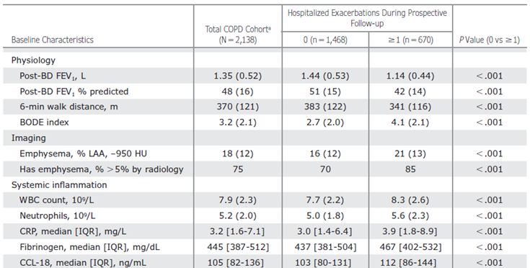
Prospective Follow-up Data from ECLIPSE
Müllerova et al., CHEST 2015

Slide 16
Prospective Follow-up Data from SPIROMICS
Han et al., Lancet RM 2017

Slide 17
Baseline Data from IMPACT
Halpin et al., ERJ 2020

Slide 18
Recurring Events
Suissa et al., 2012

Slide 19
More than „history of exacerbation“?
Adibi et al., 2020

Slide 20
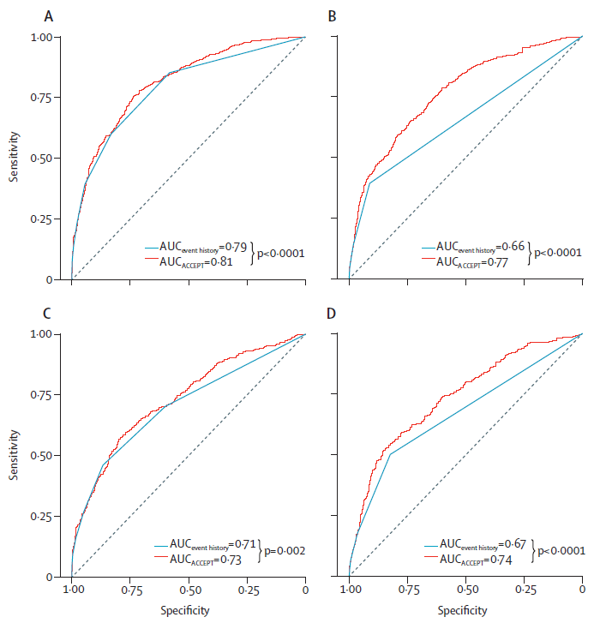
Development and Validation
Adibi et al., 2020

Slide 21
Web App
Adibi et al., 2020

Slide 22
Agenda
Background
Do the target populatons differ
Do the triggers differ
Summary

Slide 23
Do the Triggers differ
Mathioudakis et al., Thorax 2020

Slide 24
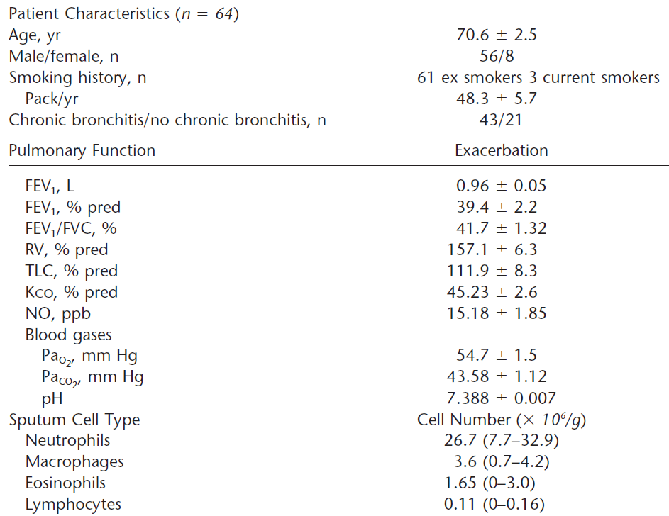
Early Study in Hospitalized Exacerbations
Papi et al., ARCCM 2006

Slide 25
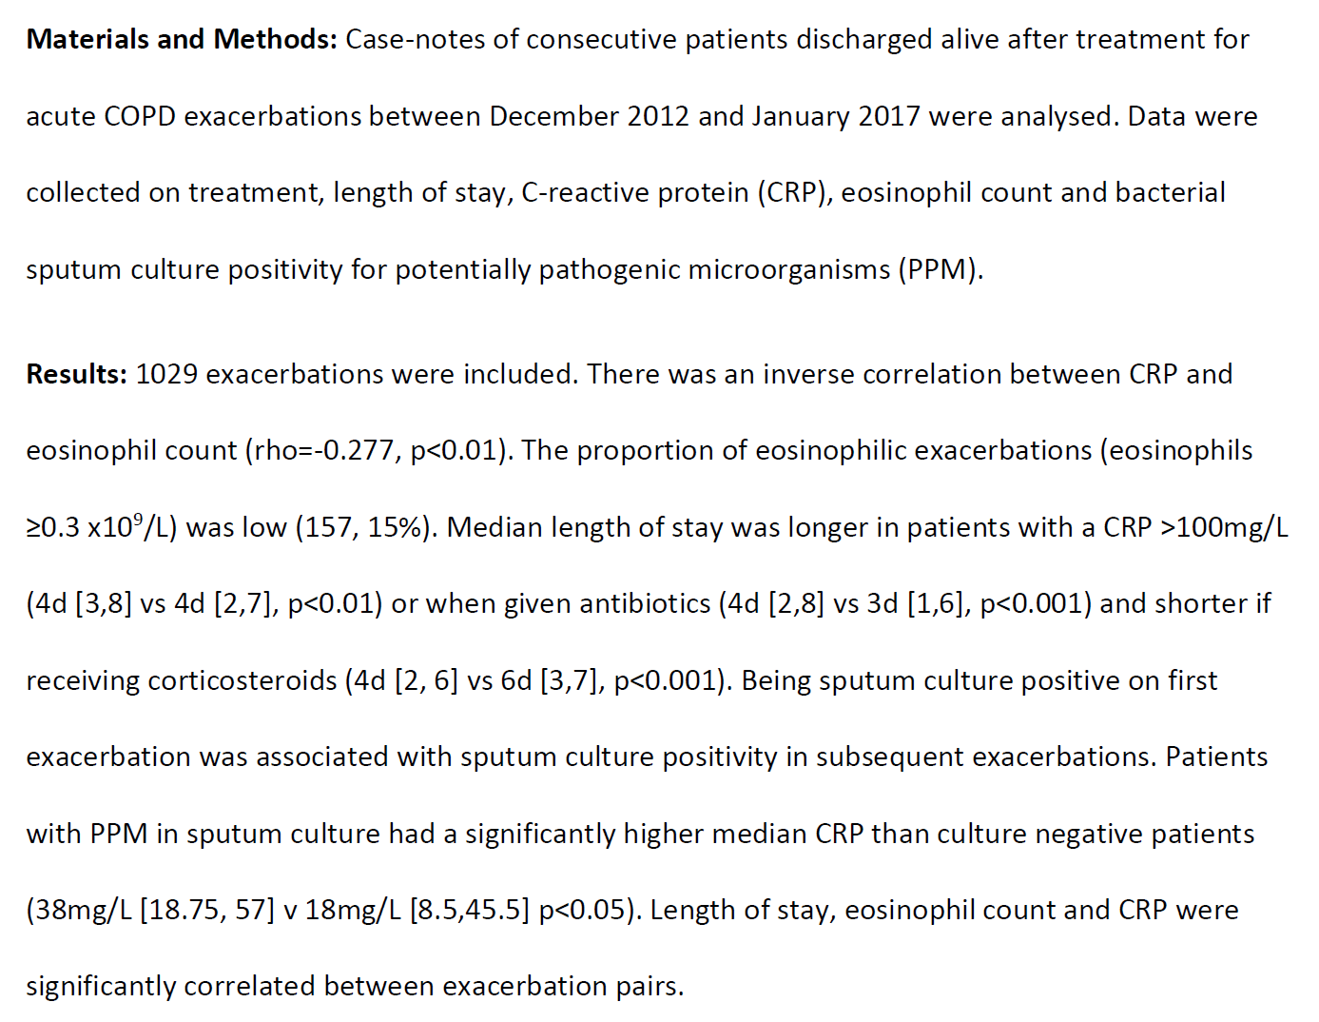
Severe Exacerbations Recent Real-World Data - Retrospective Chart Review
Jones et al., Respir Med 2020

Slide 26
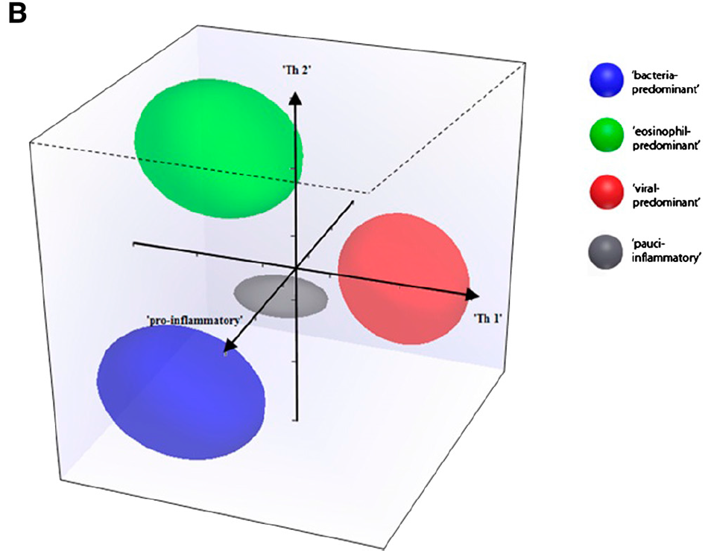
THE Landmark Study
One center, one year
n=156
COPD I – IV
FEV₁ 52 %
86 % ICS
Biomarker-panel in exacerbation
ROC in second cohort
A total of 182 exacerbation events were captured from 86 patients; of these 21 exacerbations warranted hospitalization... Hospitalized exacerbations were associated with a greater decline in lung function compared with exacerbations that were not hospitalized (∆FEV1 [ml] -355 vs. -131; mean difference 224; 95%CI of difference, -356 to -92; P , 0.001), but not health status decline (DCRQ [units] -1.25 vs. -0.91; mean difference 0.34; 95% CI of difference, -0.83 to 0.15; P = 0.18).
Bafadhel et al., AJRCCM 2011

Slide 27
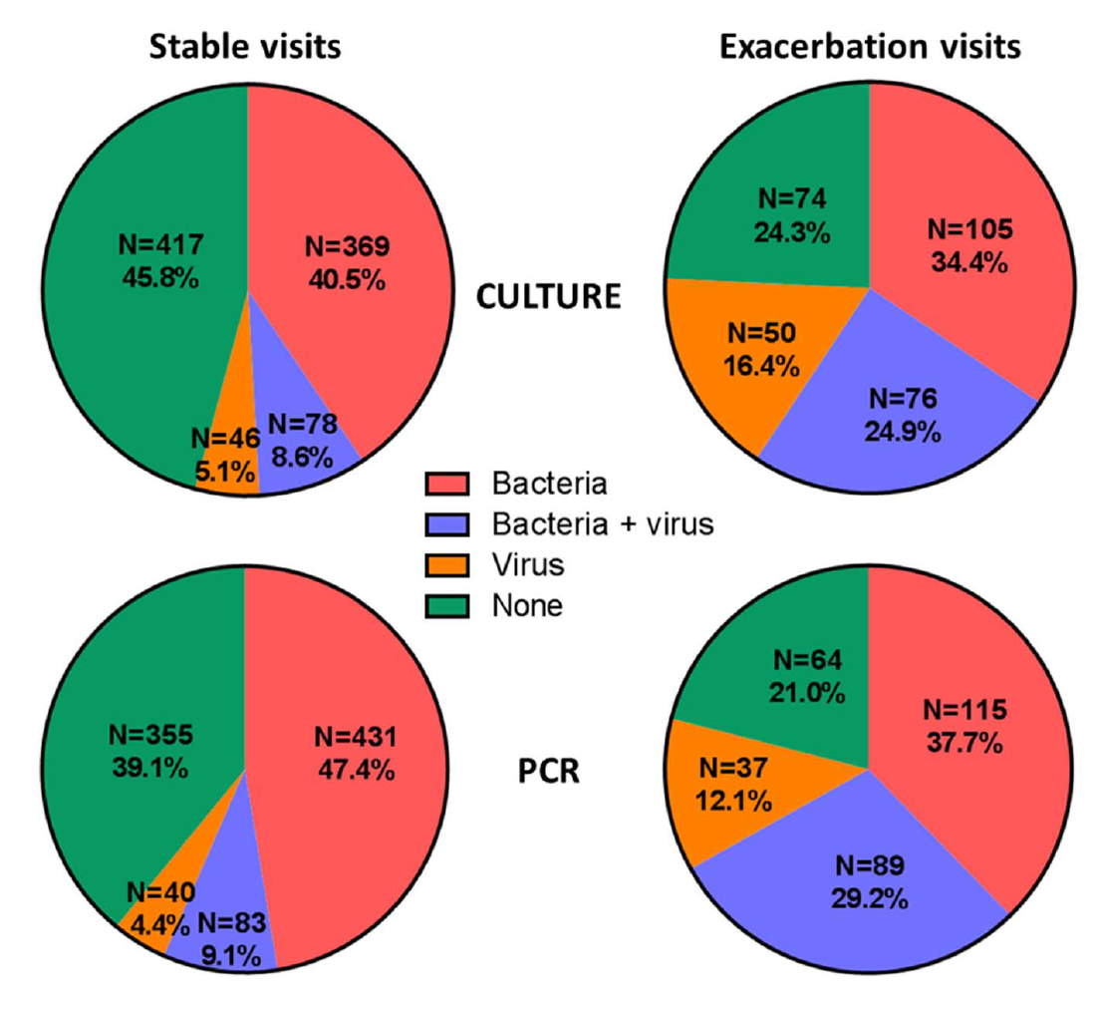
AERIS – Similar Study
The Acute Exacerbation and Respiratory InfectionS in COPD (AERIS) study - prospective, observational cohort study
2-year longitudinal epidemiological study assessed the contribution of changes in the COPD airway microbiome to the incidence of AECOPD
During the first year of follow-up: 355 acute exacerbations, and 47.2% of patients had more than two exacerbations
Mean exacerbation rate was 3.04 (95% CI 2.63 to 3.50) per patient-year
Most exacerbations (304, 85.6%) were moderate in severity, 31 (8.7%) were mild and 20 (5.6%) were severe.
Wilkinson et al., Thorax 2017

Slide 28
Agenda
Background
Do the target populatons differ
Do the triggers differ
Summary

Slide 29
Bacteria
Viruses
Type-2 stimulus
Psychological
Cardiac
?
Stable COPD patient
All Ages
GOLD A-D, I-IV
Variable burden of comorbidities
Remains stable
Mild exacerbation
Moderate
exacerbation
Severe exacerbation

