Slide 1
Thank you for viewing this presentation.
We would like to remind you that this material is the property of the author. It is provided to you by the ERS for your personal use only, as submitted by the author.
2021 by the author

Slide 2
Rehabilitation strategies around the time of hospitalisation
Sally Singh
Department of Respiratory Sciences, University of Leicester, Leicester, U.K
Centre for Exercise and Rehabilitation Science, University Hospitals of Leicester NHS trust, Leicester, U.K

Slide 3
Overview
Why might a rehabilitative strategy be important?
In and out -patient approaches
Challenges & possible solutions

Slide 4
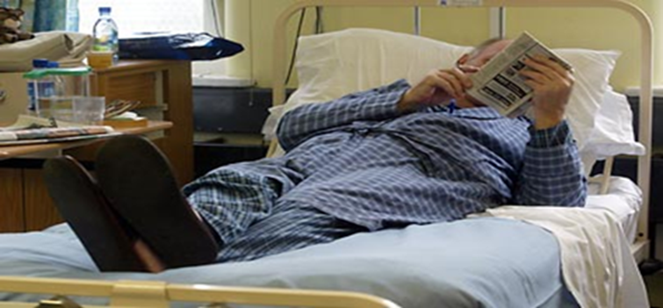
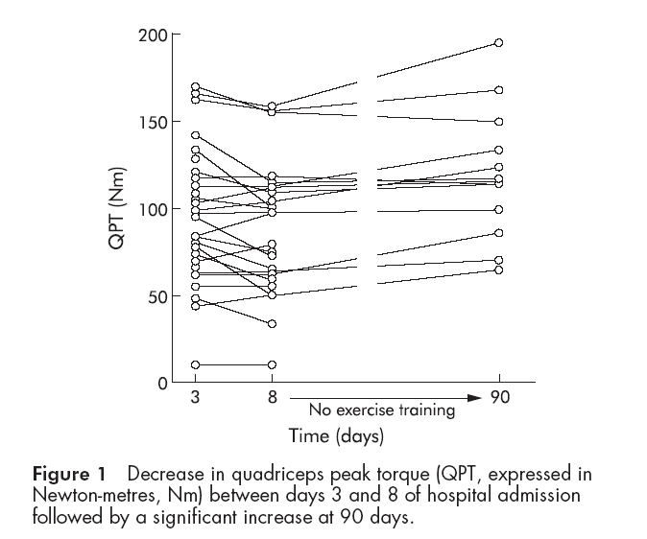
The impact of the admission (and a target for therapy?)
Spruit MA, Gosselink R, Troosters T, et al.Muscle force during an acute exacerbation in hospitalised patients with COPD and its relationship with CXCL8 and IGF-I.Thorax 2003;58:752-756.

Slide 5
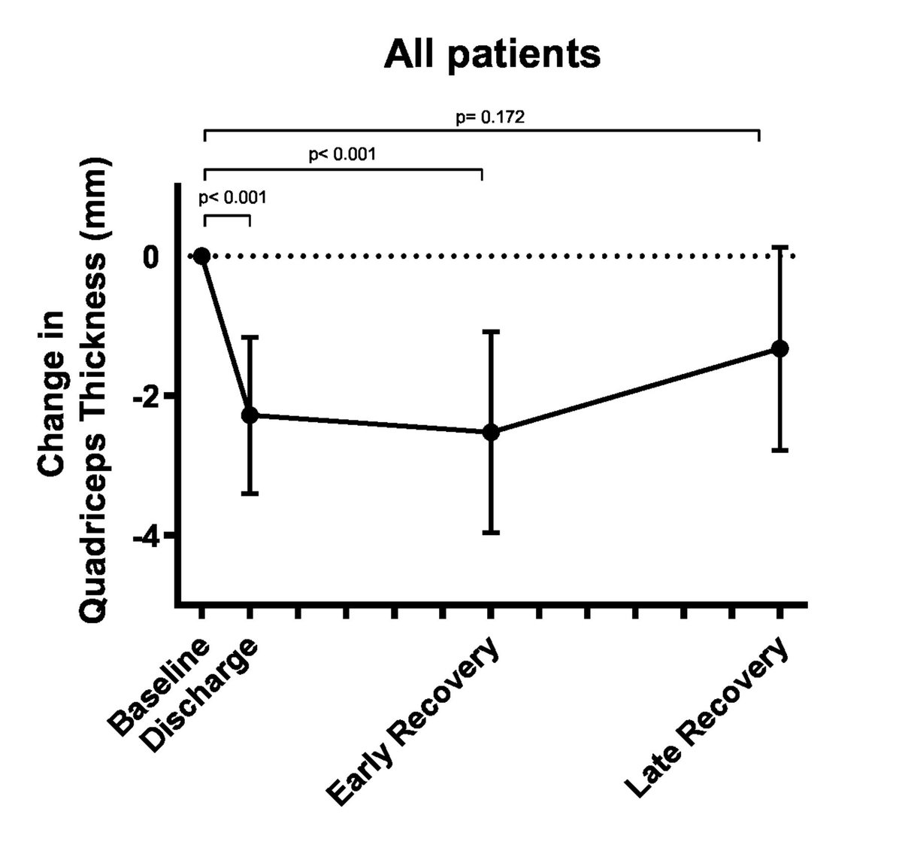
McAuley HJC, Harvey-Dunstan TC, Craner M, et al Longitudinal changes to quadriceps thickness demonstrate acute sarcopenia following admission to hospital for an exacerbation of chronic respiratory disease.Thorax 2021;76:726-728.

Slide 6
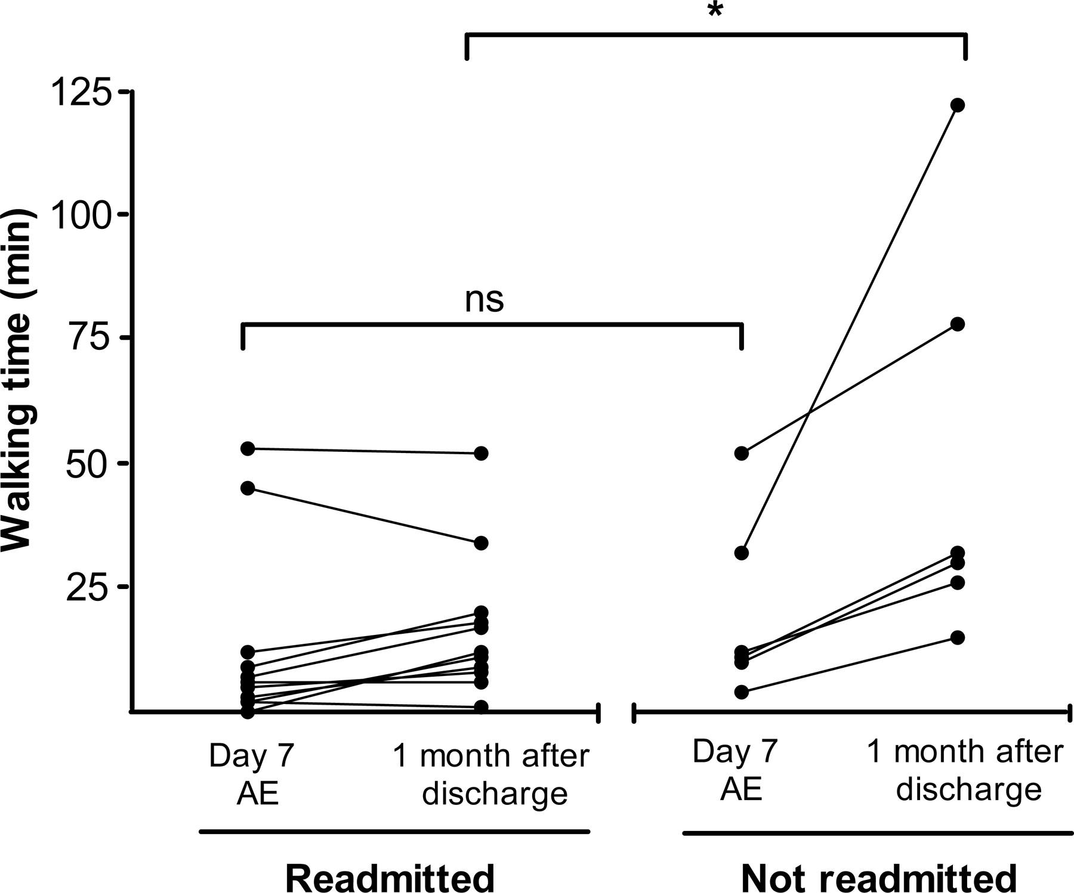
The impact of the admission (and a target for therapy?)
No significant changes in step count were observed between days during the inpatient stay (586 (95% CI: 427–744) vs 652 (95% CI: 493–812) steps/day for days 2 and 7, respectively)
Data from the REACH trial (Greening et al BMJ 2014)
Pitta F et al Physical activity and hospitalisation for exacerbation of COPD Chest 2006;129:536-544
Orme, MW, Harvey-Dunstan, TC, Boral, I, et al. Changes in physical activity during hospital admission for chronic respiratory disease. Respirology. 2019; 24: 652– 657.

Slide 7
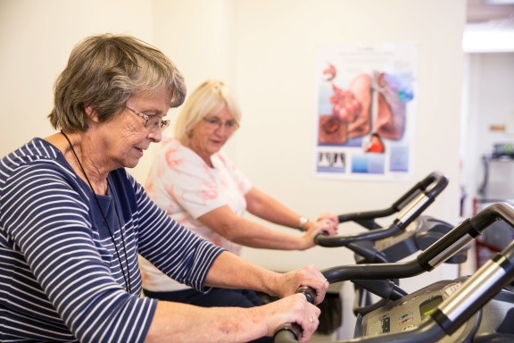
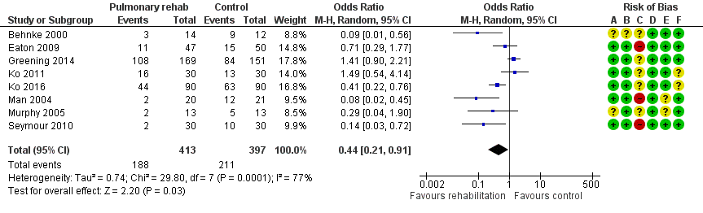
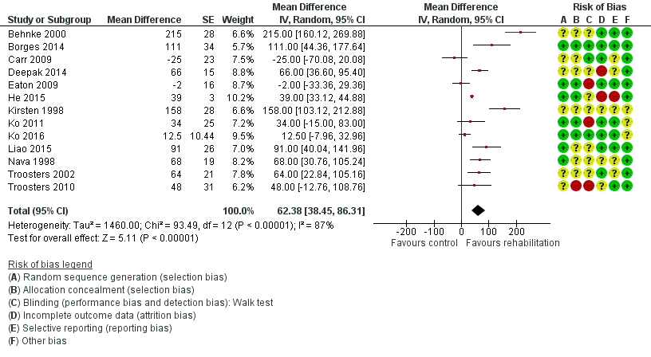
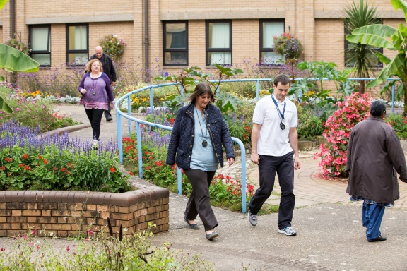
Clinical benefit of PR
Pulmonary rehabilitation improves quality of life and exercise capacity and is a safe intervention for patients with COPD after they have experienced an exacerbation. The reasons for diverse effects on hospital readmissions and mortality, however, are not fully clear. Future studies should explore whether the extent of the rehabilitation programme and the organisation of such programmes within specific healthcare systems (e.g. within the rehabilitation setting vs embedded in the continuum of care from hospital to home to outpatient care) determines the effects of rehabilitation after COPD exacerbations.
Puhan MA, Gimeno‐Santos E, Cates CJ, Troosters T. Pulmonary rehabilitation following exacerbations of chronic obstructive pulmonary disease. Cochrane Database of Systematic Reviews 2016, Issue 12. Art. No.: CD005305. DOI: 10.1002/14651858.CD005305.pub4. Accessed 15 June 2021

Slide 8
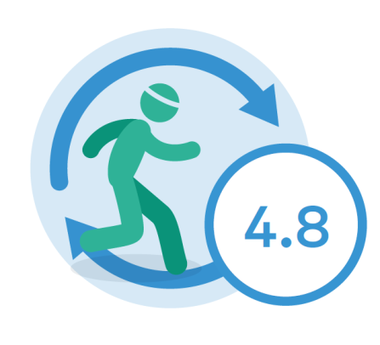
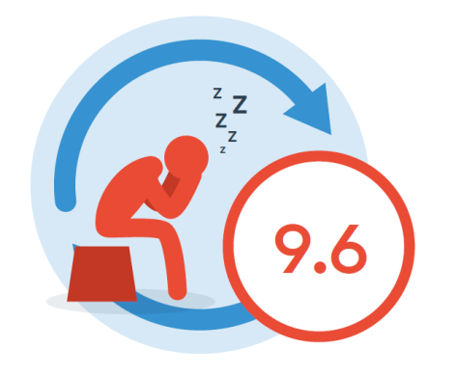
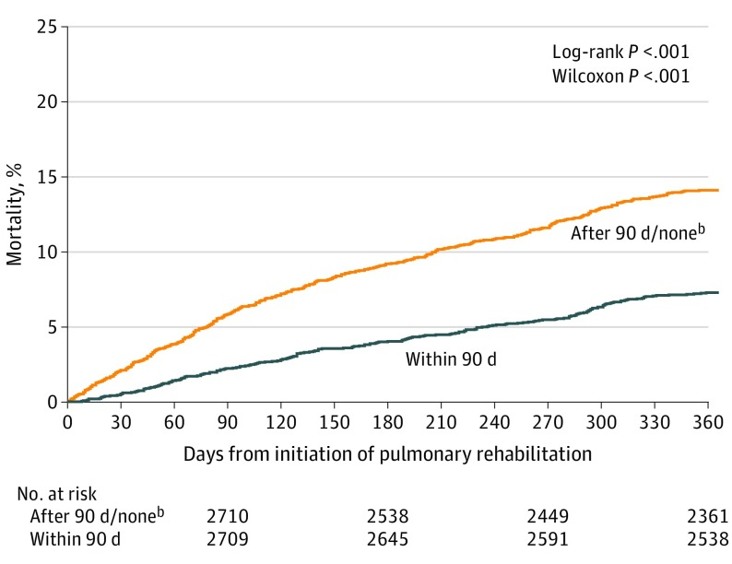
Hospital bed days
Patients who completed their PR course was 4.8 days
Patients who did not complete their PR course was 9.6
Overall, the mean number of bed days spent in hospital within 90 days was 5.5 and within 180 days was 7.3
Survival
Lindenauer, Peter K et al. “Association Between Initiation of Pulmonary Rehabilitation After Hospitalization for COPD and 1-Year Survival Among Medicare Beneficiaries.” JAMA vol. 323,18 (2020): 1813-1823. doi:10.1001/jama.2020.4437

Slide 9
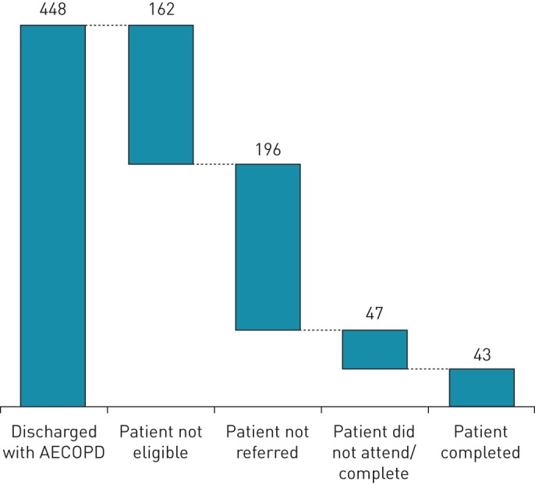
The challenge of recruiting to post AE rehabilitation
The challenge is to develop interventions that are deliverable and acceptable around the time of an acute exacerbation but also deliver the desired clinical impact.
Options
Strategies to increase uptake
Different approaches - Therapies directed at the impact
Bridging intervention into PR
Man WD, Puhan MA, Harrison SL, Jordan RE, Quint JK, Singh SJ. ERJ Open Res. 2015 Oct 6;1(2).

Slide 10
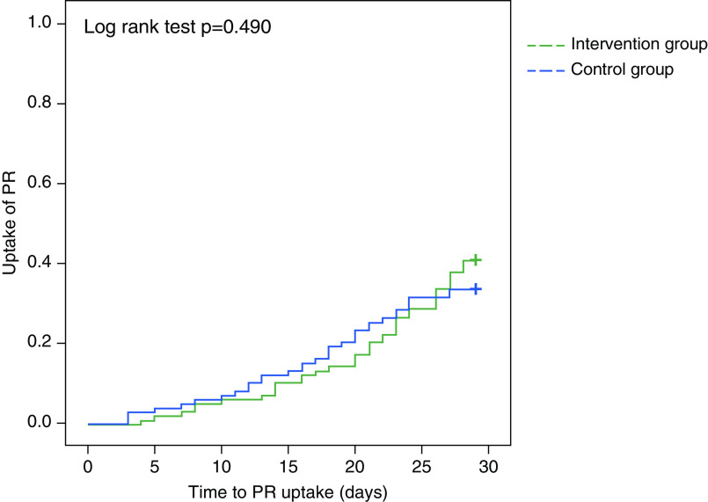
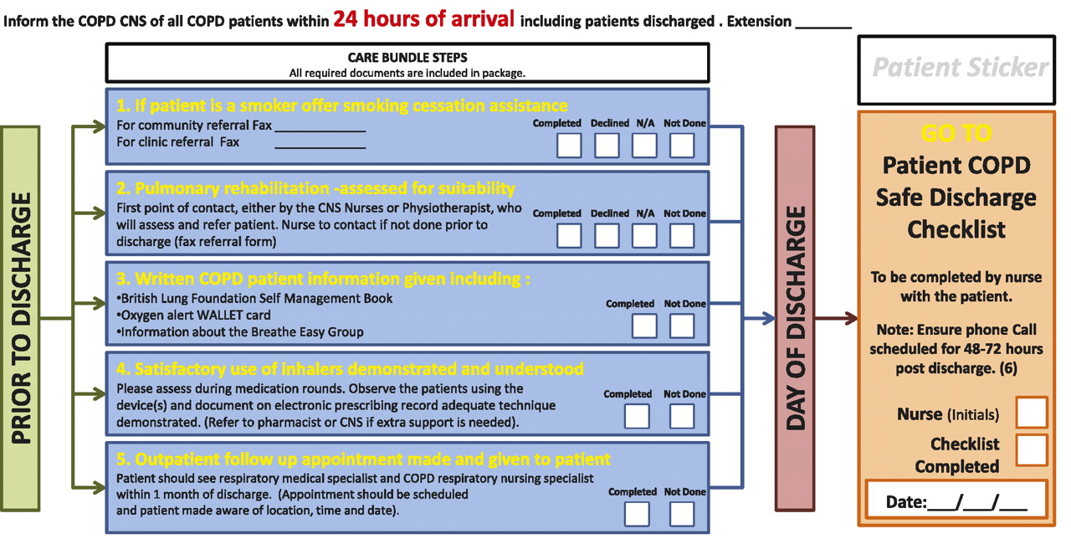
Approaches to increase uptake
COPD discharge bundles delivered by PR practitioners(n=25) compared with non-PR practitioners (n=203) were associated with increased PR referral (60% vs 12%)
Barker, Ruth E et al. “The Effects of a Video Intervention on Posthospitalization Pulmonary Rehabilitation Uptake. A Randomized Controlled Trial.” American journal of respiratory and critical care medicine vol. 201,12 (2020): 1517-1524. doi:10.1164/rccm.201909-1878OC
Barker RE, Kon SS, Clarke SF, Wenneberg J, Nolan CM, Patel S, Walsh JA, Polgar O, Maddocks M, Farquhar M, Hopkinson NS, Bell D, Wedzicha JA, Man WD. COPD discharge bundle and pulmonary rehabilitation referral and uptake following hospitalisation for acute exacerbation of COPD. Thorax. 2021 Mar 2:thoraxjnl-2020-215464. doi: 10.1136/thoraxjnl-2020-215464.

Slide 11
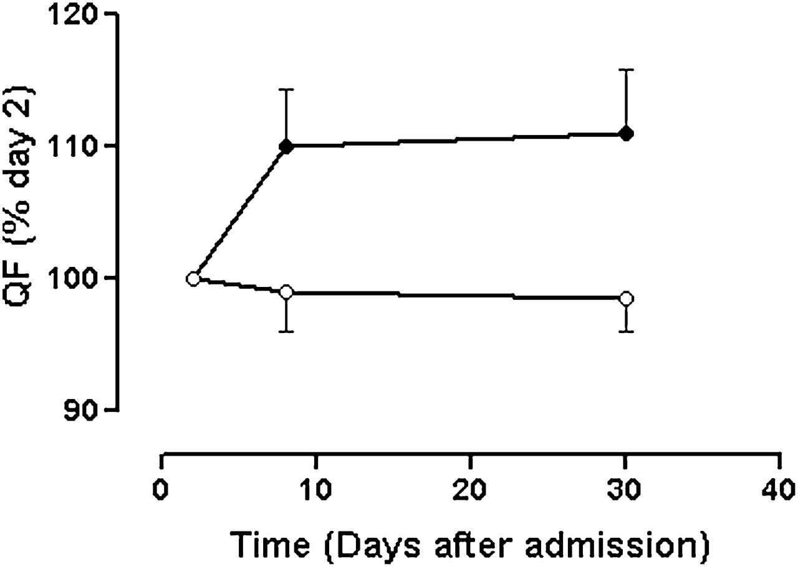
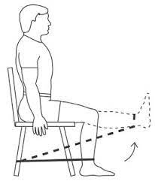
Resistance training strategies
N=36 , 17 patients in the training group
6 ± 1 sessions.
Intensity of the training was > 70% 1RM.
6.8 ± 2.7 kg on Day 2 , 7.7 ± 3.0 kg Day 8.
No impact on the readmission rate of patients at 6 months.
Troosters T, Probst VS, Crul T, Pitta F, Gayan-Ramirez G, Decramer M, Gosselink R. Resistance training prevents deterioration in quadriceps muscle function during acute exacerbations of chronic obstructive pulmonary disease. Am J Respir Crit Care Med. 2010 May 15;181(10):1072-7. doi: 10.1164/rccm.200908-1203OC. Epub 2010 Feb 4. PMID: 20133927

Slide 12
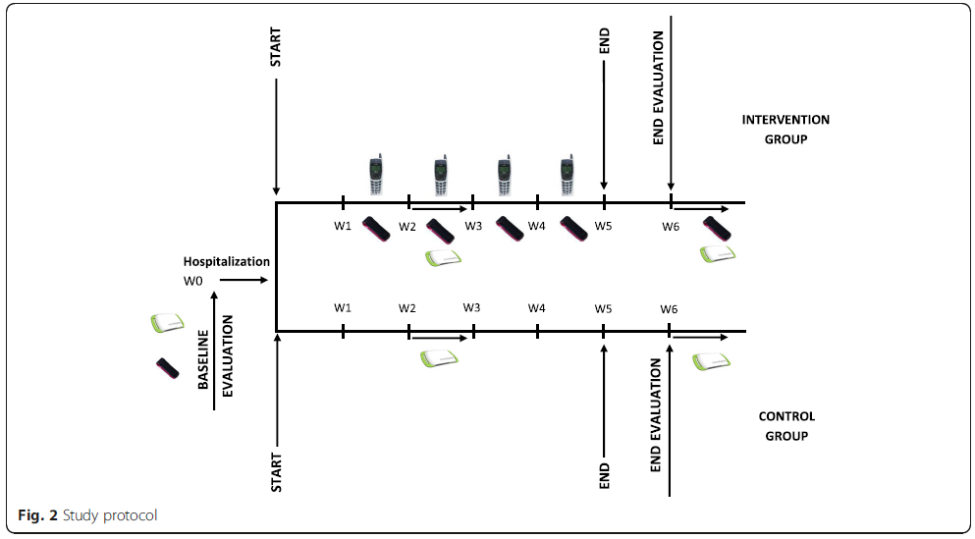
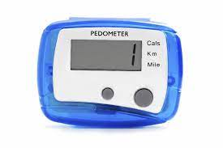
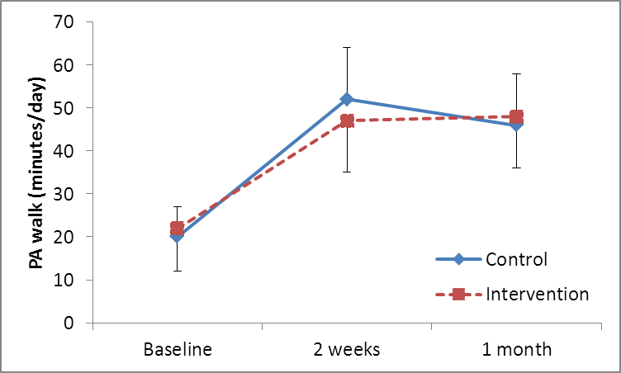
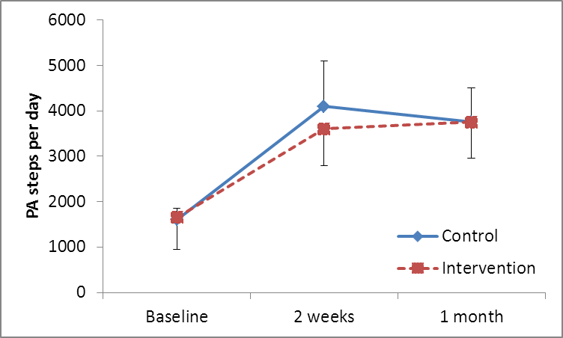
A physical activity solution post hospitalisation
………difficult recruitment (n=30) and the negative intermediate analyses, this study was not continued.
Hornikx M, Demeyer H, Camillo CA, Janssens W, Troosters T. The effects of a physical activity counseling program after an exacerbation in patients with Chronic Obstructive Pulmonary Disease: a randomized controlled pilot study. BMC Pulm Med. 2015 Nov 4;15:136. doi: 10.1186/s12890-015-0126-8. PMID: 26530543; PMCID: PMC4632467.

Slide 13
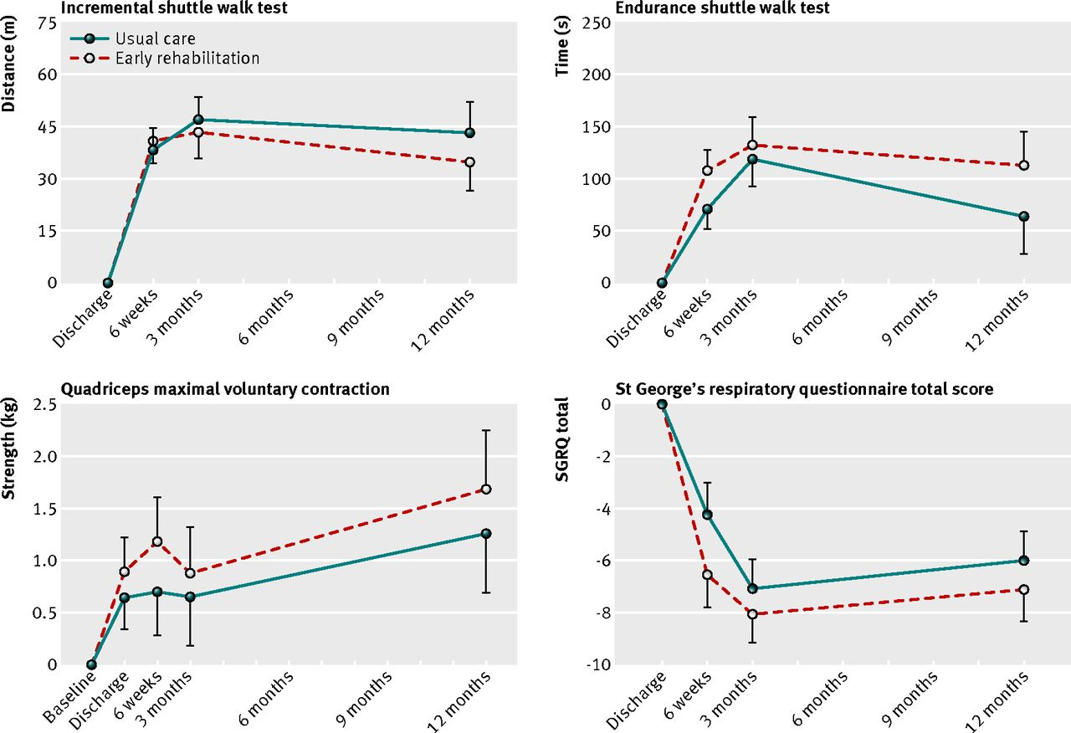
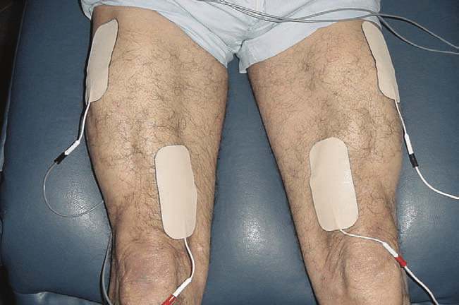
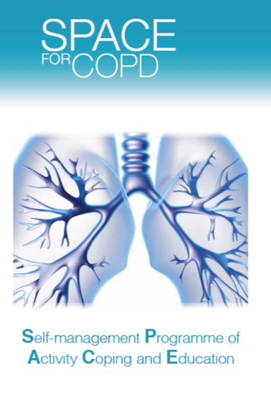
Hybrid intervention (in and out-patient)
Greening N et al early rehabilitation intervention to enhance recovery during hospital admission for an exacerbation of chronic respiratory disease : randomised controlled trial BMJ 2014;349:g4315
Notes:
Fig 5 Intention to treat analysis: change in functional measures (from first measure) in year after admission in all participants. Initial measures were taken at discharge for incremental and endurance shuttle walk tests and at baseline for quadriceps maximal voluntary contraction and St George’s respiratory questionnaire. *P<0.05

Slide 14
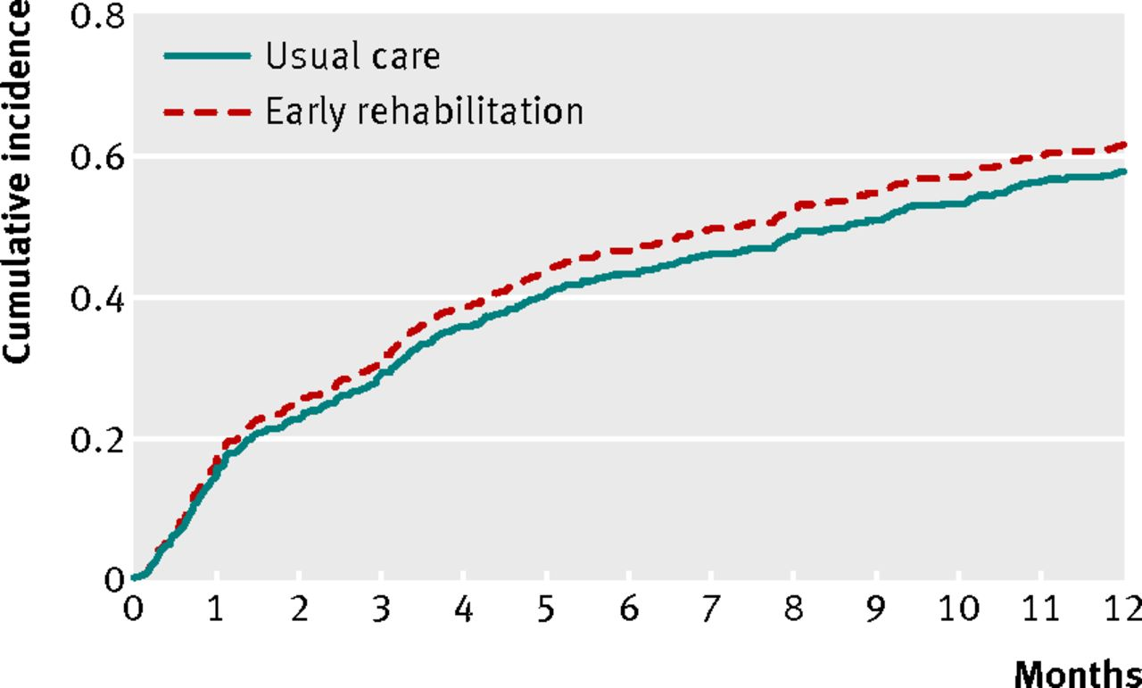
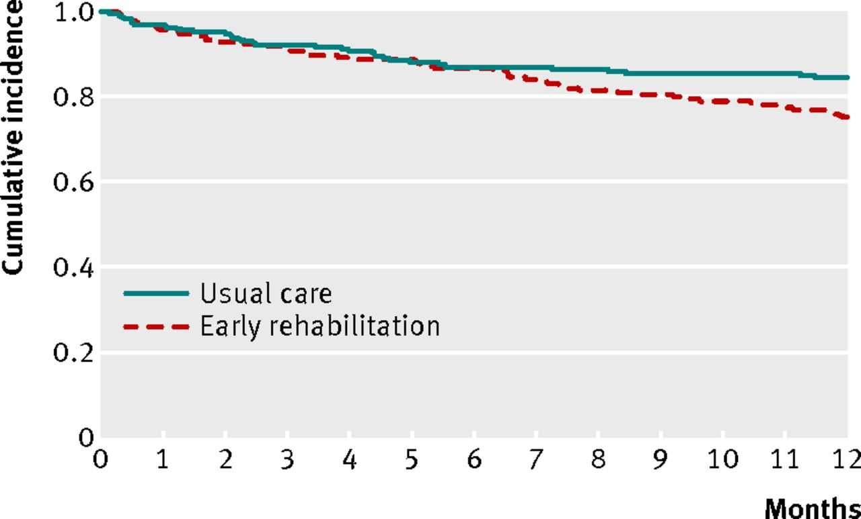
Hospital readmission & survival
Greening N et al early rehabilitation intervention to enhance recovery during hospital admission for an exacerbation of chronic respiratory disease : randomised controlled trial BMJ 2014;349:g4315An
Notes:
Fig 3 Cumulative incidence of hospital readmission, using competing risks regression analysis, in usual care and early rehabilitation groups. The groups did not differ (P=0.4)‏

Slide 15
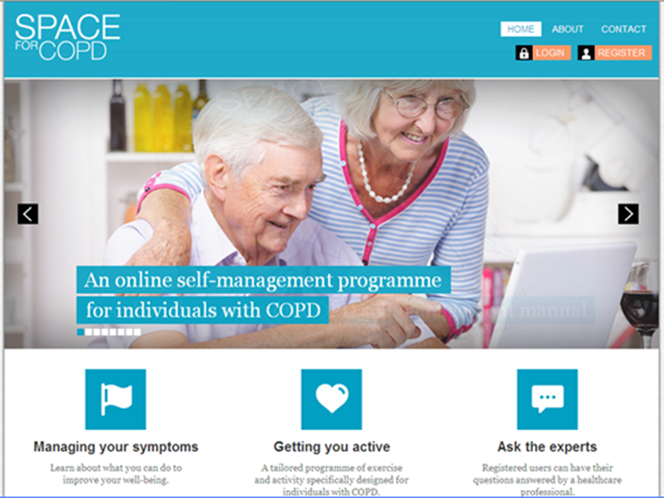
Digital/bridging interventions (are they feasible?)
281 identified
126 approached
26 recruited
14 withdrew
8 completed
4 continuing with intervention
.
.
Screened 2080 patients.
Recruited and consented 100.
4.8% of those screened.
Whelan M, Biggs C, Areia C, King E, Lawson B, Newhouse N, Ding X, Velardo C, Bafadhel M, Tarassenko L, Watkinson P, Clifton D, Farmer A. Recruiting patients to a digital self-management study whilst in hospital for a chronic obstructive pulmonary disease exacerbation: A feasibility analysis. Digit Health. 2021 May 27;7:20552076211020876. doi: 10.1177/20552076211020876. PMID: 34104470; PMCID: PMC8165816
Houchen-Wolloff L, Orme M, Barradell A, Clinch L, Chaplin E, Gardiner N, Singh SJ. Web-Based Self-management Program (SPACE for COPD) for Individuals Hospitalized With an Acute Exacerbation of Chronic Obstructive Pulmonary Disease: Nonrandomized Feasibility Trial of Acceptability. JMIR Mhealth Uhealth 2021;9(6):e21728

Slide 16
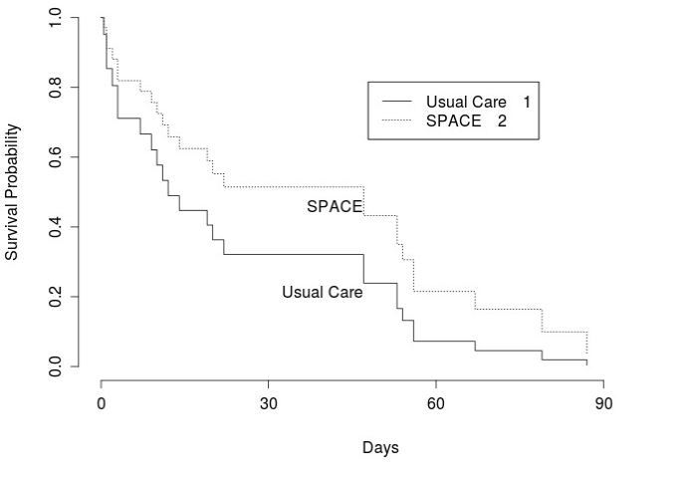
Supported self management – paper based
Median (IQR) days to first respiratory re-admission 14 (4-39) for UC and 47 (4.5-55.5) for SPACEforCOPD (p>0.05).
CRQ
ISWT (m)
Per protocol usual care = 36 intervention arm = 35
Johnson-Warrington, Vicki et al. “Can a supported self-management program for COPD upon hospital discharge reduce readmissions? A randomized controlled trial.” International journal of chronic obstructive pulmonary disease vol. 11 1161-9. 2 Jun. 2016,
Notes:
Days to first re-admission was skewed, hence the median. Kruskal wallis. ITT presented, no sig if looking at per protocol.
Not stat significant, but could be money-wise

Slide 17
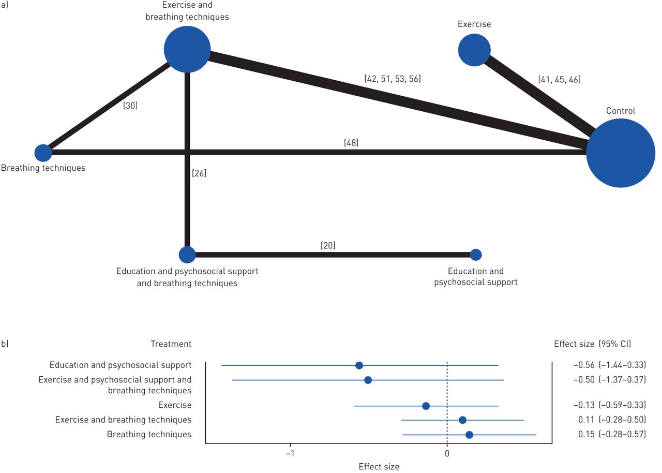
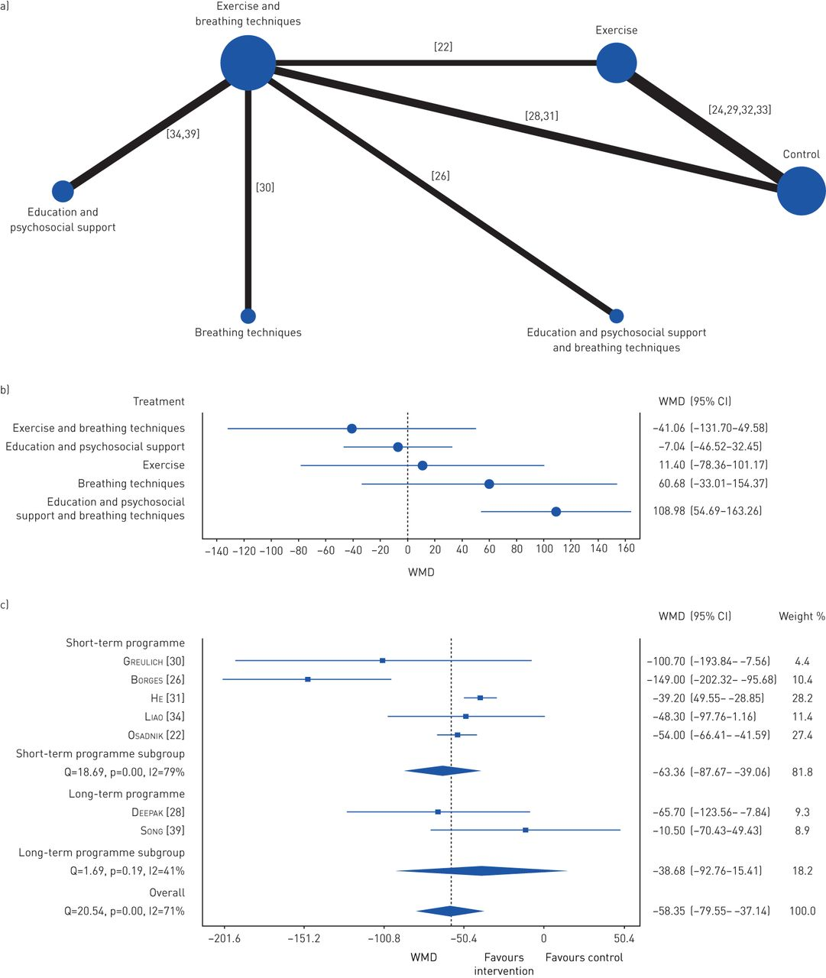
Effects of the different interventions
Exercise and breathing techniques improve exercise capacity (NS between interventions)
Breathing techniques/ exercise and breathing techniques impact LoS (NS between interventions)
Ana Machado et al. Eur Respir Rev 2020;29:200039
Notes:
Effects of the different interventions on length of hospitalisation measured in number of days. a) Network plot of treatments with nodes representing the number of interventions being compared and edges representing the available direct comparisons (comparisons evaluated in at least one study) between pairs of interventions. b) Forest plot of network meta-analysis results (all interventions versus standard of care).

Slide 18
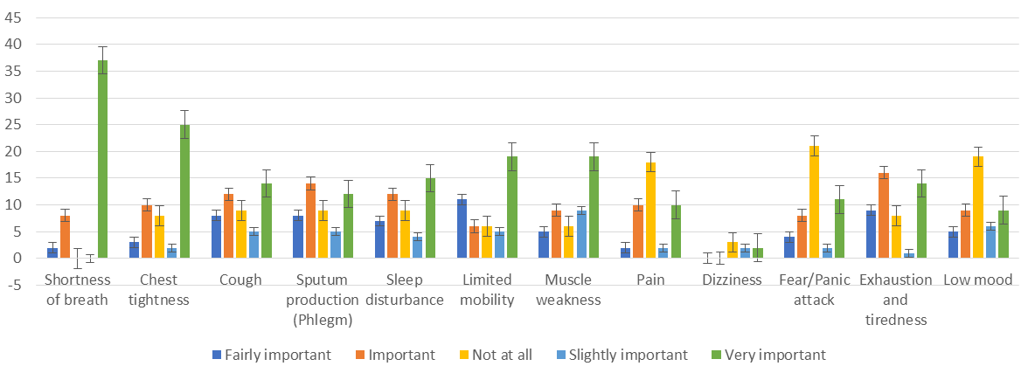
Patient treatment priorities
%
N=50
During an admission for AECOPD
Unpublished data: Bedor Alkhathlan PhD student (submitted to the ERS)

Slide 19
Summary
Negative impact of an exacerbation
Therapeutic targets identified
Evidence that (generic) PR post AE works
Referral and uptake problematic
If delivered with 90 days survival benefit
Could we relax the threshold for recruitment (especially against a background of natural recovery) ?
Should we focus on patient priorities to facilitate engagement?

Slide 21
Acute exacerbation & PR
Should pulmonary rehabilitation be implemented in patients hospitalised with a COPD exacerbation?
Overall readmissions (45.0 vs 50.8%), SGRQ (11.75), 6MWT (88.9m).
Post hoc
Post discharge hospital readmissions (21.5 vs 46.8%) quality of life, exercise capacity.
During hospitalisation increased mortality (no change in readmission)
Management of COPD exacerbations: a European Respiratory Society/American Thoracic Society guideline. Eur Respir 2017; 49: 1600791

