Slide 2
GERD in ILDs
Michael Kreuter
Center for rare and interstitial lung diseases
Pneumology and Respiratory critical care medicine
Thoraxklinik, University of Heidelberg, Germany

Slide 3
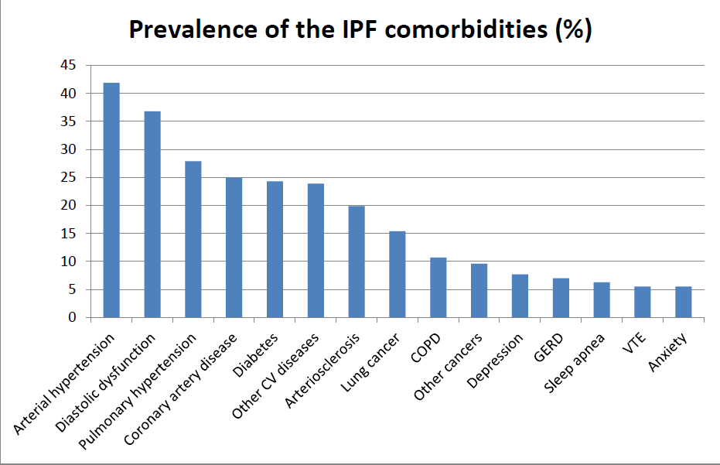
Comorbidities in IPF
Kreuter et al, PlosOne, 2016

Slide 4
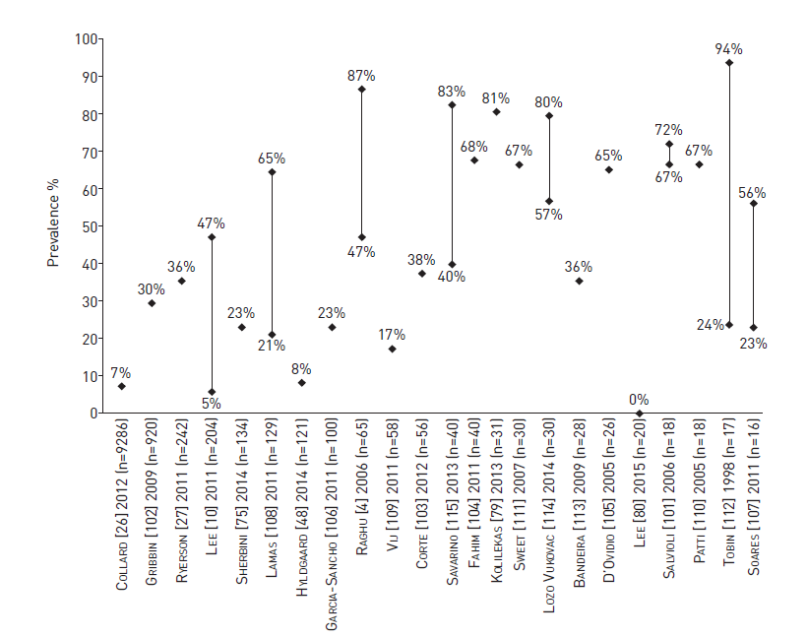
Prevalence of GERD in IPF
Raghu et al., Eur Resp J 2015

Slide 5
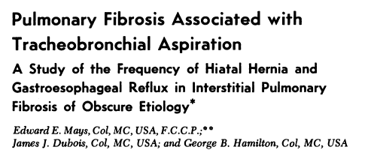
GERD – where it started
“The incidence of both hiatal hernia and reflux were statistically higher in the study group than in a group of 270 age-matched controls”
Mays et al., CHEST, 69: 4, APRIL, 1976.
Notes:
American Thoracic Society. Idiopathic pulmonary fibrosis: diagnosis and treatment. International Consensus Statement. Am J Respir Crit Care Med. 2000;161:646-664.
Raghu G, Weycker D, Edelsberg J, Bradford WZ, Oster G. Incidence and prevalence of idiopathic pulmonary fibrosis. Am J Respir Crit Care Med. 2006;174:810-816.

Slide 6
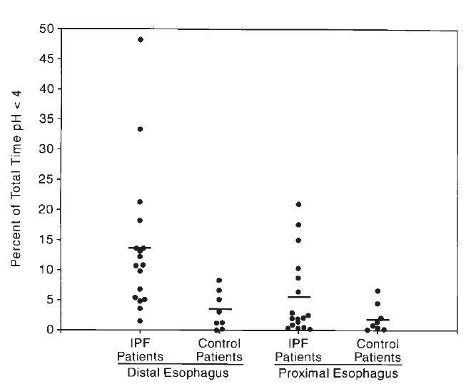
dual-channel, ambulatory esophageal pH monitoring
Significant higher rate of esophageal acid exposure (16/17 IPF) compared to controls (4/8)
Controls: other ILDs
Tobin et al., AM J RESPIR CRIT CARE MED 1998;158:1804–1808.
Notes:
American Thoracic Society. Idiopathic pulmonary fibrosis: diagnosis and treatment. International Consensus Statement. Am J Respir Crit Care Med. 2000;161:646-664.
Raghu G, Weycker D, Edelsberg J, Bradford WZ, Oster G. Incidence and prevalence of idiopathic pulmonary fibrosis. Am J Respir Crit Care Med. 2006;174:810-816.

Slide 7
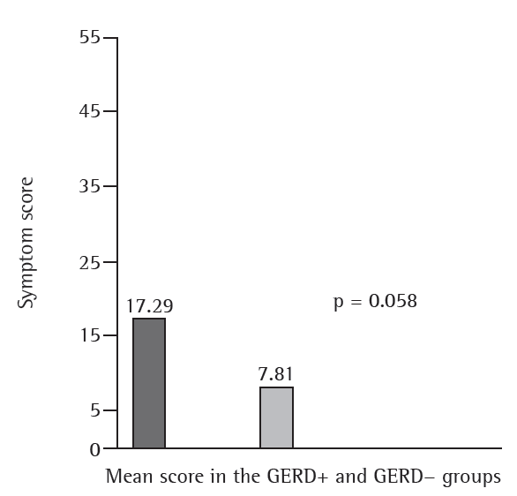
GERD in IPF
Bandeira et al., J Bras Pneumol. 2009;35(12):1182-1189;

Slide 8
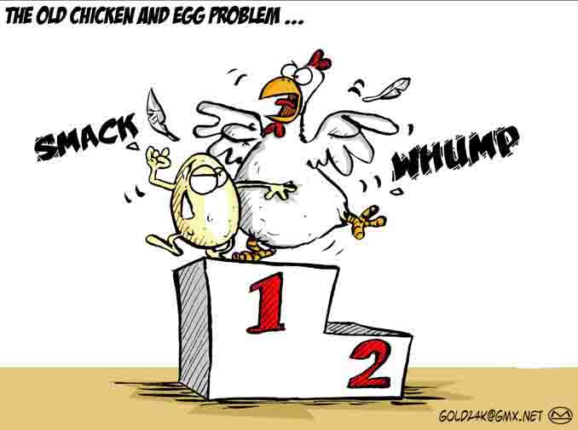
Possible pathophysiology
justiceinconflict.files.wordpress.com

Slide 9
Hypotheses on pathophysiology
Reflux with consequence of
Microaspirations => parenchymal injuries, pneumonitis, epithelial permeability => fibrotic stimulation
Possible consequence: AE-IPF ?
Afferent cough reflex hypersensitivity due to (acid) reflux
Pacheco-Galván et al., Arch Bronconeumol. 2011;47(4):195-203; Kreuter et al., Eur Resp Monograph, 2016
Notes:
Some observations, including data from animal
experiments, suggested that (micro)aspiration of acid refluxate caused parenchymal injuries,
leading to pneumonitis, increased epithelial permeability, and stimulated fibrotic
proliferation; this is comparable to the aspiration of gastroduodenal contents, which can
trigger pulmonary injury leading to bronchiolitis obliterans syndrome after lung
transplantation ([27] and reviewed in [28]).

Slide 10
Hypotheses on pathophysiology
Secondary effects:
abnormal reflux due to increased pressure gradients across diaphragm, changes in pulmonary mechanics, or secondary to medication effects
Caveat: Different forms of reflux (acid, bile, gaseous, mixed) with different consequences
Pacheco-Galván et al., Arch Bronconeumol. 2011;47(4):195-203
Kreuter et al., Eur Resp Monograph, 2016
Notes:
Some observations, including data from animal
experiments, suggested that (micro)aspiration of acid refluxate caused parenchymal injuries,
leading to pneumonitis, increased epithelial permeability, and stimulated fibrotic
proliferation; this is comparable to the aspiration of gastroduodenal contents, which can
trigger pulmonary injury leading to bronchiolitis obliterans syndrome after lung
transplantation ([27] and reviewed in [28]).

Slide 11
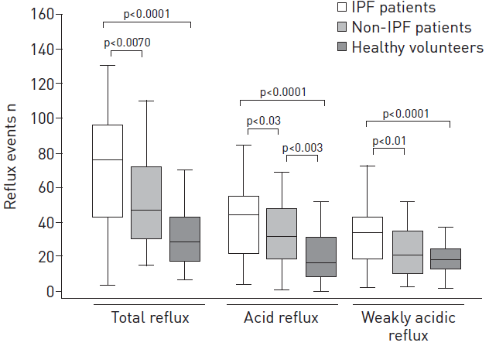
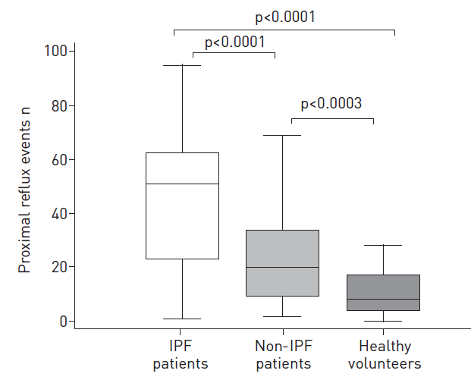
GERD in IPF
IPF patients (n=40) had more bile acids and pepsin in BALF (62% / 67%) and saliva (61% /68%) than non-IPF patients (n=40, BALF: 25%/25%; saliva 33% /36%) and controls (n=50;BALF & saliva: 0%/0%)
Savarino et al., Eur Respir J 2013; 42: 1322–1331
Notes:
American Thoracic Society. Idiopathic pulmonary fibrosis: diagnosis and treatment. International Consensus Statement. Am J Respir Crit Care Med. 2000;161:646-664.
Raghu G, Weycker D, Edelsberg J, Bradford WZ, Oster G. Incidence and prevalence of idiopathic pulmonary fibrosis. Am J Respir Crit Care Med. 2006;174:810-816.

Slide 12
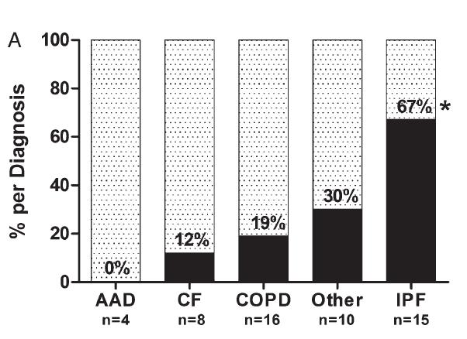
Possible pathophysiology
= reflux
Reflux in LTX-listed patients
Hypothesis: collagenV autoreactivity role in rejection in lung transplantation
Bobadilla et al., CHEST 2010; 138(2):363–370
Notes:
American Thoracic Society. Idiopathic pulmonary fibrosis: diagnosis and treatment. International Consensus Statement. Am J Respir Crit Care Med. 2000;161:646-664.
Raghu G, Weycker D, Edelsberg J, Bradford WZ, Oster G. Incidence and prevalence of idiopathic pulmonary fibrosis. Am J Respir Crit Care Med. 2006;174:810-816.

Slide 13
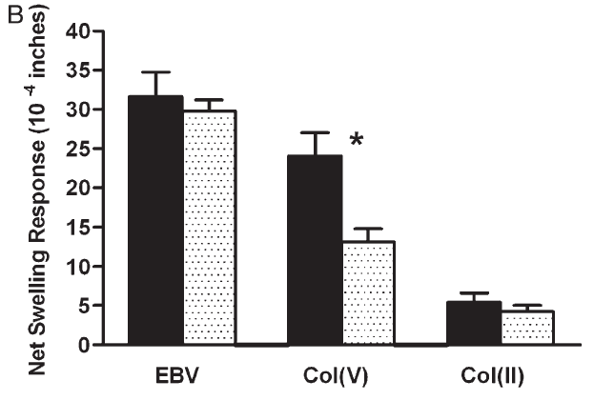
Possible pathophysiology
Method: trans vivo delayed-type hypersensitivity assay
Result: significant difference in col(V) sensitization
= reflux
Bobadilla et al., CHEST 2010; 138(2):363–370
Notes:
Fifty-three patients before lung transplantation were
analyzed while on the transplantation wait list. Refl ux status was
objectively confi rmed as previously described in the “Materials and
Methods” section. Patients with idiopathic pulmonary fi brosis
(n 5 15) had a signifi cantly higher proportion of GERD (solid bars)
than all other conditions (n 5 38) ( A ). Additionally, patients with
proven refl ux (solid bars, n 5 17) had a signifi cant and specifi c
response to col(V) not seen in the group with no objective evidence
of GERD (dotted bars, n 5 36) ( B ). This response was near
the magnitude of the positive recall antigen Epstein-Barr virus.
There was no response to collagen type II. AAD 5 a 1-antitrypsin
defi ciency; CF 5 cystic fi brosis; col(II) 5 collagen type II; col(V) 5
collagen type V; EBV 5 Epstein-Barr virus; IPF 5 idiopathic
pulmonary fi brosis. See Figure 1 legend for expansion of other
abbreviations.
American Thoracic Society. Idiopathic pulmonary fibrosis: diagnosis and treatment. International Consensus Statement. Am J Respir Crit Care Med. 2000;161:646-664.
Raghu G, Weycker D, Edelsberg J, Bradford WZ, Oster G. Incidence and prevalence of idiopathic pulmonary fibrosis. Am J Respir Crit Care Med. 2006;174:810-816.

Slide 14
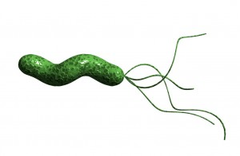
GERD & HP
Preliminary data: positive HP staining
in lung biopsy specimens from severe IPF patients
HP antibody positivity associated with probably less survival (1-year: 66.6% vs. 37%, p>0.05) & more severe disease in IPF (HP-positive IPF patients significantly lower FEV1%, FVC%, TLC%) than HP-negative patients
Yet: PCR from IPF lung biopsies negativ for HP
=> immune-mediated ?
Bennett et al., Eur Resp J 2014, Hogboam et al., WASOG 2014; Kreuter et al. Respiration, 2016

Slide 15
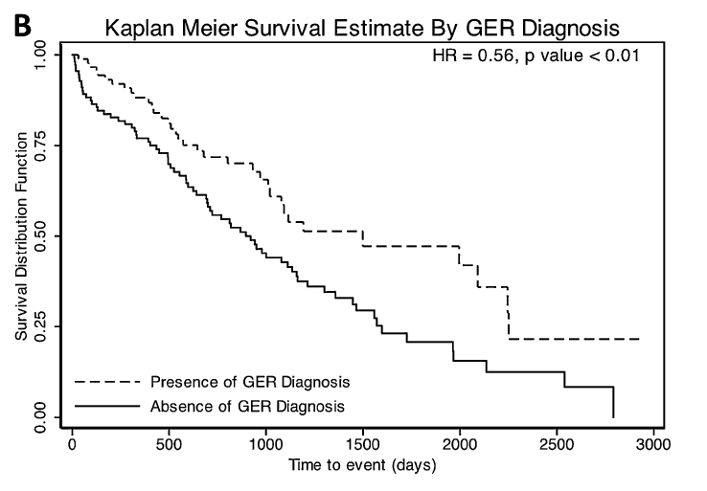
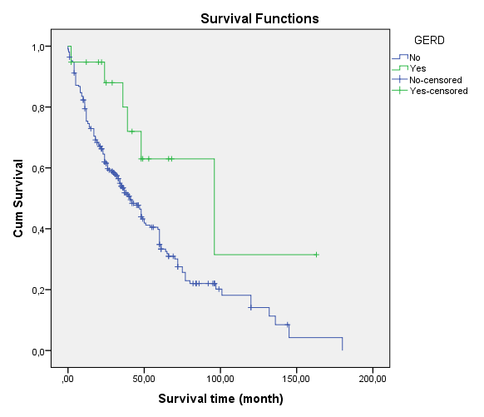
GERD – prognostic relevance ?
p=0.026
N=204;
45% GERD
N=272;
8% GERD
Lee et al., Am J Respir Crit Care Med 184:2011; Kreuter et al., PlosOne 2016
Notes:
Kaplan-Meier survival curves for patients with (N=19; median survival 96 months) or without (N=250; median survival 41 months) (p=0.026

Slide 16
Therapy (?)

Slide 17
Life style modification
Weight loss
Elevation of the bed-head if nocturnal or laryngeal symptoms
Dietary modifications
Avoidance of tight fitting garments
Promotion of salivation through oral lozenges/chewing gum to neutralize refluxed acid and increase rate of esophageal acid clearance.
Avoidance of tobacco & alcohol
Abdominal breathing exercise to strengthen the anti-reflux barrier of the lower esophageal sphincter
Uptodate.com

Slide 18
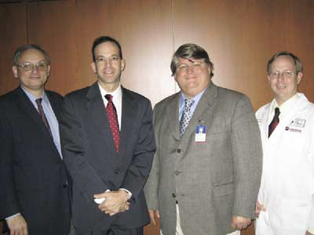
Treatment - role of fundoplicatio
149 IPF pts awaiting LTX
19 pts with GORD
14 fundoplicatio compared to 31 w/o
Aim: prevention of BOS
Fundoplicatio without perioperative complications
Stabilization of IPF-fundoplicatio pts vs. controls
Possible Conclusion:
Safe procedure in severely compromised pts (?)
Linden et al., J Thorac Cardiovasc Surg 2006;131:438-46
Notes:
American Thoracic Society. Idiopathic pulmonary fibrosis: diagnosis and treatment. International Consensus Statement. Am J Respir Crit Care Med. 2000;161:646-664.
Raghu G, Weycker D, Edelsberg J, Bradford WZ, Oster G. Incidence and prevalence of idiopathic pulmonary fibrosis. Am J Respir Crit Care Med. 2006;174:810-816.

Slide 19
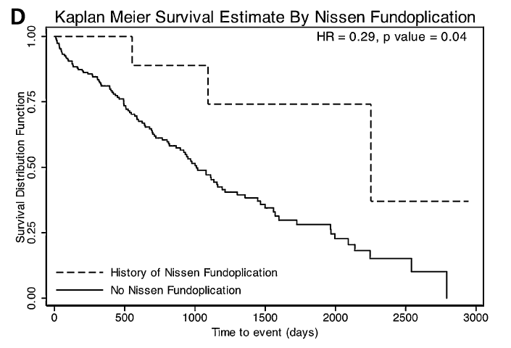
GERD - role of fundoplication ?
N= 11 with surgery
Lee et al., Am J Respir Crit Care Med 184:2011

Slide 20
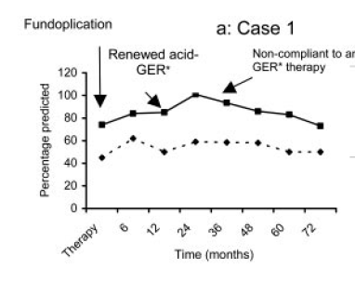
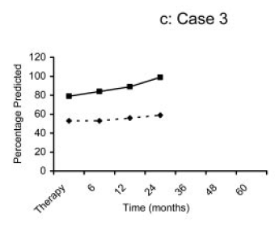
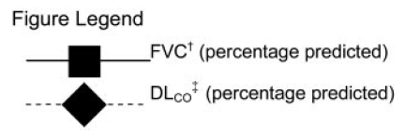
A first observation
4 IPF patients treated by PPI
Authors Conclusion:
Stabilization of IPF in compliant IPF patients
Raghu et al., CHEST 2006; 129:794–800
Notes:
American Thoracic Society. Idiopathic pulmonary fibrosis: diagnosis and treatment. International Consensus Statement. Am J Respir Crit Care Med. 2000;161:646-664.
Raghu G, Weycker D, Edelsberg J, Bradford WZ, Oster G. Incidence and prevalence of idiopathic pulmonary fibrosis. Am J Respir Crit Care Med. 2006;174:810-816.

Slide 21
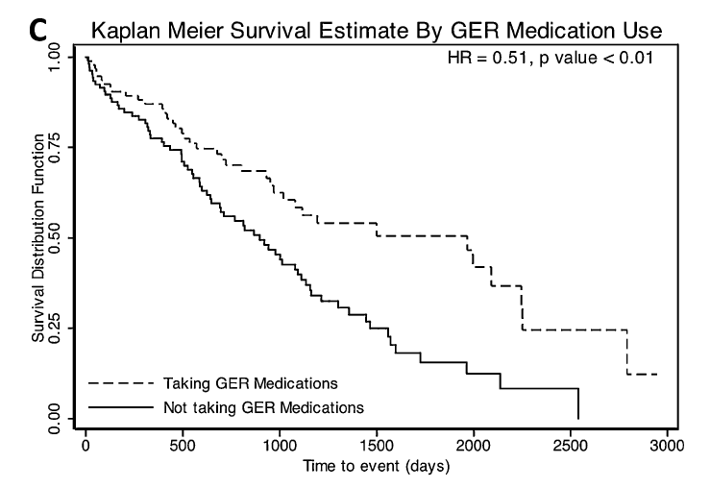
GERD – medical therapy
N=204
Treatment: proton pump inhibitor [n = 86] or H2 blocker [n = 12]
Lee et al., Am J Respir Crit Care Med 184:2011

Slide 22
GERD – medical therapy
GERD-therapy might influence IPF survival
Limitations:
retrospective analysis
Indication to therapy?
Differences between PPI / H2 Blocker ?
Lead time bias ?
earlier IPF diagnosis due to GERD-symptoms
Lee et al., Am J Respir Crit Care Med 184:2011

Slide 23
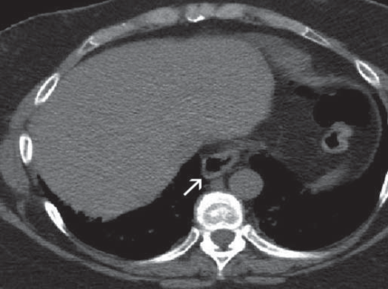
GERD & hiatal hernia on CT
Presence of hiatal hernia significantly higher in IPF:
IPF (39% of n=100), COPD (13.3% of n=60), asthma (16.67% of n=24)
Presence of HH not associated with decreased PFT
IPF & HH under “anti-reflux” therapy similar pulmonary function to those without HH
Pulmonary function lower in pts with HH if not receiving “anti-reflux” therapy
IPF patients with HH: significant differences in antiacid-medication users in DLCO % (40.9%
versus 55.7%, p<0.03)
Noth et al., Eur Respir J 2012; 39: 344–351

Slide 24
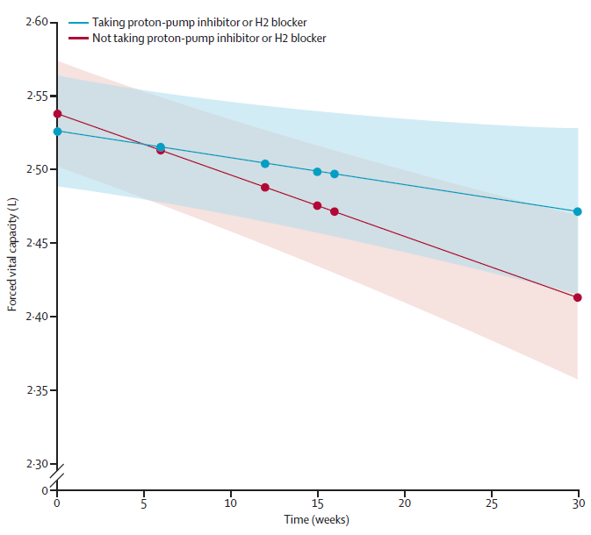
Change in forced vital capacity
p=0.05
fewer exacerbations (p=0.0017)
No difference in all-cause hospital-admission (p=0.18)
& all-cause
mortality (p=0.12)
–0·06 L
–0·12 L
Lee et al., Lancet Resp Med, 2013

Slide 25
International IPF guideline update 2015
Important recommendations
Level of confidence
in effect estimates
Agent
No strong recommendations for any drug
Nintedanib | Conditional recommendation for “We suggest that clinicians use nintedanib in patients with IPF” | ⊕⊕⊕⊝ Moderate
Pirfenidone | Conditional recommendation for “We suggest that clinicians use pirfenidone in patients with IPF” | ⊕⊕⊕⊝ Moderate
Antacid drugs (PPI / H2-blocker) | Conditional recommendation for Previous recommendations in the 2011 guideline were unchanged | ⊕⊝⊝⊝ Very low
N-acetylcysteine monotherapy | Conditional recommendation against Previous recommendations in the 2011 guideline were unchanged | ⊕⊕⊝⊝ Low
Recommendation
Raghu G, et al. Am J Respir Crit Care Med. 2015;192:e3-e19.

Slide 26
Antacid therapy
Conditional recommendation for
⊕⊝⊝⊝, very low confidence
Recommended for all IPF patients, not limited to GERD +
Unchanged from previous recommendations, 2011
Mortality HR 0.47 (0.24–0.93)
FVC, RR 0.73 (0.51–1.04)
AE-IPF, hospitalisation not estimable
Low costs
Raghu G, et al. Am J Respir Crit Care Med 2015;192:e3–e19

Slide 27
Antiacid therapy (AAT) in idiopathic pulmonary fibrosis
Post hoc analysis of placebo arms of ASCEND & CAPACITY
1.0
Unadjusted 1-year progression free survival
0.8
0.6
Survival probability
AAT users had similar progression-free survival compared with no AAT users
0.4
0.2
+ Censored Log-rank P=0.4002
Placebo + AAT
Placebo + no AAT
0.0
0
100
Time, days
200
300
400
Progression-free survival was defined as time to the first occurrence of any one of the following: a confirmed decrease of ≥10% predicted FVC, a confirmed decrease of ≥50 m in the 6-minute walk distance, or death. Kaplan-Meier estimator and log-rank test.
Kreuter et al., Lancet Respir Med, 2016

Slide 28
Effect of anti-acid medication on reduction in FVC decline with nintedanib: Post hoc analysis
 | Antacid medication at baseline |  | No antacid medication at baseline
 | Nintedanib (N=244) | Placebo (N=162) | Nintedanib (N=394) | Placebo (N=261)
Patients with ≥1 acute exacerbation, N (%) | 12 (4.9) | 19 (11.7) | 19 (4.8) | 13 (5.0)
HR (95% CI) | 0.40 (0.19-0.83) |  | 0.99 (0.49-2.00)
Treatment-by-subgroup interaction | P=0.0949
Mean (SE) observed change from baseline in FVC (mL)
Antacid medication at baseline – nintedanib, N=239
No antacid medication at baseline – nintedanib, N=387
Antacid medication at baseline – placebo, N=160
No antacid medication at baseline – placebo, N=257
Raghu, et al. ERS 2015. Session 462

Slide 29
Review on ILD & reflux
Systematic review literature 1980-2010
319 ms, 22 met entry criteria
IPF: prevalence 67–76%
No relationship between severity of GERD and severity of IPF [Evidence B]
Correlation between severity of ILD and degree of oesophageal motor impairment in patients with SSc and MCTD [Evidence B]
Hershcovici et al., Aliment Pharmacol Ther 2011; 34: 1295–1305, 2011
Notes:
American Thoracic Society. Idiopathic pulmonary fibrosis: diagnosis and treatment. International Consensus Statement. Am J Respir Crit Care Med. 2000;161:646-664.
Raghu G, Weycker D, Edelsberg J, Bradford WZ, Oster G. Incidence and prevalence of idiopathic pulmonary fibrosis. Am J Respir Crit Care Med. 2006;174:810-816.

Slide 30
Other ILDs & reflux
Pulmonary & oesophageal involvement in SSc common
SSC-ILD: higher oesophageal acid exposure, more acidic and non-acidic reflux, more reflux episodes reaching proximal oesophagus
SSc patients with severe oesophageal motor impairment compared with those with mild and w/o
significant decrease in DLCO (68% vs. 94% vs. 104%, p=0.048), higher prevalence of ILD (57% vs. 27% vs. 18%, P = 0.037).
faster deterioration of DLCO (p = 0.02)
Marie I, et al. Arthritis Rheum 2001; 45: 346–54.Hershcovici et al., Aliment Pharmacol Ther 2011; 34: 1295–1305, 2011; Savarino, et al. Am J Respir Crit Care Med 2009; 179: 408–13
Notes:
American Thoracic Society. Idiopathic pulmonary fibrosis: diagnosis and treatment. International Consensus Statement. Am J Respir Crit Care Med. 2000;161:646-664.
Raghu G, Weycker D, Edelsberg J, Bradford WZ, Oster G. Incidence and prevalence of idiopathic pulmonary fibrosis. Am J Respir Crit Care Med. 2006;174:810-816.

Slide 31
Caveats of GERD in ILD
Pathobiologic or -genetic mechanism (chicken & egg) ?
Consider: abnormal reflux due to increased pressure gradients across diaphragm, changes in pulmonary mechanics, or secondary to medication effects
Survival: lead time bias due to symptoms ?
Does treatment affect prognosis ?
Antacids conditional recommendation in IPF guideline which recent data do not support
Potentially harmful side-effects (infections, electrolyte disturbances, drug interactions)
Tzouvelekis et al., Editorial, Lancet Resp Med 2013,
Kreuter et al., Lancet Respir Med, 2016

Slide 32
Notes:
Poll Title: 22.1 Which sentence is correct? https://www.polleverywhere.com/multiple_choice_polls/N0xxAib5oXdFdUt

Slide 33
Notes:
Poll Title: 22.2 Which sentence is incorrect? https://www.polleverywhere.com/multiple_choice_polls/uiVDP25Wm1PEgtt

Slide 34
Notes:
Poll Title: 22.3 Which sentence is correct? https://www.polleverywhere.com/multiple_choice_polls/I78aHWWPgQnV6Bl

Slide 35
Thank you

