Slide 1
Fa1 so

Slide 2
Air pollution and vulnerability of children to respiratory infections
Jonathan Grigg
Centre for Paediatrics
Queen Mary University London

Slide 3
particulate matter (PM less than 10μm)

Slide 4
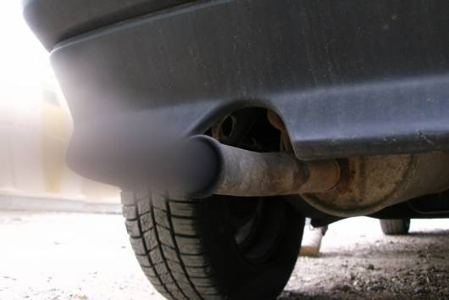
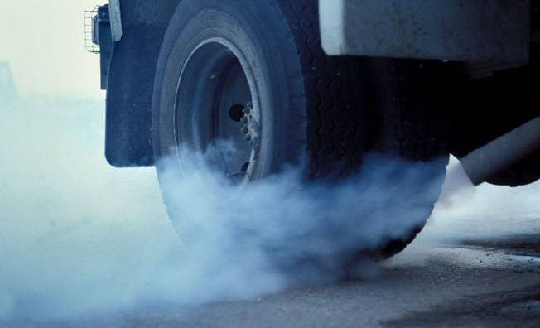

Slide 5
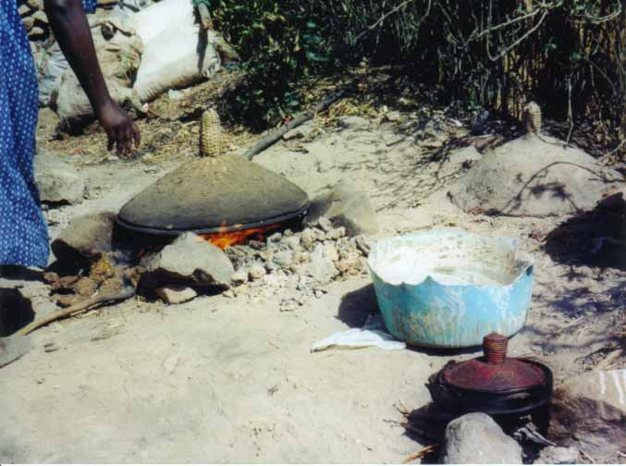

Slide 7
 | Indoor (PM_{2.5} μg/m³) | Outdoor (PM_{2.5} μg/m³)
Indoor smoking allowed | 120 | 29

Slide 8
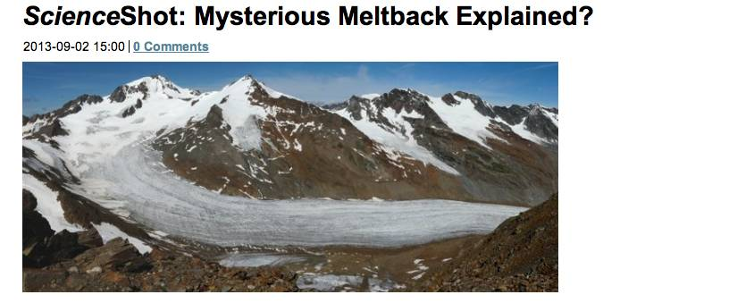
http://news.sciencemag.org/climate/2013/

Slide 11
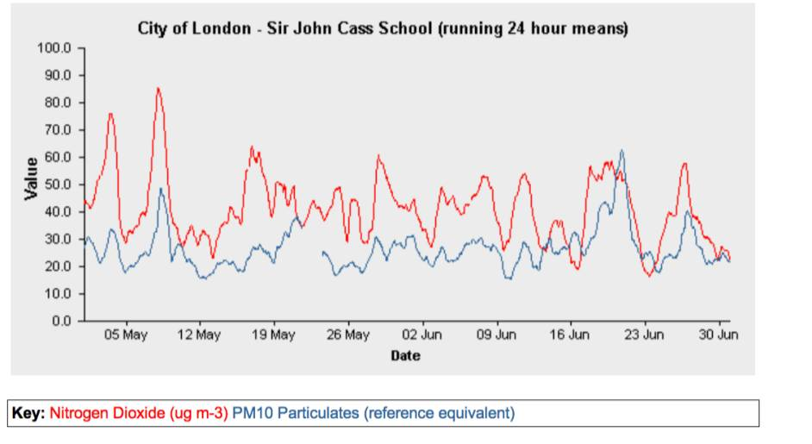
Nitrogen dioxide is a marker for PM

Slide 13
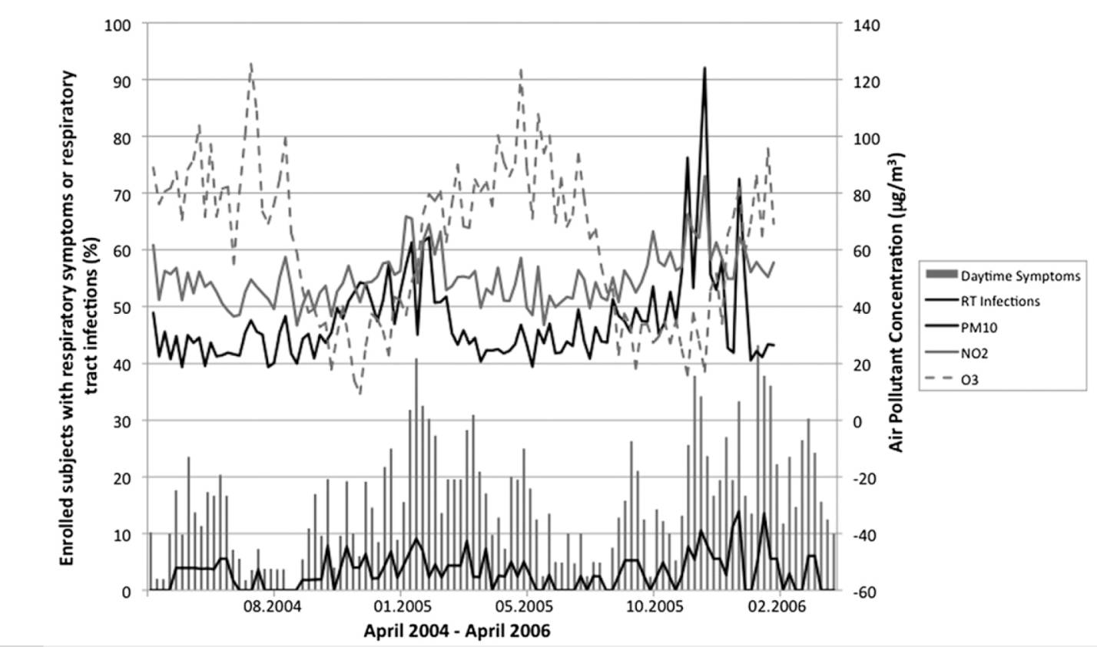

Slide 14
no association between PM₁₀/NO₂ with;
occurrence respiratory infections
severity of symptoms

Slide 15
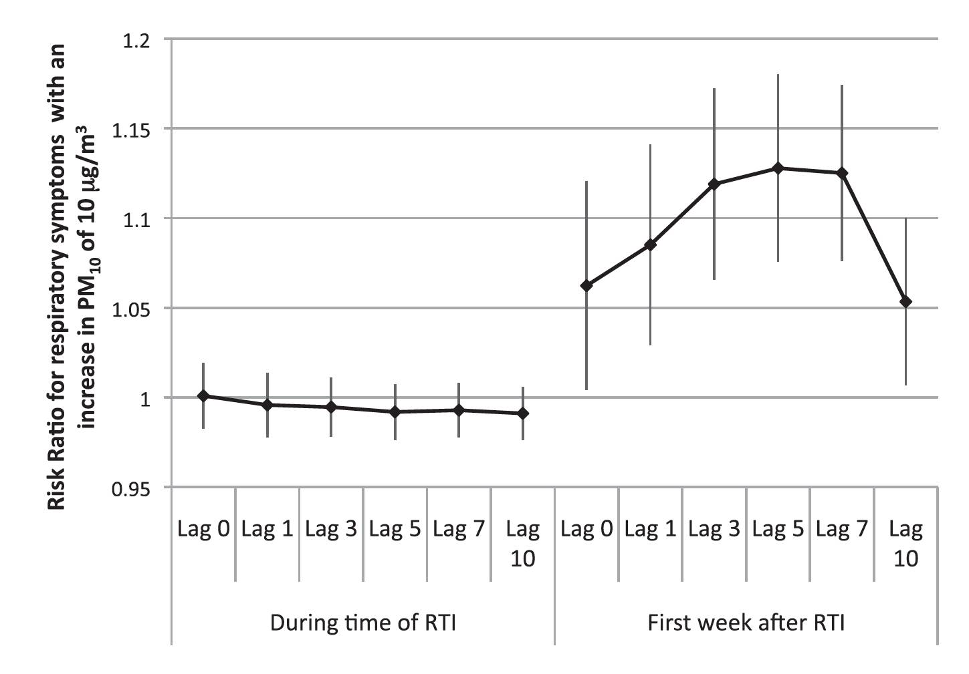

Slide 16
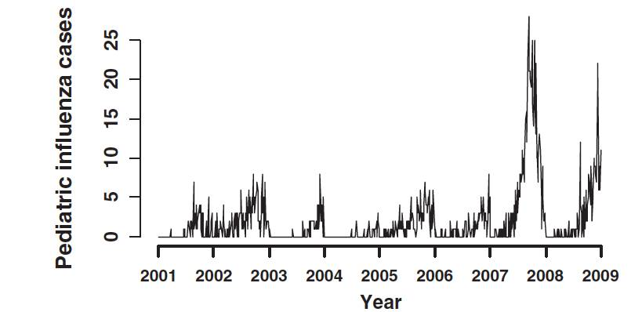
2922 paediatric flu admissions

Slide 17
mean 10 day lag (moving average)
 | RR | 95%CI
Mean temperature | 0.77 | 0.6 to 0.9
PM₁₀ | 1.06 | 1.05 to 1.07

Slide 18
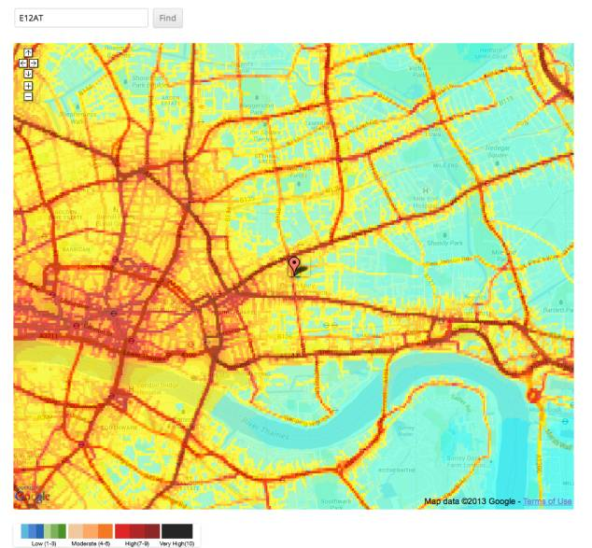
http://breathe-drydengoodwin.net

Slide 19
part of the INMA study (Spain)
2,200 infants
modeled pre- and post-natal exposure to NO₂
outcome at 12 to18 months
“has a doctor told you your son/daughter has had a chest infection?”

Slide 20
high correlation between pre-and post- natal exposure
10 μg/m³ increase in average outdoor NO₂ during pregnancy was associated with
LRTI relative risk= 1.05 (0.98 to 1.12)
ear infections rr = 1.18 (0.98 to 1.41)

Slide 22
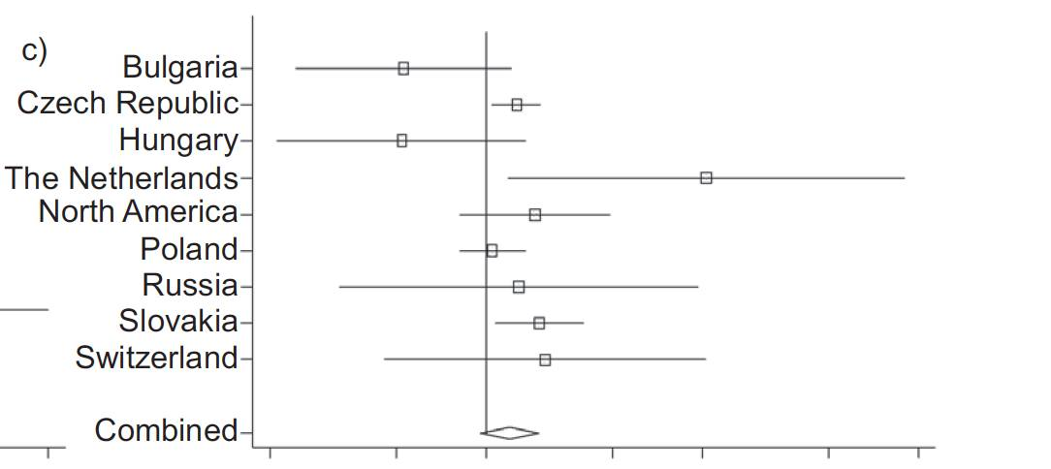
bronchitis (10μg/m³ mean annual)

Slide 23
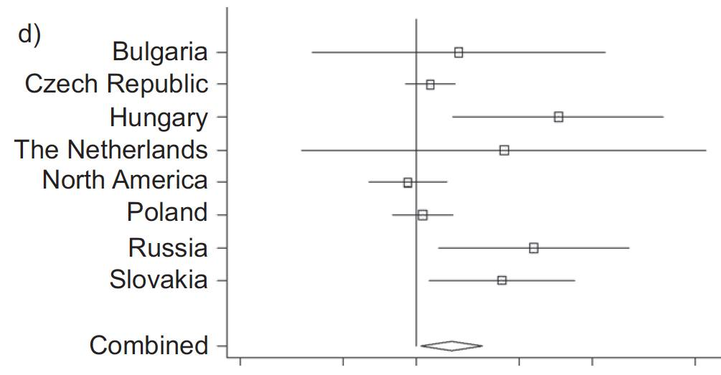
phlegm (10μg/m³ mean annual)

Slide 25
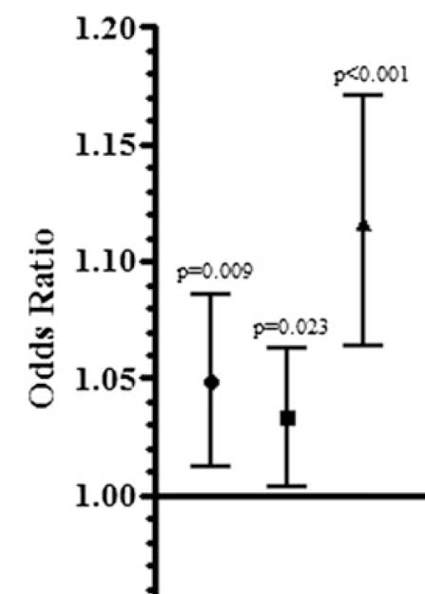
Start of IV or oral antibiotic treatment
Lag 0
PM₁₀
NO₂
Odds
Ratio
p<0.001
p<0.01

Slide 26
for 10μg/m³ increase (on the day and the day before) in exposure of a CF patient there is an increase risk for exacerbation of;
4.3% for PM₁₀
10.6% for NO₂

Slide 28
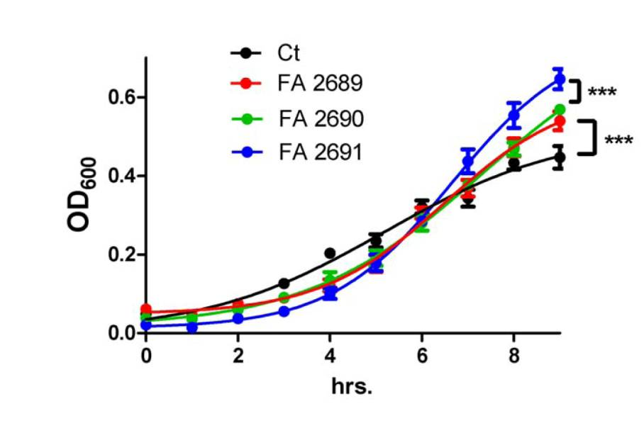
Pseudomonas growth

Slide 29
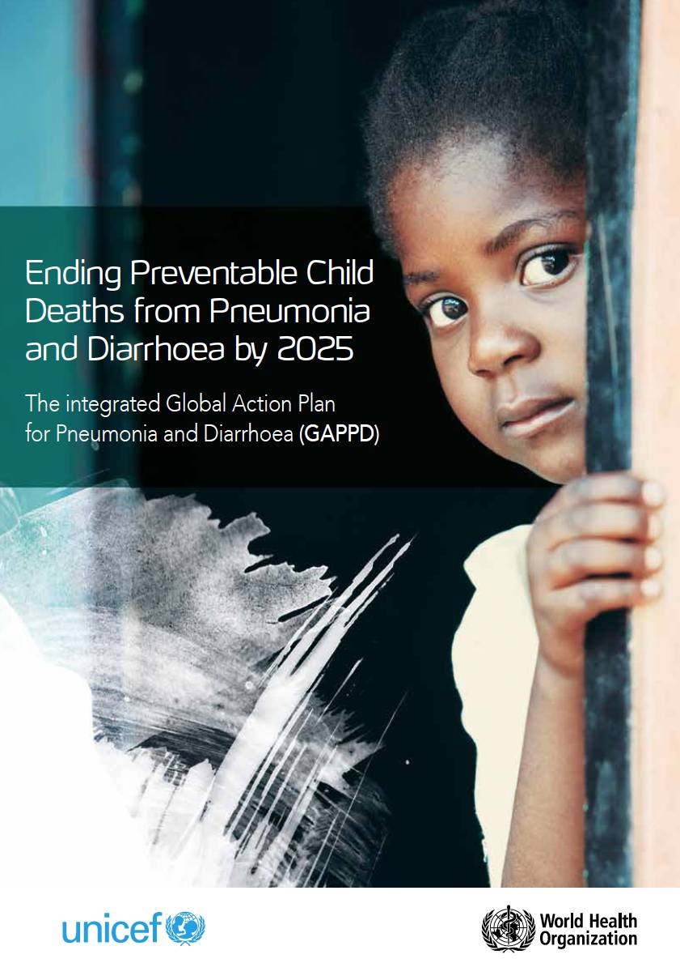

Slide 30
Am J Respir Crit Care Med. 2012; 185(6):687-8
María Alejandra Mena M.D. , Fernando Woll M.D. ,et al
histopathological analysis
4 accidental deaths
biomass exposed Peruvian children
3/4 “bronchitis”

Slide 31
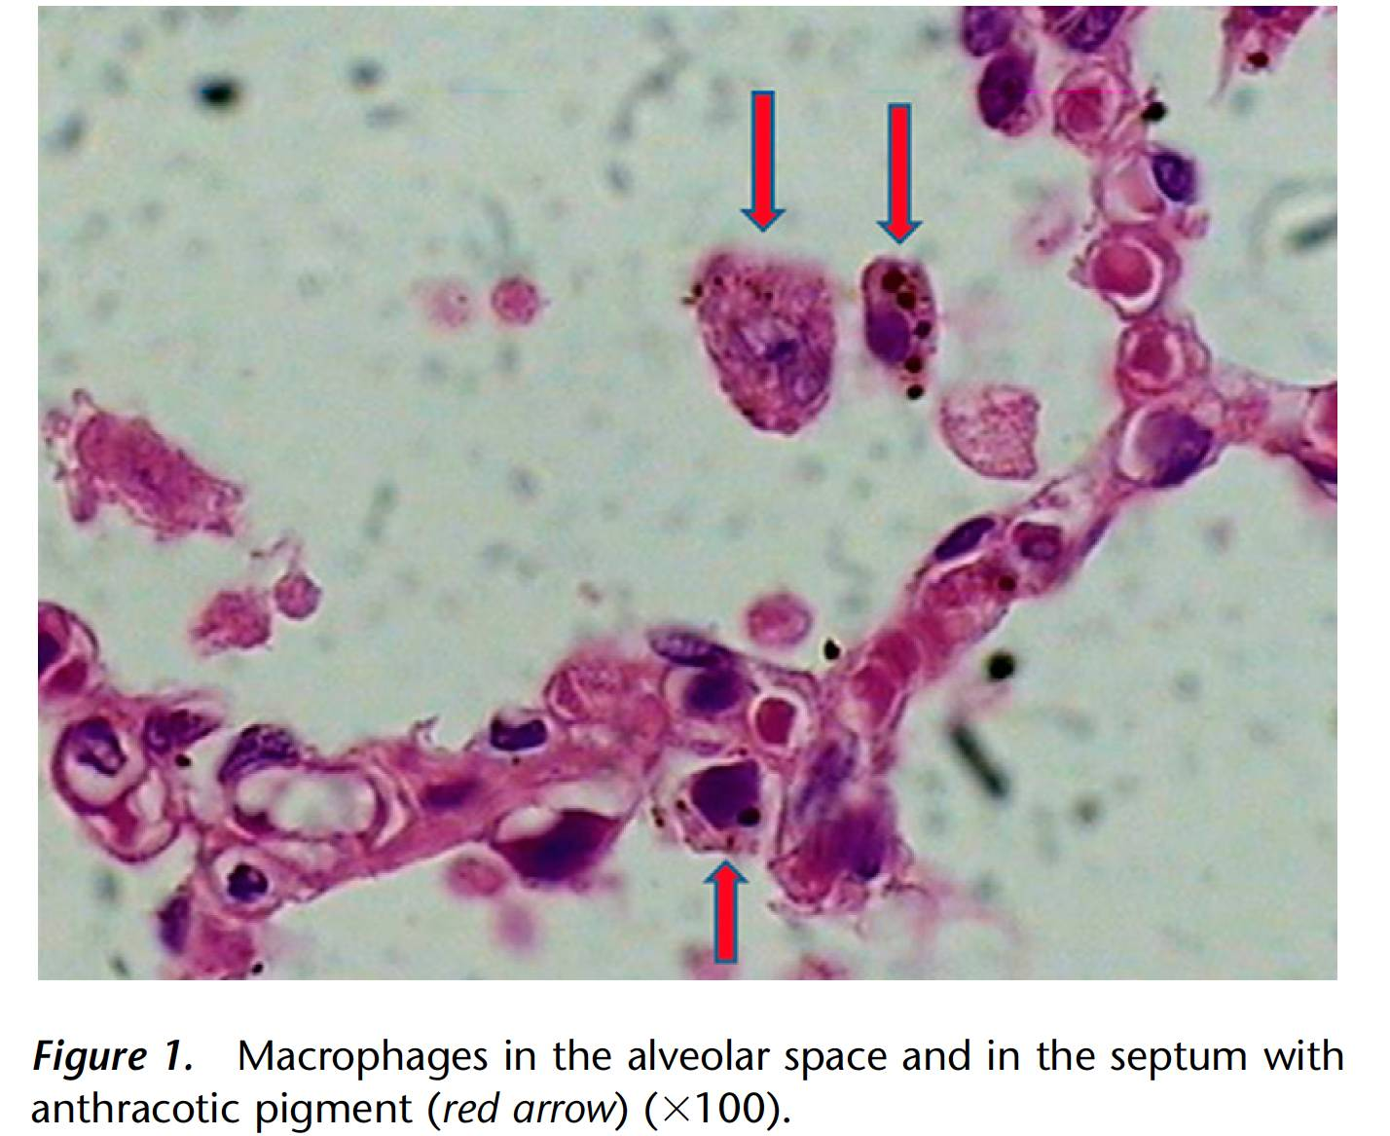
Am J Respir Crit Care Med. 2012; 185(6):687-8

Slide 34
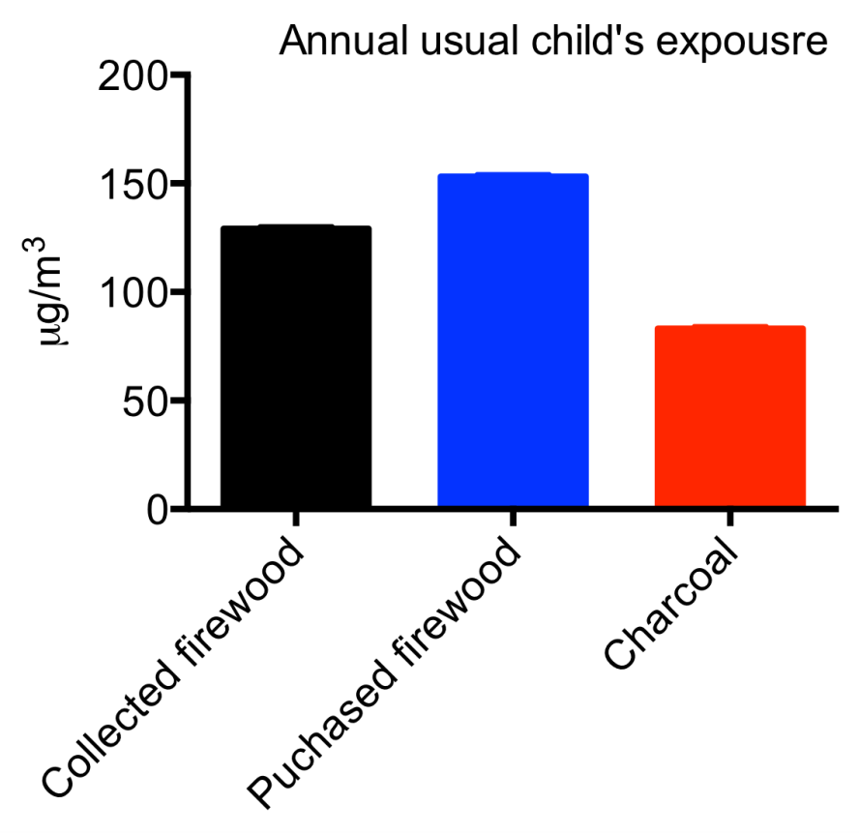

Slide 35
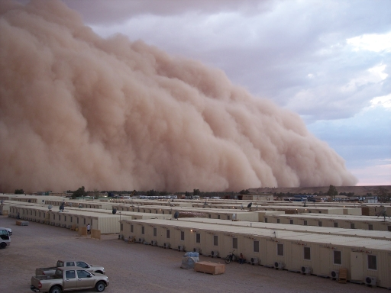

Slide 36
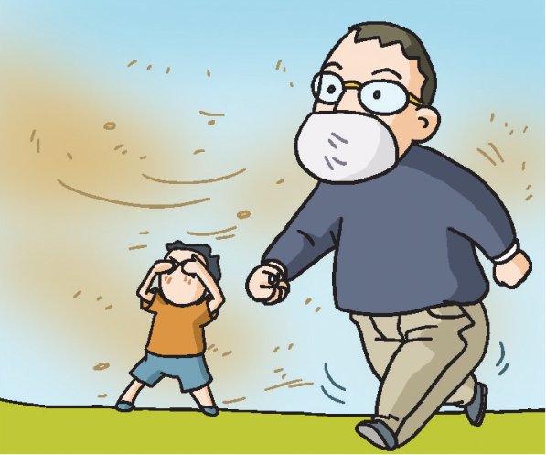
vulnerable people avoid outdoor activity
wash hands and feet on returning home
check windows
http://eng.nema.go.kr

Slide 37
1,025,990 pneumonia admissions
36% children

Slide 38
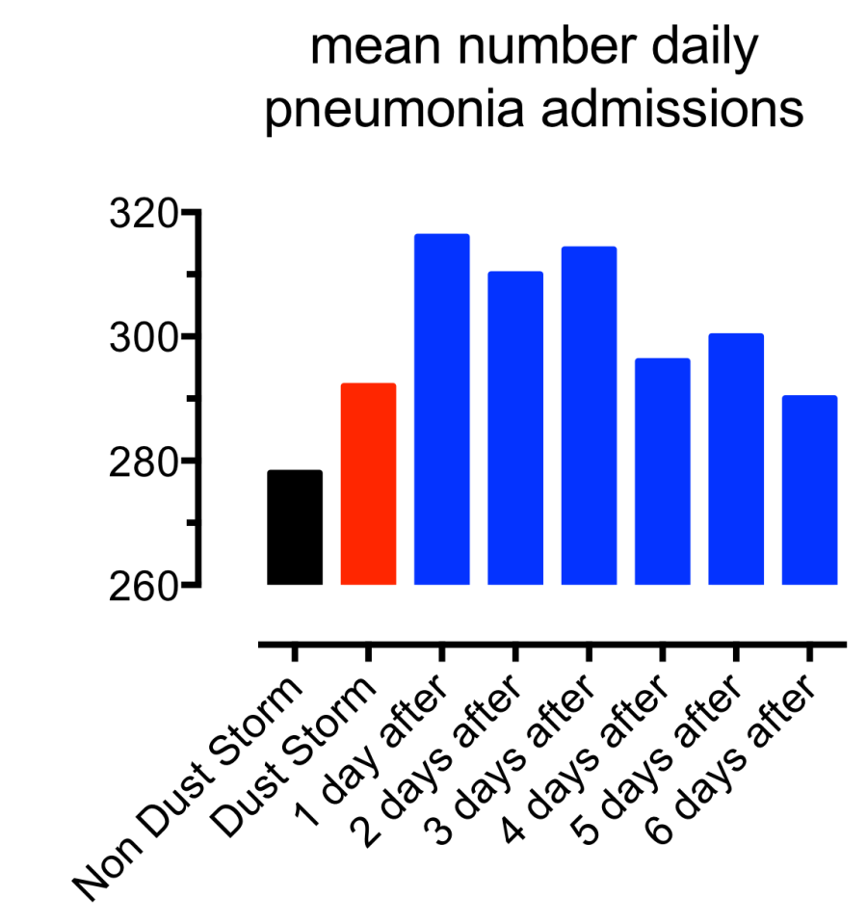

Slide 39
children 7 to 17 yr
 | p value
Day of dust storm | 0.27
1 day post | 0.007
2 days post | 0.03
3 days post | 0.001
4 days post | 0.116
5 days post | 0.76

Slide 40
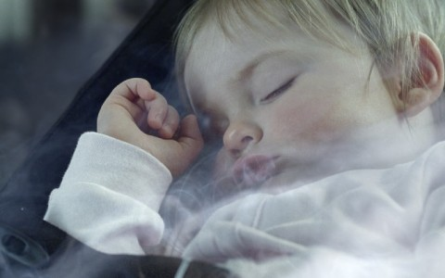

Slide 42
at least 1 type of ETS exposure was associated with statistically significant increases in risk
12 of 14 studies positive for risk of hospitalization or ED visit for laboratory confirmed RSV bronchiolitis

Slide 44
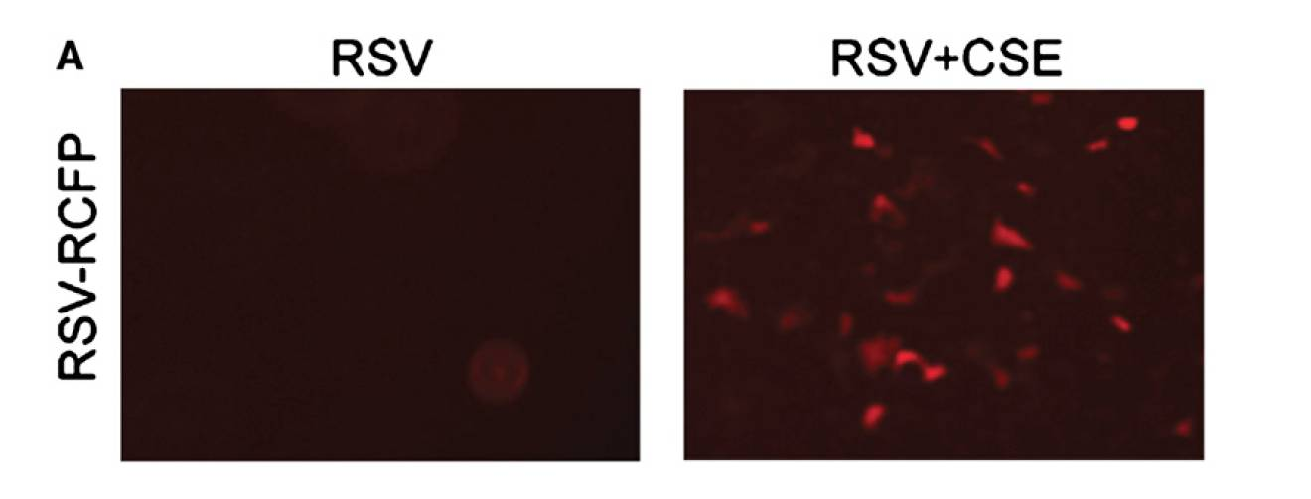
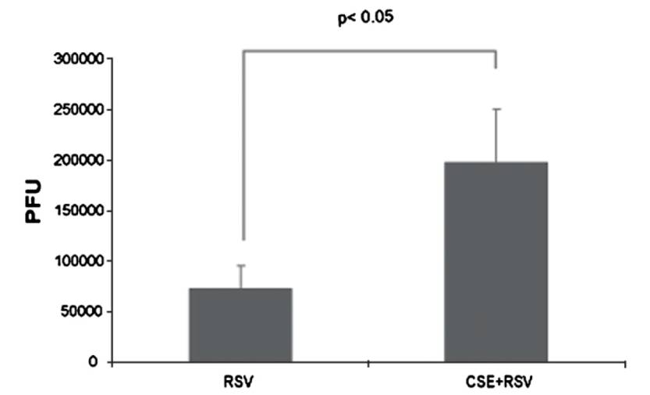

Slide 45
J Pediatr 2013;162-21
117 children admitted with influenza
40% exposed to second hand smoke

Slide 46
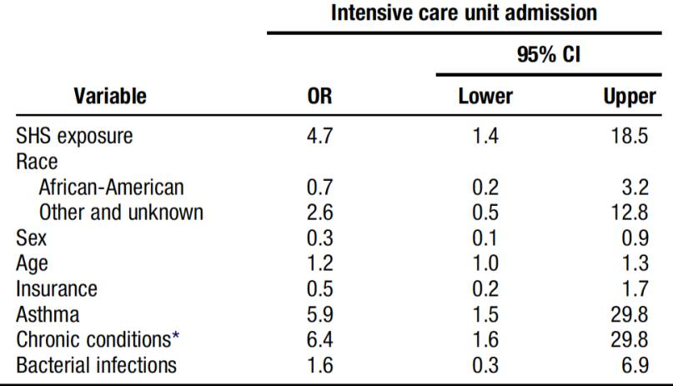
SHS exposed
increased need for intensive care
increased need for intubation
increased length of stay
J Pediatr 2013;162-21

Slide 48
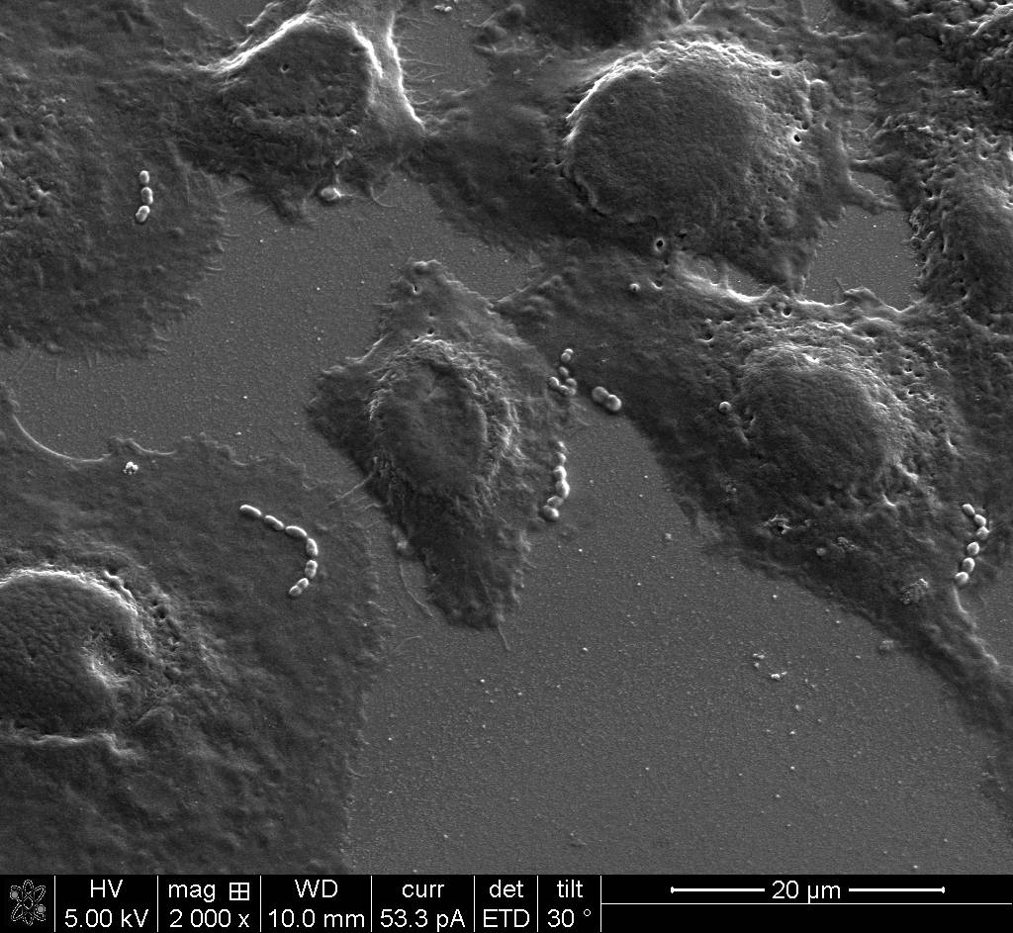

Slide 49
Bacterial cell wall
CHoP
Host airway cell wall
PAFR

Slide 50
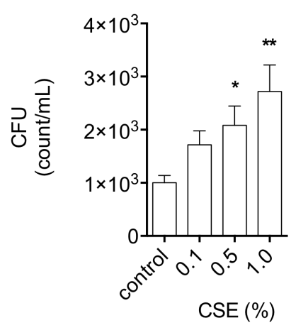
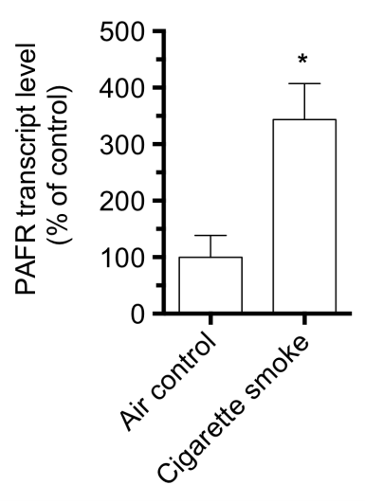

Slide 51
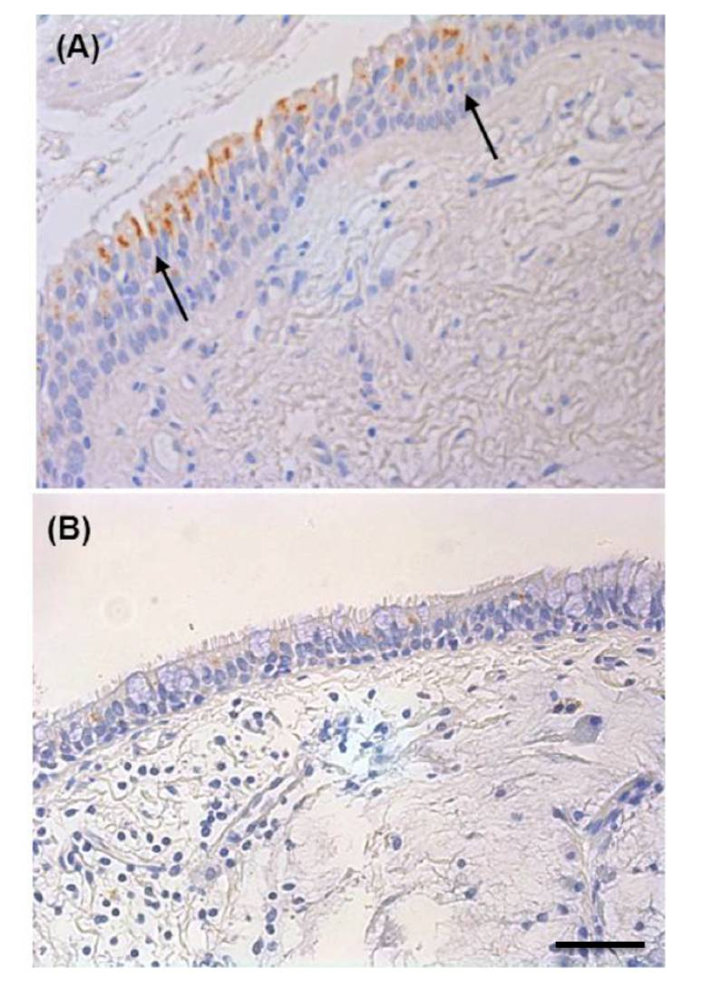

Slide 53
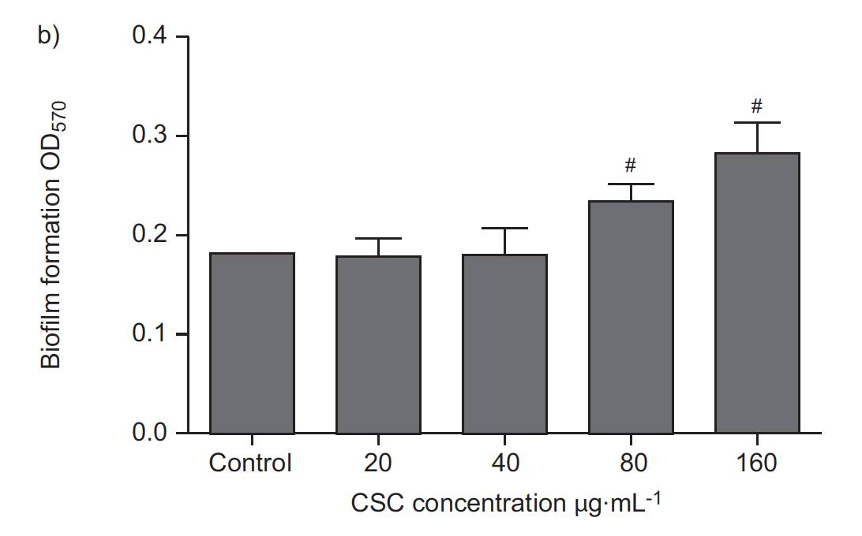

Slide 55
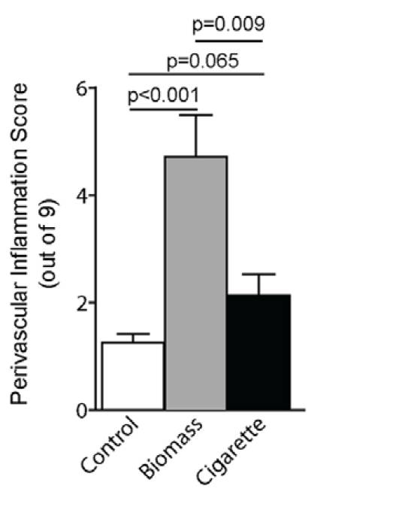
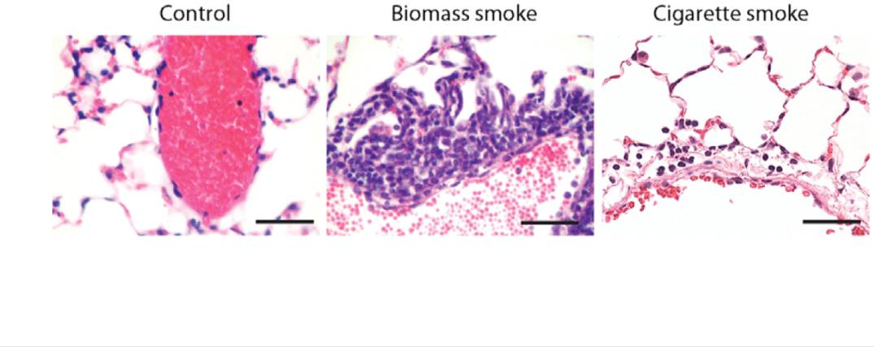

Slide 56
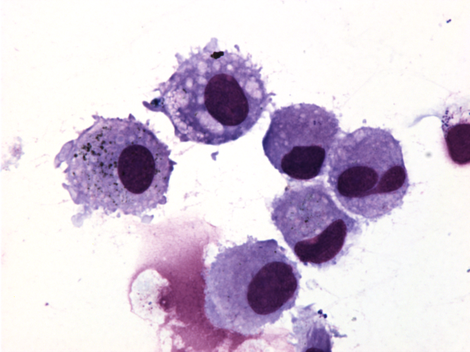
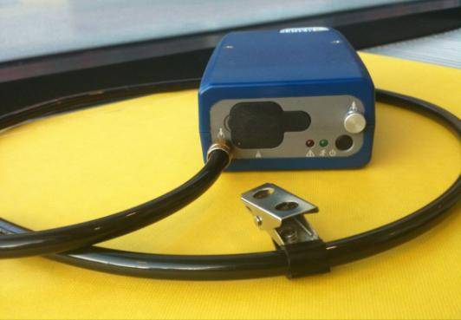
personal exposure

Slide 58
summary
increasing evidence of an association between air pollution and both bacterial and viral respiratory tract infections
more studies needed
to establish biological plausibility
biomarkers of vulnerability
linking individual exposure to risk

Slide 59
