Slide 2
CELL THERAPY IN ILD
Thomas Geiser
Bern, Switzerland

Slide 3
Introduction
AIMS
What is the rational using (stem) cells as a novel therapy in IPF ?
Methodological issues
Which cells to be used ?

Slide 4
Old Hypothesis
Current Hypothesis
Stimulus
Repeated stimuli
Chronic
inflammation
Sequential lung injury
Inflammation
Injury
Aberrant wound repair
Fibrosis

Slide 5
Typ I
Alveolar epithelium
Typ II
Growth factors
PDGF, TGF-β
Endothelin-1
Coagulation activation
Fibrinous
matrix
Proteases
Antiproteases
Myofibroblasts
Notes:
Schema 2
Inhalative Noxen führen zu epithelialer Schädigung
Apoptose des Alveolarepithels, va type I Alveolarepithelzellen
Destruktion der Basalmembran
Gerinnungsaktivierung, eigene Daten mit tissue factor
Fibroblastenaktivierung, Sekretion von Wachstumsfaktoren für Fibroblasten (Platelet derived growth factor, transforming growth factor b, endothelin-1 und viele andere ), Differenzierung von in (Myo)fibroblasten, welche in die provisorische fibrinöse Matrix einwandern.

Slide 6
Growth factors
Fibrinous
Matrix
Neoangiogenesis
Collagen
Keratinocyte Growth Factor (KGF)
Hepatocyte Growth Factor (HGF)
Am J Physiol
Lung 2004, 2007

Slide 7
Endogenous and
exogenous stem cells
Adapted from Selman, Ann Intern Med. 2001;134:136-51.

Slide 8
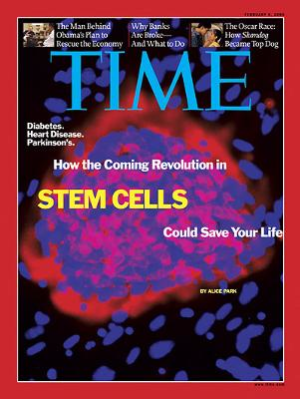

Slide 10
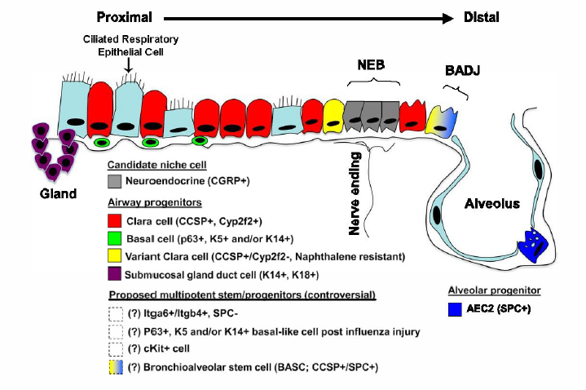
LUNG STEM AND PROGENITOR CELLS
Endogenous lung stem
and progenitor cells
Circulating and exogenously
administered
stem/progenitor cells
Resident lung progenitor cells
located in niches along the airway
tract
Endothelial progenitor cells
(Bone marrow-derived)
mesenchymal stem cells
Embryonic stem cells
Induced pluripotent stem cells
Weiss et al, Stem Cells 2014

Slide 11
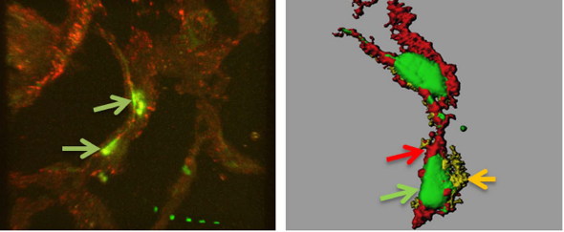
BMSC engraft and interact with the injured alveolar epithelium in the animal model
Gazdhar, Geiser et al PLOS 2013

Slide 12
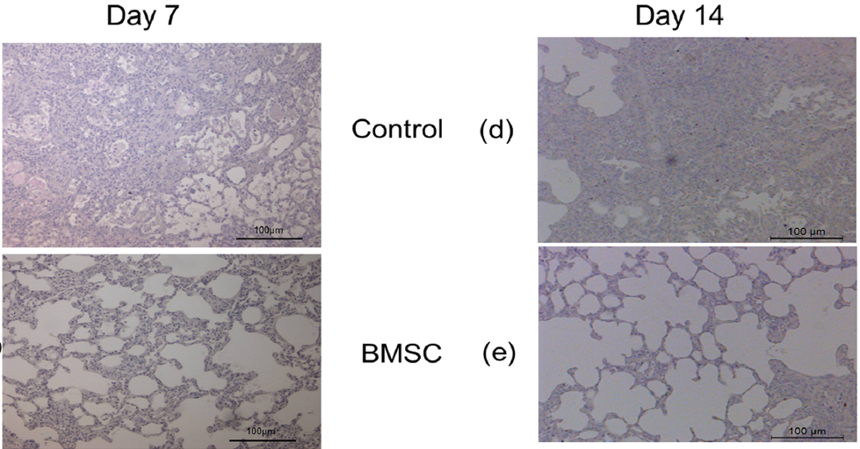
Intratracheally administered bone marrow derived mesenchymal stem cells (BMSC) are antiinflammatory and antifibrotic
Gazdhar, Geiser et al, PLOS 2013

Slide 13
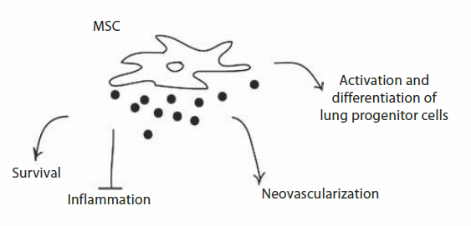
THE SECRETED PRODUCTS (SECRETOME) OF BMSC ARE ANTIFIBROTIC
Antifibrotic

Slide 14
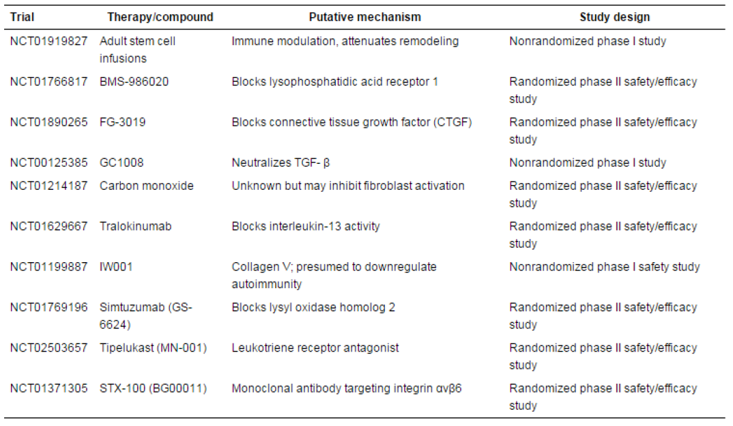
ONGOING CLINICAL TRIALS IN IPF
adapted from clinicaltrials.gov and George et al., 2016

Slide 15
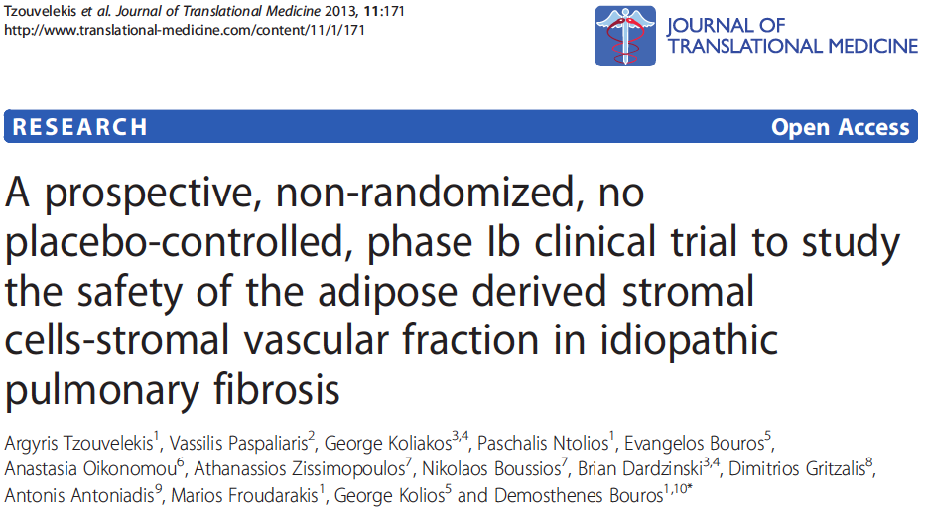
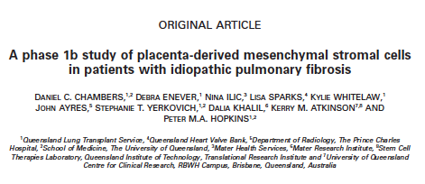
Clinical stem cell trials in IPF

Slide 16
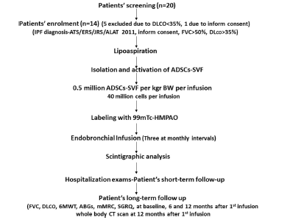
Study protocol
Tzouvelekis et al, J Trans Med 2013

Slide 17
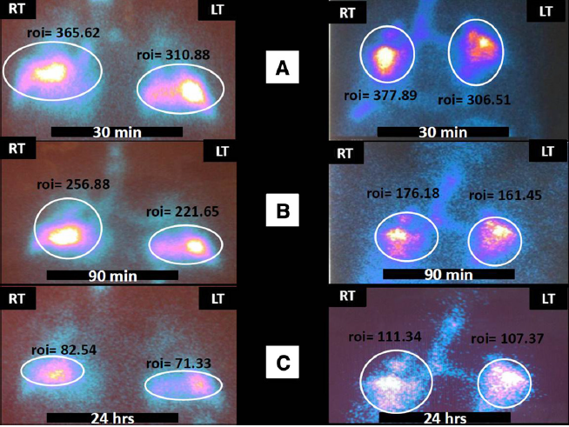
Stem cells in ipf patients
Tzouvelekis et al, J Trans Med 2013

Slide 18
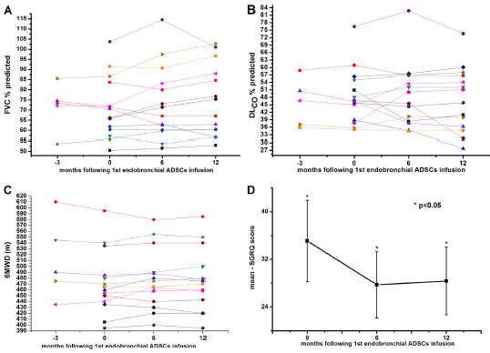
results
Tzouvelekis et al, J Trans Med 2013

Slide 19
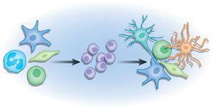
Induced pluripotent stem cells (iPSC) as a novel therapeutic approach in IPF ?
polycystronic lentiviral vector encoding 4
reprogramming factors
(OCT4, SOX2, KLF4, and c-MYC)
Somatic cells
(Fibroblasts,
muscle cells,
fat cells)
iPS cells
iPSC secretome
Differentiated cells to any cell type

Slide 20
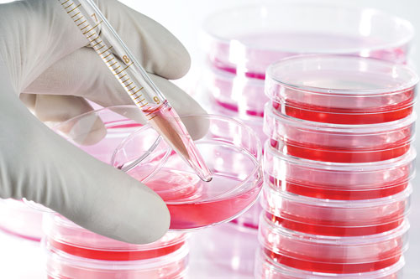
THERAPEUTIC APPROACHES USING IPS CELLS OR THEIR SECRETOME
Skin biopsy
Adult fibroblasts
Reprogramming factors: OCT4, SOX2, KLF4 and c-MYC
iPSC
Differentiation
Autologous
transplantation
Secretome

Slide 21
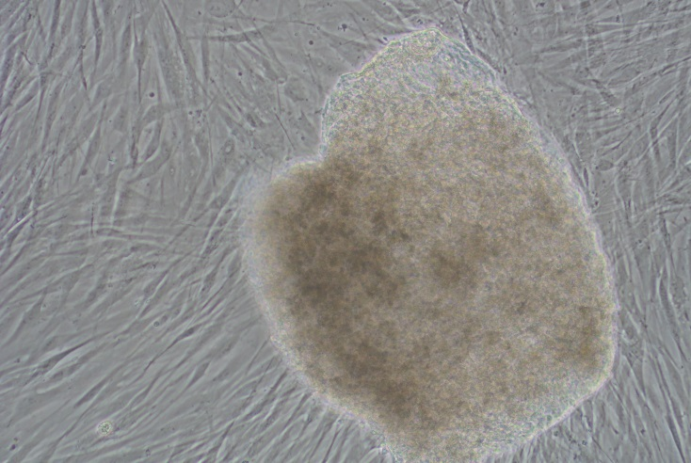
iPSC characterization
Nanog
Oct4
Tra1-60
50μm
50μm
50μm
(Tamo, Gazdhar, Geiser al., under submission)

Slide 22
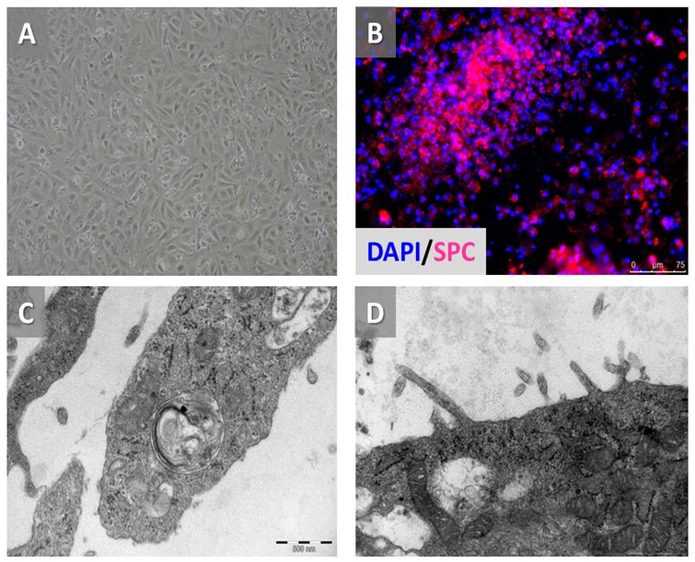
- Generation of a new cell line -
Differentiated alveoalar epithelial cells originating from iPSC
(Tamò L. et al., submitted)

Slide 23
- The role of iPSC in lung repair and regeneration -

Slide 24
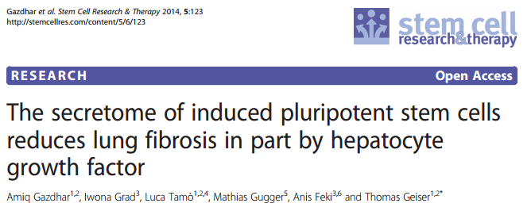
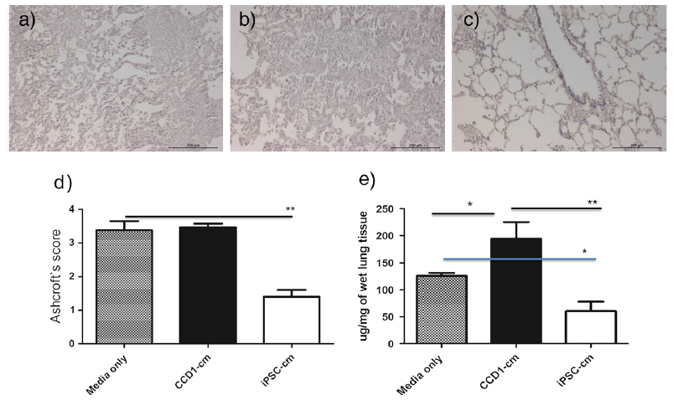

Slide 25
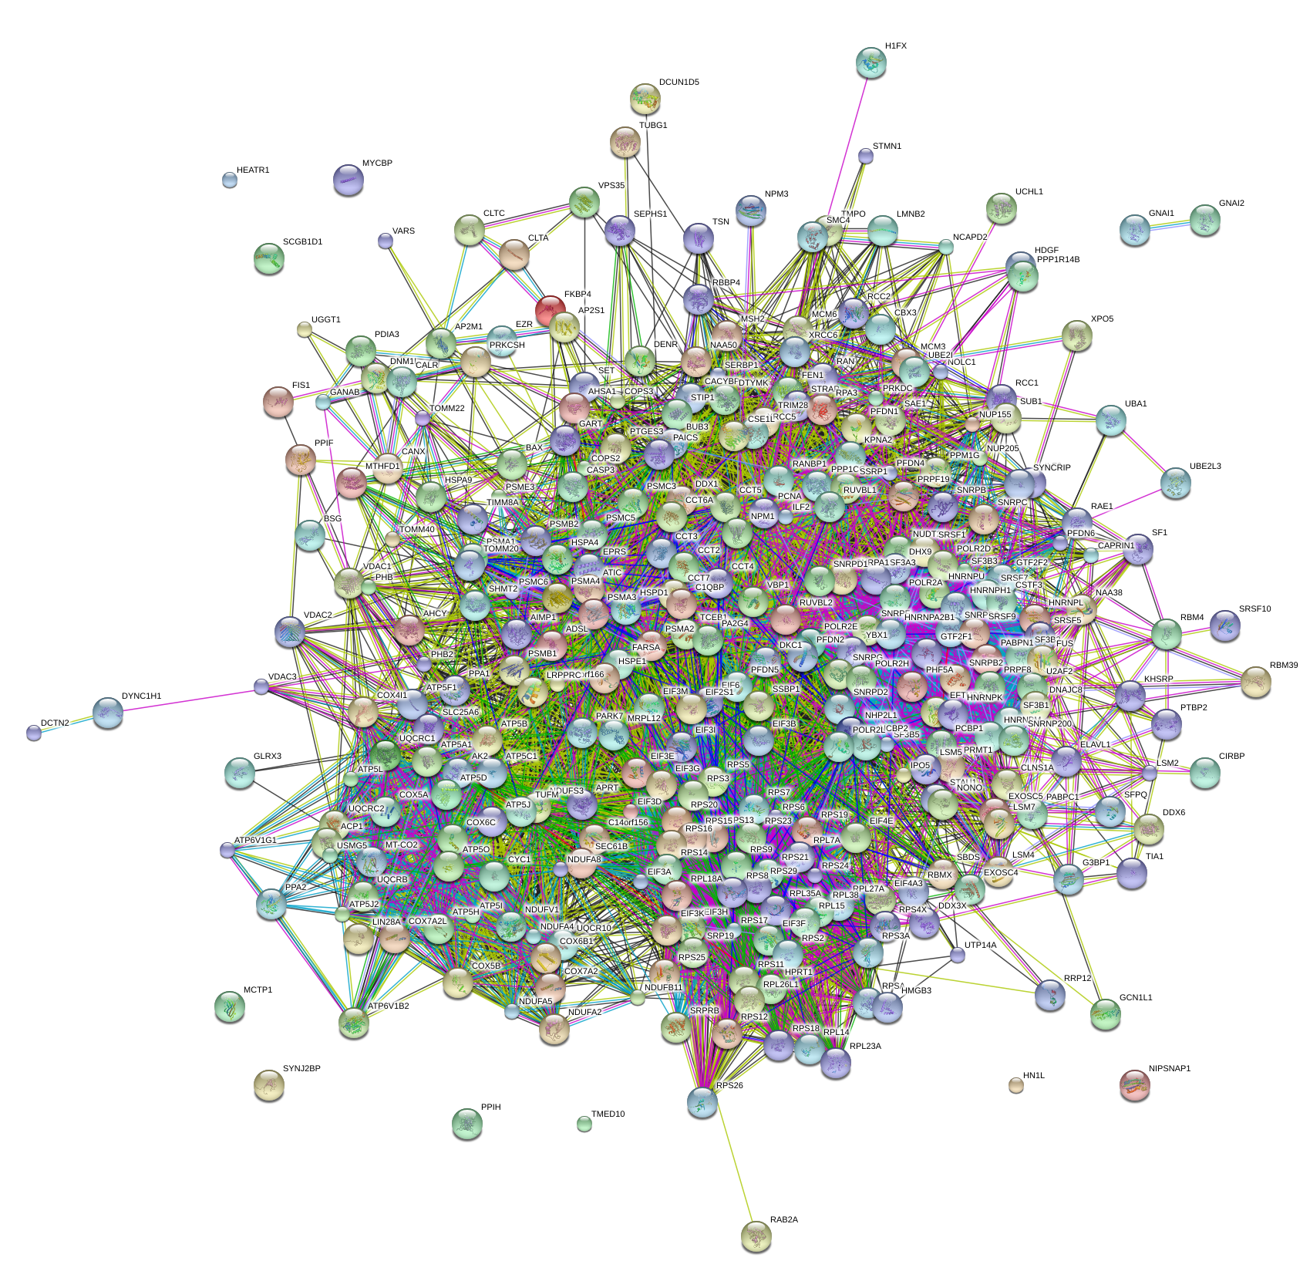
IPSC SECRETOME : A BIG SECRET ?
Presented at ERS Lung Science Conference, Estoril 2016

Slide 26
PRO cell based therapies in ild
Biological rationale
Positive animal studies
Disease with poor prognosis
Lack of effective treatment
Complex disease (single target approach will probably not be successful)

Slide 27
Open questions regarding stem cell therapies
Which type of stem cells ?
How to prepare before use
How to apply (route of application ?)
Dosage (Cell numbers, single vs repeatedly)
When ? (within the course of the disease)
Adverse effects ? (short – long term)
Which ILD to be treated ?
Mechanisms ?

Slide 28
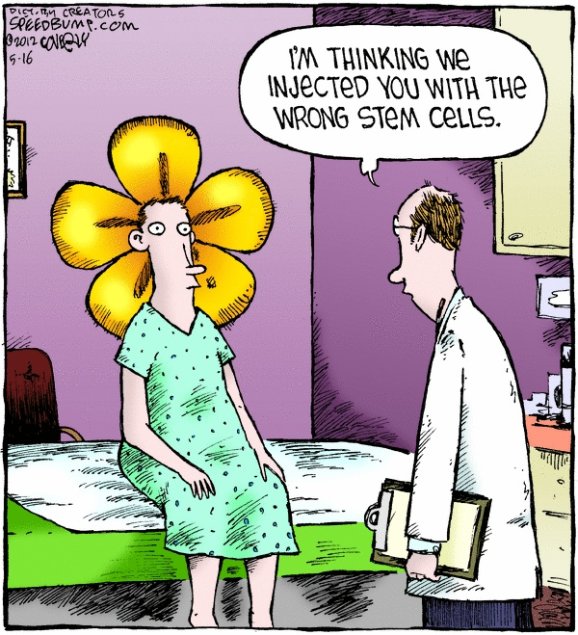

Slide 29
Are stem cells the future cure of IPF ?
Yes, hopefully, but...
- we need more research on stem cell biology and their role in disease
- we need well designed, high quality clinical trials

