Slide 1
Thank you for viewing this presentation.
We would like to remind you that this material is the property of the author. It is provided to you by the ERS for your personal use only, as submitted by the author.
2014 by the author

Slide 2
LAM Patient Priority Setting Workshop
Understanding and addressing unmet needs in LAM treatment, management and research
50 patients, patient groups, professionals and industry
Tuesday, 9 September
09.00-12.00

Slide 3
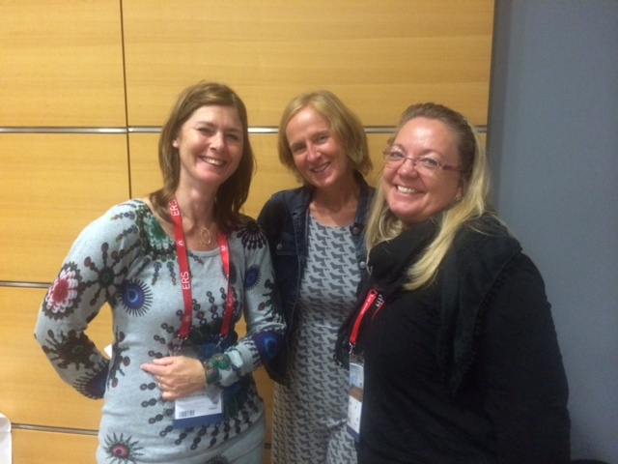
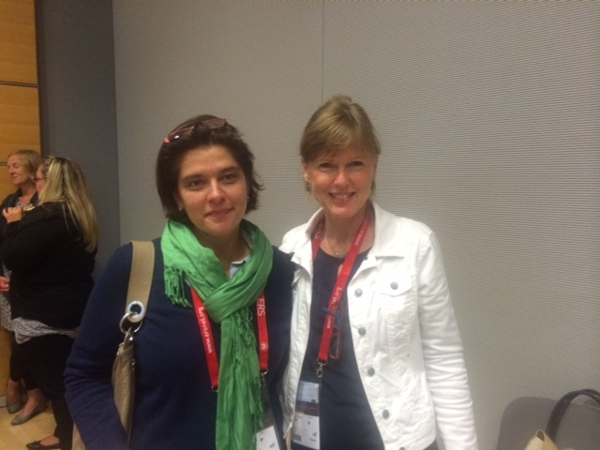
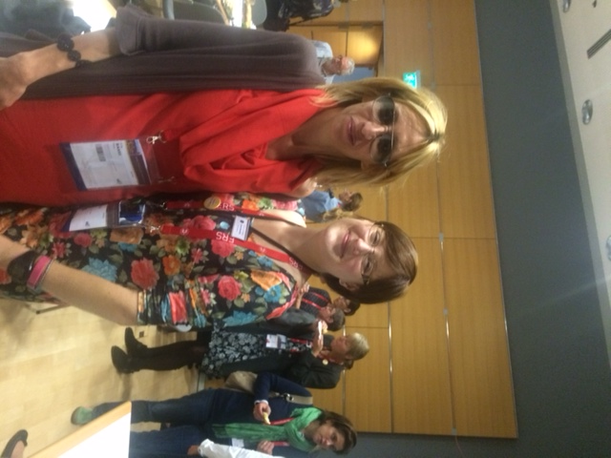
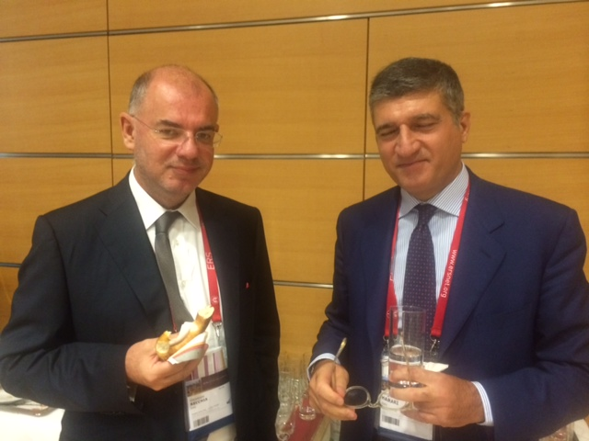

Slide 4
Workshop aims
To bring together people affected by Lymphangioleiomyomatosis (LAM) and people working in the field of LAM to discuss the priorities of patients and potential solutions.
To reach agreement on the actions needed by patients, healthcare professionals and industry to improve LAM treatment and care, in response to the priorities identified in the LAM survey.
To identify the information needs of patients and their families and if there is a need for a European guide on living with LAM for patients and their families developed in collaboration with LAM specialists.
To inform the patient perspective presentation to be delivered in the following symposium “Advances in care for patients with Lymphangioleiomyomatosis (LAM)”.

Slide 5
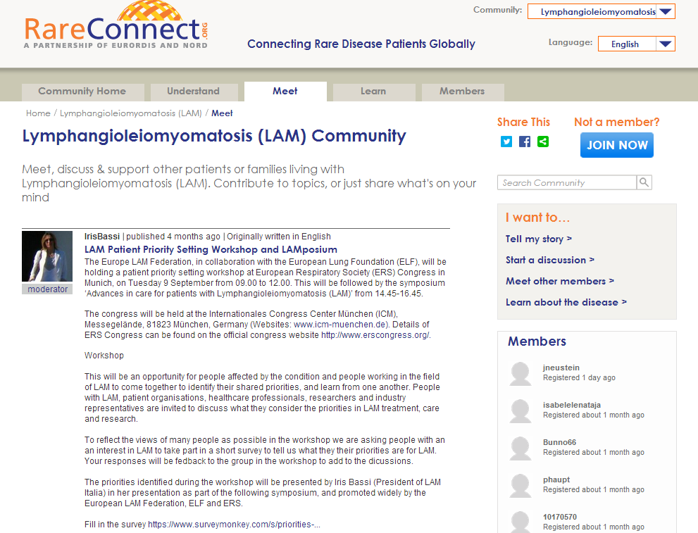
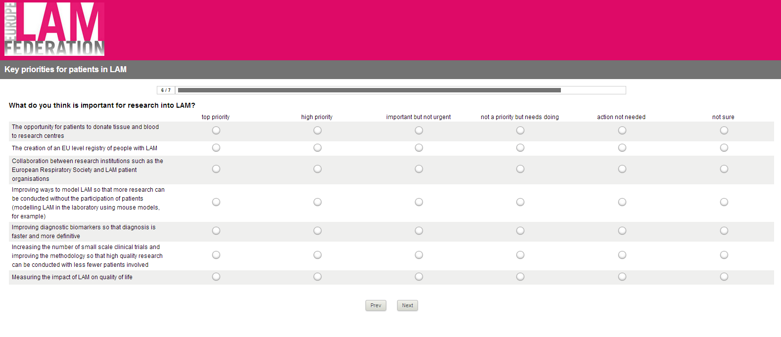
Key priorities for patients with LAM
Notes:
Background
Lymphangioleiomyomatosis is pronounced lim-fan-gee-o-ly-o-my-o-ma-to-sis. “Lymph” refers to the lymph vessels and “angio” refers to the blood vessels. “Leiomy” means smooth muscle, “oma” is a tumor, and “tosis,” refers to a disease condition.
Lymphangioleiomyomatosis (LAM) is a rare lung disease, which occurs sporadically or in association with the genetic disease tuberous sclerosis complex (TSC). Sporadic LAM affects fewer than 1 in 400,000 adult females; however LAM occurs in 30-40% of people with TSC (information from the 2010 ERS guidelines for LAM = still the definitive guide on diagnosis and management). Current estimates of the incidence of LAM are based on data from registries in the United States, France, and the United Kingdom, three countries where there have been substantial organized efforts in contacting pulmonary physicians to determine the number of patients with LAM. As previously mentioned, because LAM is relatively uncommon, it is often misdiagnosed. Therefore, the current number of women diagnosed with LAM does not accurately represent the true prevalence of the disease. Rough estimates suggest that there could be as many as 30,000 to 50,000 women worldwide who actually have sporadic LAM (info from the LAM Foundation website (US LAM patient org)).
Survey methodology
Online survey available in 7 languages (English, Spanish, French, Italian, German, Swedish, Norwegian)
Key areas and questions identified by European LAM Federation, and developed by ELF. Reviewed by European LAM Federation members via Iris.
Survey translated by national LAM patient organisations
Survey open: 1 May – 15 July
Open responses translated into English by national LAM organisations
Data analysed by ELF and discussed with LAM Federation
Findings used to structure this Workshop – with the priorities of the patients and professionals setting the agenda for the workshop rather than ELF and LAM Federation identifying the priorities etc.
Dissemination
ELF website and social media
ELF patient organisation network (160+ organisations)
ELF newsletter (6,000 recipients)
RareConnect LAM community webpage
LAM national networks via European LAM Federation (national networks raised awareness via mass mail and social media channels)

Slide 6
Demographics
Notes:
Greatest response to English language survey but this does not mean that all respondents were native English speakers or resident in the UK. The scope of the survey was international since the workshop and LAM community includes people from across Europe as well as from America, New Zealand and Australia. However, respondents were not asked to state their country of residence.

Slide 7
Survey Questions
What do you think is important in LAM diagnosis and tests?
What do you think is important in LAM treatment?
What do you think is important in on-going care for people with LAM?
What do you think is important for living well with LAM?
What do you think is important for research into LAM?
Can you think of any other priorities for LAM?
Notes:
For each of these 6 questions, respondents were asked to rate 3-8 statements from top priority through to action not needed.

Slide 8
Top 10 priorities (across all questions)
Improving methods of identifying patients with active disease (81.15%)
Availability of drugs for LAM in all EU countries (80.75%)
All patients can access a specialist LAM centre (80.75%)
Lung transplants should be available to more patients and with shorter waiting times (79.16%)
Improving non-invasive diagnosis (e.g. diagnosis by patient history, X-rays and CT scans rather than by bronchoscopy and/or open lung biopsy) (78.37%)

Slide 9
6. Improving care for LAM patients in general (non-specialist) hospitals/services (77.19%)
7. Patients can access treatments such as low dose sirolimus/everolimus (76.69%)
8. The opportunity for patients to hear about and participate in clinical trials (75.20%)
9. Improving diagnostic biomarkers so that diagnosis is faster and more definitive (74.60%)
10. The development of a European-wide organ donor service (72.64%)

Slide 10
Priority setting Task
Define the priorities (and explain them to any members who are unsure)
Identify how important the priorities are for stakeholders (patients, healthcare professionals and industry)
Identify how the priorities could be met or the situation improved
Identify any significant challenges to addressing the priorities
Notes:
Within the groups that you have been allocated to (tables 1-5), please use the next 50 minutes to complete Task 1. There is a designated note taker on each table, who will take notes on the discussions held, to be brought together and summarised at the end of the workshop.
The results of two of the survey questions have been placed on your tables. Please give 20 minutes to look at the results as a group and discuss each of the points shown on the slide.
The workshop chairs will also try to get around each table to join in your discussions. If you have any questions either ask your note taker.

Slide 11
Open responses: thematic analysis
Reliable, easy to understand information for patients and their partners and families
Need for increased professional awareness and education
A clear care pathway and service improvement across all countries (Europe and world-wide)
Psychological support and counselling
Ongoing support and self-management
Increased funding for research and outreach
Research:
Funding
Outreach
Recommendations (causes and progression, treatments, relational factors)
Notes:
40% of people who completed the survey entered open responses.
7 key themes emerged from the thematic analysis, however the need for reliable, easy to understand information answering patient’s questions was the most frequently stated additional priority. These information needs ranged from living an active life with LAM, to information for families on supporting a person with LAM, to specific areas such as LAM and pregnancy, vaccinations, needing oxygen and weight management.

Slide 12
ELF Patient Priorities
Patient Priorities: Patient-led recommendations for healthcare professionals and patients
New ELF/ERS initiative
Patient priorities: patient-led recommendations for healthcare professionals and patients
Aim: to provide medically accurate information on key areas identified by patients and carers

