Slide 1
Thank you for viewing this presentation.
We would like to remind you that this material is the property of the author. It is provided to you by the ERS for your personal use only, as submitted by the author.
2014 by the author

Slide 3
Faculty disclosure
No faculty or industry association
Chairman of U-BIOPRED Patient Input Platform
Member of Scientific Advisory Board of ERACoSysMed
Independent member of Trial Steering Committee for LASER (Laminar Airflow in Severe Asthma for Exacerbation Reduction)

Slide 4
Introduction
AIMS
Reflections on how patient engagement can provide insight into research protocols and thus the overall scope of the research proposal
Examine how patient engagement can improve the ongoing delivery of the project, and provide more accessible communications
Consider how the passion of patients ‘with skin in the game’ can help maintain long-term energy and motivation for the research project

Slide 5
U-BIOPRED Illustration > Study outline
U-BIOPRED stands for ‘Unbiased Biomarkers for the Prediction of Respiratory Disease Outcomes’. This is the technical name for the 5-year European-wide project (2010-2014), which aims:
to understand more about severe asthma
to determine how it differs from person to person
to uncover new information and ideas that could lead to the creation of effective new treatments
Using samples and medical information from hundreds of adults and children with severe asthma and by comparing them to samples from people with mild asthma, no asthma and chronic obstructive pulmonary disease (COPD), the project hopes to identify different sub-types (known as phenotypes) of severe asthma.

Slide 6
Reflect on patient involvement in U-BIOPRED via the Patient Input Platform: pre 2010 > 2014+
Framework questionnaires that went out to all PIP members before Congress
Asked about the transition over time of their involvement and key interactions in the research project as viewed by PIP members.

Slide 7
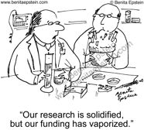
Aim 1 - Reflections on how patient engagement can provide insight into research protocols and thus the overall scope of the research proposal
U-BIOPRED Phase 1 >

Slide 8
What did we do? > Leading up to 2010
The project allowed a space for adaptation at an early stage to take on board the views of patients
Engaged in the project design from the project outset – more effective for people with severe hard to control asthma, which made it easier for them to participate.
Comments and feedback were taken seriously and fed into the WP’s of the study
The communication tools provided (apart from webforum) and the group setting of the PIP were seen as a positive inter-PIP tool (albeit with little interaction with researchers)
Had a committed, patient-friendly PIP coordinator who could take the journey alongside the PIP

Slide 9
What did we learn / feel? > Leading up to 2010
+ Excitement! Honoured - eagerness to be involved in something new and ground-breaking
+ Felt good to be asked to give something back
+ Mixed sentiment about the appropriate level of scientific complexity, but overall positive
- Sometimes difficult to feel connected to the researchers
- Feeling that the PIP should have been involved in pre-submission work - some missed opportunities of patient involvement in the project writing stage
- Some members felt uninvolved in aspects of the project
- Not always enough feedback on what was done with comments
- Not effective in providing European-wide patient engagement – not enough diversity in socio demographics of PIP members and a focus on English language

Slide 10
Aim 2 - Examine how patient engagement can improve the ongoing delivery of the project, and provide more accessible communications
U-BIOPRED Phase 2 >
Motivation of researchers
Motivation of study participants
Motivation of patient representitives

Slide 11
What did we do? > 2010 – 2013 (Recruitment Phase)
PIP members took active participation in WP TC discussions, reviewing and commenting on documentation or partaking in recruitment issues – including active participation in planning $∆$ reduction
We were given an avenue to promote (the importance of) patient involvement and developing a relevant exit questionnaire and leaflet in the framework of the project.
We attended and spoke at the AGMs in Barcelona
Continued to leverage the ‘connectivity’ of the PIP coordinator model

Slide 12
What did we learn? > 2010 – 2013 (Recruitment Phase)
+ Made members feel more involved in the research process – one PIP member was even shown around their local centre and facilities
+ Allowed PIP members a voice to remind anyone who would listen about the importance of the project to people with severe asthma
+ AGM interactions were positive allowing a PIP voice and meeting other Board members, especially the difference our input had made in Ethics
- Sometimes unsure if it was appropriate to be involved in TC’s and if we were deemed to be ‘professional’ enough
- TC’s at fixed times and days may have been difficult for some to participate in due to own work planning
- Issues for discussion with patients/representatives were gathered and sent for feedback rather ad hoc or sparsely
- We still somewhat hampered by a limited European-wide involvement

Slide 13
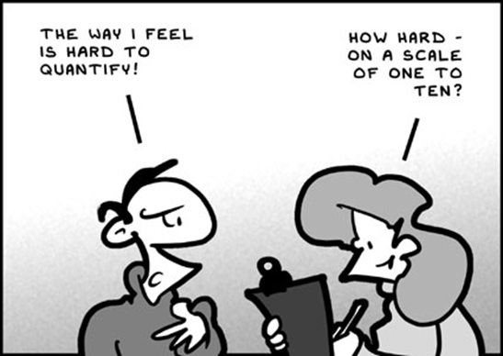
Aim 3 - Consider how the passion of patients ‘with skin in the game’ can help maintain long-term energy and motivation for the research project

Slide 14
What did we do? > 2014 and beyond
We didn’t find a cure! Commitment runs as high as ever; the TC’s are attended, the notes are still circulated, the PIP still meets, reviews documents and if there was a problem the PIP would be straight there to help
The experiences in setting up, working with and using patients’ advice were shared with other IMI projects and wider scientific and public communities
We have developed a model for the continuation of a PIP structure for other studies – don’t want 5 years to go to waste!
We have recognised (and promoted) a continuing level of coordination and growing awareness of the importance of patient involvement
We have continued with a clear coordination and involvement within the project along (through the support of ELF) with the importance of collaboration between healthcare professionals and patient organisations

Slide 15
What did we learn? > 2014 and beyond
+ Members can clearly point to their impact on aspects of the study
+ Members can help provide the ‘accessible’ voice for the forthcoming outputs of the study – the value of the patient focused ‘soundbite’
+ Members have the developed the confidence to begin to demonstrate PIP involvement in other areas of policy and other studies
- There does however remain a level of uncertainty on the role of patient involvement during the future of the research process.
- That PIP ‘drop-off’ not effectively addressed
- That in hindsight some previous actions and choices would have been done differently, however this was a learning process and thus expected.
- We feel the project still has a long way to go… In addition, it cannot be done without yet more good coordination and mutual understanding
- We recognised a concern of being “lost in the system” at the end of study

Slide 16
Conclusion
Patient involvement is a passion not a profession
Over 5 years, patient involvement can vary. If you don’t want it to wane, be clear and consistent in commitments and communications - keep the group running and well coordinated
Recognize that patient involvement needs motivation – share your concerns, your victories, foster excitement!
Need communications and processes to make involvement a European-wide activity, and not just led by the few
You need a coordinator / coordinating body to help bring the two very different worlds together
“Patient involvement is a learning process, not something that is can be done all at once. If we knew beforehand what we know now, we would have done and arranged some things differently and more adequately”

